Slide 1
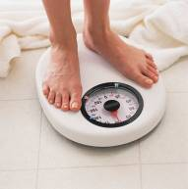
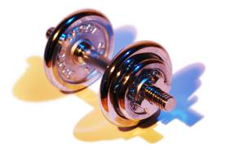
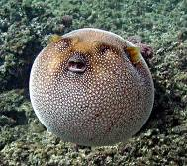
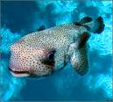
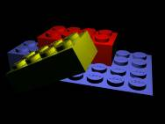
matter: anything having mass and volume
mass:
the amount of matter in an object
weight:
the pull of gravity on an object
volume:
the space an object occupies
units: L, dm³, mL, cm³
conversions: 1 L = 1 dm³; 1 mL = 1 cm³
state of matter:
solid, liquid, or gas
atom: a basic building block of matter
-- ~100 diff. kinds

Slide 2
Elements
contain only one type of atom.
Broken Dreams Blvd.
(a) monatomic elements consist of “unbonded,”
identical atoms
(i.e., in element form,
they DON’T form m’cules)
e.g.,
Fe, Al, Cu, He
(b) polyatomic elements consist of several
identical atoms bonded together
(i.e., in element form, they DO form m’cules)
-- diatomic elements:
H₂ O₂ Br₂ F₂ I₂ N₂ Cl₂
-- others:
P₄ S₈
“7 7 7”

Slide 3
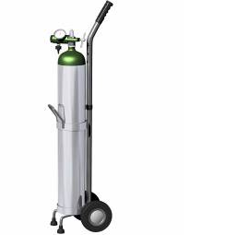
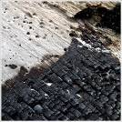

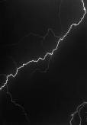
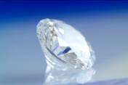
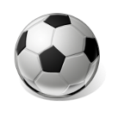
(c) allotropes: different forms of the same element in
the same state of matter
OXYGEN CARBON
oxygen gas
(O₂)
elemental
carbon
graphite
ozone
(O₃)
diamond
buckyball

Slide 4
molecule: a neutral group of bonded atoms
Description | Chemical Symbol | Model
1 oxygen atom
1 oxygen molecule
2 unbonded oxygen atoms
1 phosphorus atom
1 phosphorus molecule
4 unbonded phosphorus atoms
O
O₂
2 O
P
P₄
4 P
Elements may consist of… either molecules or unbonded atoms.

Slide 5
2
Chemical symbols for elements
appear on the periodic table;
only the first letter
is capitalized.
He
4.003
10
Ne
20.180
18
Ar
39.948
36
Kr
83.80
54
Xe
131.29
86
Rn
STOP
(222)

Slide 6
FINAL THOUGHTS: Matter and the Elements
1. Matter is anything made of atoms. Weight is a
measure of the pull of gravity on a mass. Volume
is the amount of space a sample of matter occupies.
2. Elements are samples of matter that contain only
one type of atom. Most are monatomic; the
HOBrFINCls are diatomic; P and S are polyatomic.
3. A molecule is any neutral group of bonded atoms.
Those atoms may
be of the same type,
or they may be of
different types.
H₂ O₂ Br₂ F₂ I₂ N₂ Cl₂
P₄ S₈

Slide 7
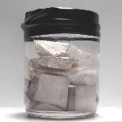
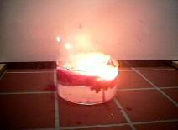
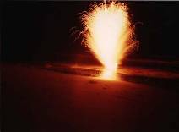
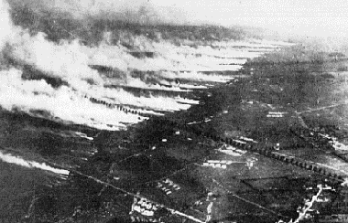
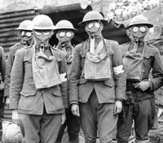
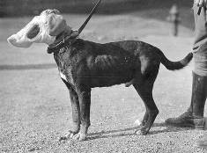
Compounds
contain two or more different types of atoms.
-- have properties that differ from
those of their constituent elements
table salt
e.g., Na (sodium):
explodes in water
(NaCl)
Cl₂ (chlorine):
poisonous gas

Slide 8
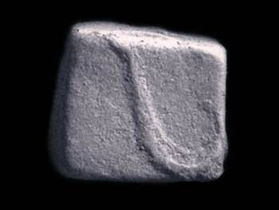
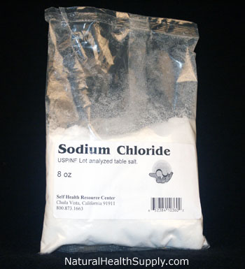
Compound Composition
All samples of a given compound
have the same composition by mass.
Every sample of NaCl tastes the same,
melts at the same temp., and is
39.3% Na and 60.7% Cl by mass.

Slide 9
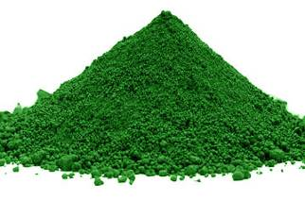
A 550. g sample of chromium(III) oxide (Cr₂O₃)
has 376 g Cr. How many grams of Cr and O
are in a 212 g sample of Cr₂O₃?
% Cr =
68.4% Cr
and
31.6% O
(New sample has same composition.)
Cr:
212 g (0.684)
= 145 g Cr
chromium(III) oxide
O:
212 g (0.316)
= 67 g O

Slide 10
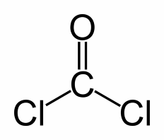
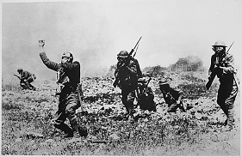
composition:
what the matter is made of
copper:
water:
many Cu atoms
many “threesomes” of
2 H’s and 1 O
Properties
describe the matter.
e.g., what it looks like, smells like, how it behaves
Chemistry tries to relate
the microscopic and
macroscopic worlds.

Slide 11
FINAL THOUGHTS: Compounds
1. Compounds have two or more types of atoms
strongly bonded together in an unvarying ratio. It is
for this reason that all samples of a given compound
have the same composition and intensive properties.
2. The properties of compounds can’t necessarily be
predicted based on the properties of their
constituent elements.
3. Chemistry connects the macroscopic world of
empirical observation with the microscopic (or
molecular, or atomic, or subatomic) world. This is
done by the creation, analysis, and use of models.

Slide 12
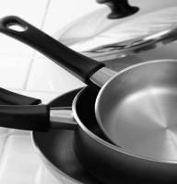


States of Matter
SOLID
LIQUID
GAS
( ( ) )
( ( ) )
( ( ) )
( ( ) )
( ( ) )
( ( ) )
( ( ) )
( ( ) )
( ( ) )
( ( ) )
( ( ) )
( ( ) )
( ( ) )
( ( ) )
( ( ) )
vibrating
translating;
close together
translating quickly;
far apart
vapor:
the gaseous state of a substance that
generally is found as a solid or liquid

Slide 13
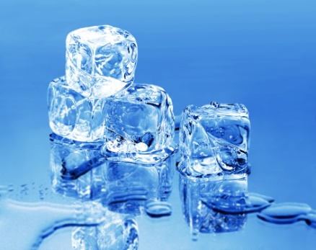
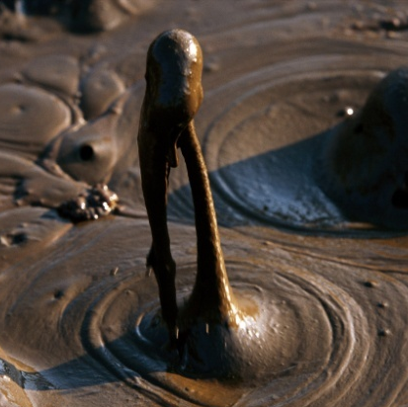
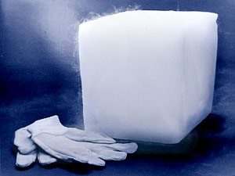
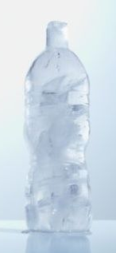
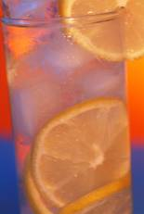

Changes in State
Energy put into system:
sublimation
melting
boiling
SOLID
LIQUID
GAS
freezing
condensation
deposition
Energy removed from system:

Slide 14
FINAL THOUGHTS: Compounds
1. Compounds have two or more types of atoms
strongly bonded together in an unvarying ratio. It is
for this reason that all samples of a given compound
have the same composition and intensive properties.
2. The properties of compounds can’t necessarily be
predicted based on the properties of their
constituent elements.
3. Chemistry connects the macroscopic world of
empirical observation with the microscopic (or
molecular, or atomic, or subatomic) world. This is
done by the creation, analysis, and use of models.

Slide 15
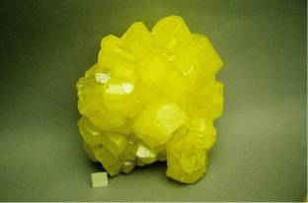
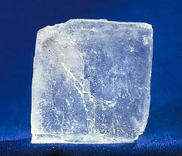
Classifying Matter
(Pure) Substances
have a fixed composition
and fixed properties.
-- they have a single chemical formula
ELEMENTS
COMPOUNDS
e.g.,
Fe, N₂, S₈, U
e.g.,
H₂O, NaCl, HNO₃
sulfur (S₈)
sodium chloride (NaCl)

Slide 16
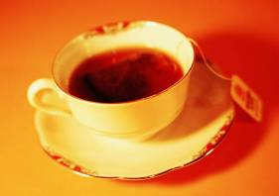
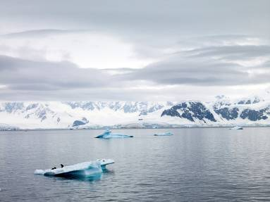
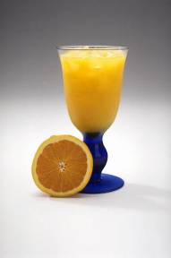
Mixtures
contain two or more substances
mixed together.
-- have varying composition
and varying properties
-- The substances are NOT chemically bonded;
they retain their individual properties.
Tea, orange
juice, oceans,
and air are
mixtures.

Slide 17
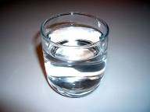
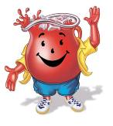
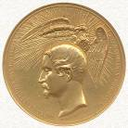
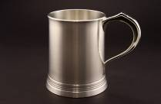
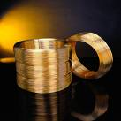
Two Types of Mixtures
homogeneous: (or solution)
sample has same composition and properties
throughout; evenly mixed at the
particle level
e.g.,
salt water
Kool Aid
alloy: a homogeneous mixture of metals
e.g.,
bronze (Cu + Sn)
pewter (Pb + Sn)
brass (Cu + Zn)

Slide 18
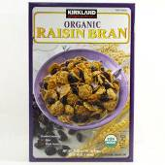
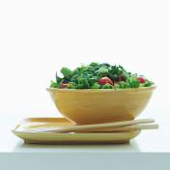
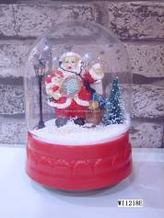

Two Types of Mixtures (cont.)
heterogeneous:
different composition and properties in the
same sample; unevenly mixed
tossed salad
e.g.,
raisin bran
suspension: settles over time
e.g.,
paint
snow globes

Slide 19
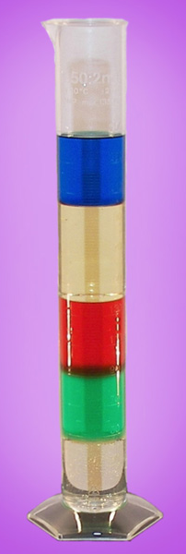
Chart for Classifying Matter
MATTER
(PURE) SUBSTANCE
MIXTURE
ELEMENT
COMPOUND
HETEROGENEOUS
HOMOGENEOUS
STOP

Slide 20
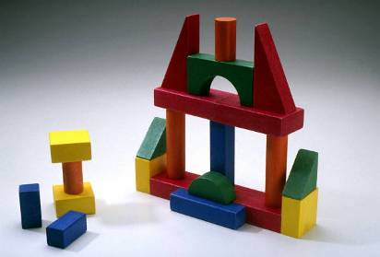
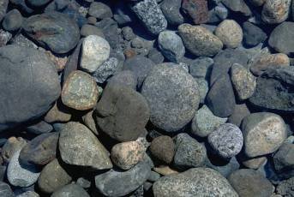

Separating Mixtures
-- No chemical reactions
are needed because…
involves
physical means, or
physical changes.
substances are NOT bonded.
1. sorting:
by color,
shape,
texture,
etc.
2. filtration:
by particle
size
filtrate: the portion of a
mixture that passes
through a filter

Slide 21
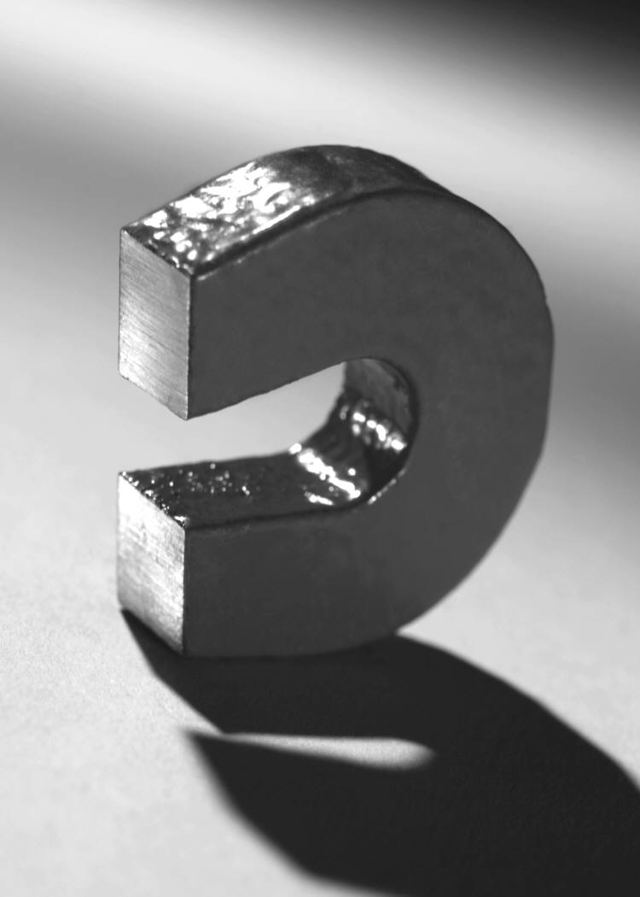
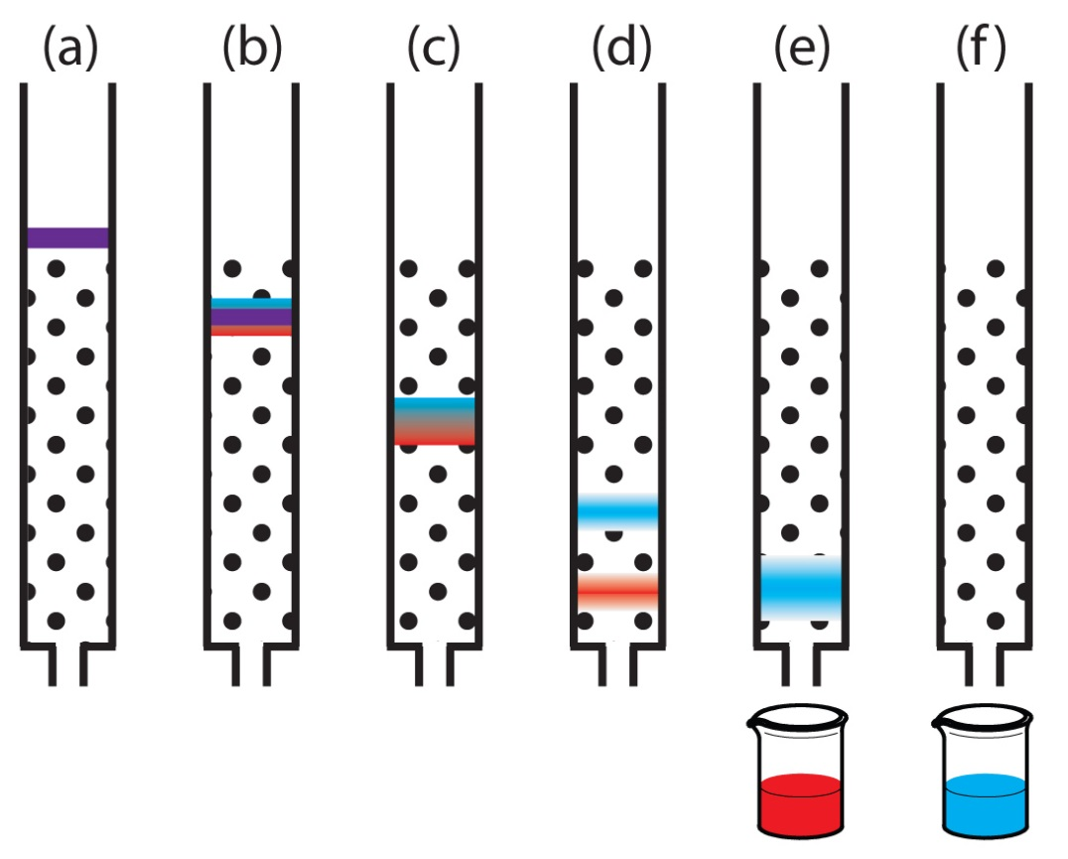
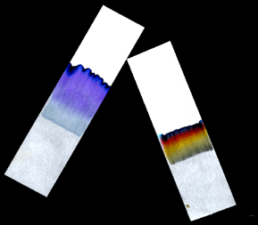
Separating Mixtures (cont.)
3. magnetism:
one substance
must contain iron
4. chromatography:
some substances dissolve
more easily than others
analyte: any substance
you are investigating
eluent: the solvent in column
chromatography
paper
chromatography
column chromatography

Slide 22
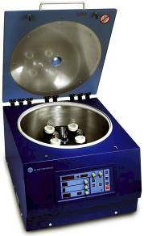
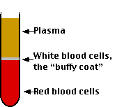
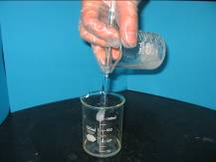
Separating Mixtures (cont.)
5. density:
“sink vs. float”;
perhaps use a centrifuge
blood after high-
speed centrifuging
decant: to pour
off the liquid

Slide 23
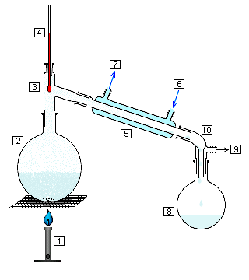
Separating Mixtures (cont.)
6. distillation:
different boiling points
(i.e., different
vapor
pressures)
thermometer
water out
(warmer)
water in
(cooler)
more-volatile
substance
condenser
(i.e., the one
with the lower
boiling point)
mixture
more-volatile
substance, now
condensed
heat source
Volatile substances evaporate easily.

Slide 24
FINAL THOUGHTS: Compounds
1. Compounds have two or more types of atoms
strongly bonded together in an unvarying ratio. It is
for this reason that all samples of a given compound
have the same composition and intensive properties.
2. The properties of compounds can’t necessarily be
predicted based on the properties of their
constituent elements.
3. Chemistry connects the macroscopic world of
empirical observation with the microscopic (or
molecular, or atomic, or subatomic) world. This is
done by the creation, analysis, and use of models.

Slide 25
Properties of Matter
CHEMICAL properties tell how a substance
reacts with other substances.
ONE OF THESE
PHYSICAL properties can be observed without
chemically changing the substance.
AND
EXTENSIVE properties depend on the amount
of substance present.
ONE OF THESE
INTENSIVE properties do NOT depend on the
amount of substance.

Slide 26





Examples:
electrical conductivity………………………
P,
I
P,
I
ductile: can be drawn (pulled) into wire…..
malleable: can be hammered into shape…
P,
I
reactivity with water………………………...
C,
I
P,
I
brittleness…………………………………….
P,
I
magnetism……………………………………

Slide 27
Density
→ how tightly packed the particles are
Density =
** Density of water =
1.0 g/mL = 1.0 g/cm³
The density of a liquid or solid is nearly constant,
no matter the sample’s temperature.
Density of gases is highly dependent on temperature.
A student needs 15.0 g of ethanol, which has a density
of 0.789 g/mL. What volume of ethanol is needed?
= 19.0 mL
STOP

Slide 28
FINAL THOUGHTS: Compounds
1. Compounds have two or more types of atoms
strongly bonded together in an unvarying ratio. It is
for this reason that all samples of a given compound
have the same composition and intensive properties.
2. The properties of compounds can’t necessarily be
predicted based on the properties of their
constituent elements.
3. Chemistry connects the macroscopic world of
empirical observation with the microscopic (or
molecular, or atomic, or subatomic) world. This is
done by the creation, analysis, and use of models.

Slide 29

SI Prefixes
to Memorize
Prefix | Symbol | Meaning
giga- | G | 10⁹
mega- | M | 10⁶
kilo- | k | 10³
deci- | d | 10^{–1}
centi- | c | 10^{–2}
milli- | m | 10^{–3}
micro- | μ | 10^{–6}
nano- | n | 10^{–9}
pico- | p | 10^{–12}
femto- | f | 10^{–15}
“That’s a fact,
Jack!”

Slide 30

10⁹
10⁶
10³
10^{–1}
10^{–2}
10^{–3}
10^{–6}
10^{–9}
10^{–12}
10^{–15}
G
M
k
d
c
m
μ
n
p
f
iga
ega
ilo
eci
enti
illi
icro
ano
ico
emto
“Got
my
kilt,
Dad!
Can’t
miss
μidsummer’s
no-
pants
Friday!”
STOP

Slide 31

Significant Figures:
Is a digit significant?
All non-zeroes are significant.
Zeroes might or might not be.
Use the box-and-dot method to determine the sig figs
in a given quantity.
?
1. Identify the leftmost AND rightmost non-zeroes.
2. Draw a box around these AND everything in-between.
3. Everything in the box is significant.
4. Zeroes on the box’s LEFT are NOT significant.
5. If there is a decimal point ANYWHERE, the zeroes on the box’s RIGHT ARE significant. Otherwise, no.

Slide 32
3
8 0 . 0
3
0 . 0 9 4 4
2
0 . 0 0 3 2
1
2 0 0 0
6
1 3 0 0 . 4 0
5
1 2 4 . 0 0
3
0 . 0 0 3 0 4
3
0 . 0 2 5 0
In scientific notation, the
exponent has no effect on
the number of sig. figs.
3
1 . 4 0 x 10⁹
3
5 . 0 6 x 10^{–3}
4
7 . 1 2 0 x 10⁵
7.2 x 10⁵
2
7 2 0 x 10³
STOP

Slide 33
Rules:
Significant Figures and Mathematical Operations
1. When multiplying or dividing, the answer must have the same number of sig. figs. as does the quantity with the fewest sig. figs.
.
.
1.52 C 3.431 s =
0.443 C/s
.
.
0.0251 N x 4.62 m 3.7 s =
0.031 N.m/s
2. When adding or subtracting, the answer must be
rounded to the place value of the least precise
quantity.
2.53 s + 117.4 s =
119.9 s
2.11 m + 104.056 m + 0.1205 m =
106.29 m

Slide 34



3. Because conversion factors are exact numbers, they do NOT affect the # of sig. figs. Your answer should have the same # of sig. figs. as does the quantity you start with.

Slide 35
FINAL THOUGHTS: Compounds
1. Compounds have two or more types of atoms
strongly bonded together in an unvarying ratio. It is
for this reason that all samples of a given compound
have the same composition and intensive properties.
2. The properties of compounds can’t necessarily be
predicted based on the properties of their
constituent elements.
3. Chemistry connects the macroscopic world of
empirical observation with the microscopic (or
molecular, or atomic, or subatomic) world. This is
done by the creation, analysis, and use of models.

Slide 36
Conversion Factors and
Unit Cancellation
For the rectangular solid:
L = 14.2 cm
W = 8.6 cm
H = 21.5 cm
Find volume.
V = L . W . H
= (14.2 cm)(8.6 cm)(21.5 cm)
=
2600
cm³

Slide 37
Convert to mm³.
(
)
______
2600 cm³
10 mm
³
= 2,600,000 mm³
1 cm
= 2.6 x 10⁶ mm³
mm and cm differ by a factor of……….
mm² “ cm² “ “ “ “ “ ……….
mm³ “ cm³ “ “ “ “ “ ……….
10
100
1000
STOP

