Slide 1
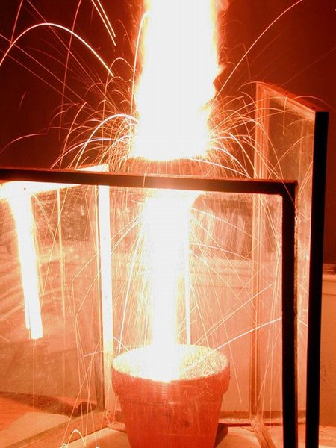
AP Chemistry
Stoichiometry
In the thermite reaction, a
mixture of powdered aluminum
and powdered iron(III) oxide
react to yield iron and aluminum
oxide. The reaction burns hot
enough to be useful in under-
water welding.
2 Al + Fe₂O₃ → 2 Fe + Al₂O₃ + energy

Slide 2

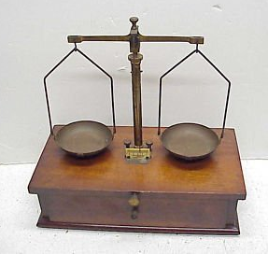
Chemical Equations
In a reaction:
atoms are rearranged
mass
AND
energy
are conserved
charge
Balancing Chemical Equations
law of
conservation
of mass
same # of atoms
of each type on each
side of equation
=
Hint: Start with most complicated substances first
and leave simplest substances for last.

Slide 3
Solid lithum reacts ^{w}/oxygen
to form solid lithium oxide.
Li⁺
O^{2–}
4
2
Li(s)
+
O₂(g)
Li₂O(s)
+
Aqueous aluminum sulfate reacts ^{w}/aqueous barium
chloride to form a white precipitate of barium sulfate.
The other compound remains in solution.
Al³⁺
SO₄^{2–}
Ba²⁺
Cl–
+
3
3
+
2
Al₂(SO₄)₃
(aq)
BaCl₂
(aq)
BaSO₄
(s)
AlCl₃
(aq)

Slide 4
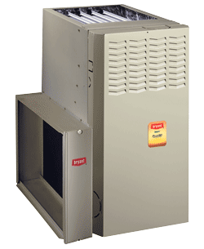
Methane gas (CH₄) reacts with
oxygen to form carbon dioxide
gas and water vapor.
Furnaces burn primarily methane.
CH₄(g)
2
2
+
O₂(g)
CO₂(g)
+
H₂O(g)
CaC₂(s) + H₂O(l) C₂H₂(g) + CaO(s)
CaSi₂ + SbI₃ Si + Sb + CaI₂
3
2
6
2
3
3
Al + CH₃OH Al(CH₃O)₃ + H₂
2
6
2
3
STOP

Slide 5
2
5
2
4
2
C₂H₂(g) + O₂(g) CO₂(g) + H₂O(l)
5
3
4
C₃H₈ + O₂ CO₂ + H₂O
8
2
4
10
5
C₄H₁₀ + O₂ CO₂ + H₂O
13
Complete combustion of a hydrocarbon,
or of a compound containing C, H, and O
(e.g., methanol, CH₃OH) yields CO₂ and H₂O.
Another pattern of reactivity:
alkali
metal
metal
hydroxide
hydrogen
gas
+
water
+
e.g.,
2 Rb(s) + 2 H₂O(l) → 2 RbOH(aq) + H₂(g)

Slide 6
Two (of the several) Types of Reactions
combination (synthesis): simpler substances combine
to form more complex substances
-- form:
A + B → AB AB + C → ABC A + B + C → ABC
sodium + chlorine gas sodium chloride
2
Na
+
Cl₂
2
NaCl

Slide 7
decomposition: complex substances are broken
down into simpler ones
-- form:
AB → A + B ABC → AB + C ABC → A + B + C
lithium chlorate lithium chloride + oxygen
Li⁺
ClO₃–
Li⁺
Cl–
2
2
3
LiClO₃
LiCl
+ O₂
water hydrogen gas + oxygen gas
2
2
+ O₂
H₂O
H₂

Slide 8
SUMMARY: Some Simple Reaction Patterns
1. When we say ‘complete combustion,’ we mean
two things: one, oxygen gas (O₂) is a reactant, and
two, the other thing(s) is/are entirely consumed (i.e.,
that O₂ is the excess reactant...more on this later).
2. The complete combustion of either a hydrocarbon or
or a compound containing only C, H, and O yields
the products carbon dioxide (CO₂) and water (H₂O).
3. Alkali metals (Alk) react with water (H₂O) to yield the
metal hydroxide (AlkOH) and hydrogen gas (H₂).
4. Synthesis reactions begin with simple substances
and yield more complex substances; decomposition
reactions break complex ones into simpler ones.

Slide 9
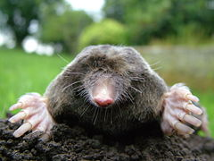
formula weight: the mass of all of the atoms in
a chemical formula (unit is amu)
-- If the substance is a molecular substance
(e.g., C₃H₈), then the term molecular weight
is also used.
molar mass: the mass of one
mole of a substance
(unit is usually grams)
-- recall that 1 mole of any
substance
=
6.02 x 10²³ particles
of that substance

Slide 10

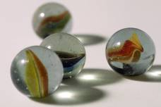
How Big is a Mole?
…about the size of a chipmunk,
weighing about 5 oz. (140 g), and
having a length of about 7 inches (18 cm).
I Meant, “How Big is 6.02 x 10²³?”
BIG.
6.02 x 10²³ marbles would cover the
entire Earth (including the oceans)
…to a depth of 2 miles.
6.02 x 10²³ $1 bills stacked face-to-face
would stretch from the Sun to Pluto
…and back
…7.5 million times.
(It takes light 9,500 years to travel that far.)

Slide 11

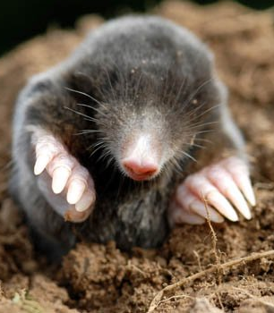
The current world population is about 7.5 billion.
An average human is made up of about 37 trillion cells.
The total number of human cells on Earth is about…
(7.5 x 10⁹ people) X (37 x 10¹² cells/person)
= 2.8 x 10²³ cells
(less than half a mole)

Slide 12
Find the molar mass and formula weight of
ammonium phosphate.
NH₄⁺
PO₄^{3–}
(NH₄)₃PO₄
N:
3
(14.0 g)
= 42.0 g
H:
12
(1.0 g)
= 12.0 g
m.m. =
149.0 g
P:
1
(31.0 g)
= 31.0 g
O:
4
(16.0 g)
= 64.0 g
f.w. = 149.0 amu

Slide 13
percentage composition: the mass % of each
element in a compound
equation:
g element
% of element =
x 100
molar mass of compound
Find the percentage of oxygen, by mass, in
calcium nitrate.
Ca(NO₃)₂
% O =
= 58.5% O
STOP

Slide 14
Empirical Formula and Molecular Formula
lowest-terms
formula
shows the true number and
type of atoms in a m’cule
Compound | Molecular Formula | Empirical Formula
glucose | C₆H₁₂O₆
propane | C₃H₈
butane | C₄H₁₀
naphthalene | C₁₀H₈
sucrose | C₁₂H₂₂O₁₁
octane | C₈H₁₈
CH₂O
C₃H₈
C₂H₅
C₅H₄
C₁₂H₂₂O₁₁
C₄H₉

Slide 15
Finding an Empirical Formula from Experimental Data
1. Find # of g of each element.
2. Convert each g to mol.
3. Divide each “# of mol” by the smallest “# of mol.”
4. Use ratio to find formula.

Slide 16
A ruthenium/sulfur compound is 67.7% Ru.
Find its empirical formula.
RuS_{1.5}
Ru₂S₃

Slide 17
A sample of a compound contains 4.63 g lead, 1.25 g
nitrogen, and 2.87 g oxygen. Name the compound.
?
PbN₄O₈
?
Pb(NO₂)₄
lead(IV) nitrite
Pb? 4 NO₂–
STOP

Slide 18
To find molecular formula…
A. Find empirical formula.
B. Find molar mass of
empirical formula.
C. Find n = mm molecular
mm empirical
D. Multiply all parts of
empirical formula by n.
(How many empiricals “fit into” the molecular?)

Slide 19
A sample of a compound has 26.33 g nitrogen, 60.20 g
oxygen, and molar mass 92 g. Find molecular formula.
NO₂
92 g
mm_{emp} =
46 g
= 2
N₂O₄
46 g
STOP

Slide 20
Hydrates and Anhydrous Salts
anhydrous salt: an ionic compound (i.e., a salt) that
attracts water molecules and forms
weak chemical bonds with them;
symbolized by MN
“anhydrous” = “without water”
Same idea as with…
desiccants in leather goods,
electronics, vitamins
hydrate: an anhydrous salt with the water attached
-- symbolized by MN . ? H₂O
Examples:
CoCl₂ . 6 H₂O BaCl₂ . 2 H₂O
Na₂CO₃ . 10 H₂O FeCl₃ . 6 H₂O

Slide 21




H₂O
H₂O
H₂O
HEAT
H₂O
H₂O
MN
H₂O
MN
+
H₂O
H₂O
H₂O
H₂O
H₂O
H₂O
hydrate
anhydrous salt
water
ENERGY
+
ENERGY
+

Slide 22
Finding the Formula
of a Hydrate
1. Find the # of g of MN and # of g of H₂O.
2. Convert g to mol.
3. Divide each “# of mol” by the smallest “# of mol.”
4. Use the ratio to find the hydrate’s formula.

Slide 23

Strontium chloride
is an anhydrous salt on which the
following data were collected. Find formula of hydrate.
beaker = 65.2 g
beaker + sample before
heating = 187.9 g
beaker +
salt + water
beaker + sample after
heating = 138.2 g
beaker + salt
Sr²⁺
Cl–
SrCl₂
SrCl₂ . 6 H₂O
STOP

Slide 24
Converting Between Various Units
Mass
(g)
1 mol = molar mass (in g)
Volume
(L or dm³)
1 mol = 22.4 L
1 mol = 22.4 dm³
MOLE
(mol)
(For
gases
only!)
Particle
(at. or m’c)
at STP
1 mol = 6.02 x 10²³ particles
One-Substance Island Diagram

Slide 25
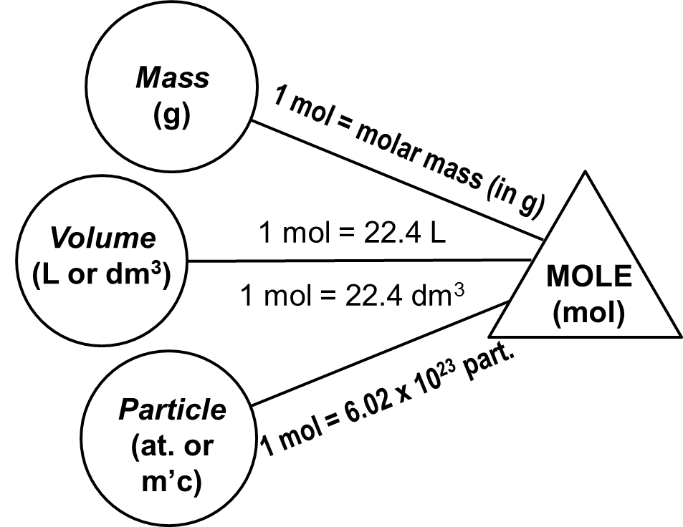
aluminum sulfate
What mass is 6.29 x 10²⁴ m’cules ?
Al³⁺
SO₄^{2–}
Al₂(SO₄)₃
(
)
(
)
1 mol
342.3 g
6.29 x 10²⁴ m’c
6.02 x 10²³ m’c
1 mol
= 3580 g
At STP, how many g is 87.3 dm³ of nitrogen gas?
N₂
(
)
(
)
1 mol
28.0 g
87.3 L
= 109 g
22.4 L
1 mol
STOP

Slide 26
Mass
(g)
1 mol = molar mass (in g)
Volume
(L or dm³)
1 mol = 22.4 L
MOLE
(mol)
1 mol = 22.4 dm³
Particle
(at. or m’c)
1 mol = 6.02 x 10²³ part.

Slide 27
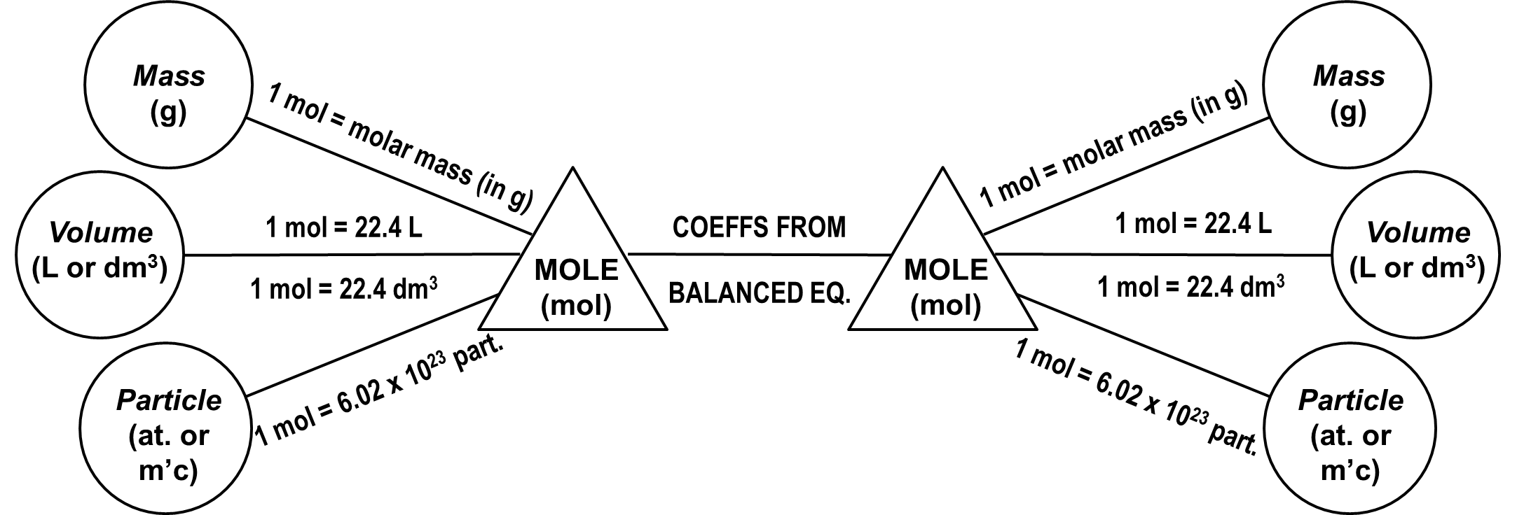
When going from moles of one substance to
moles of another, use the coefficients from
the balanced equation.
SUBSTANCE “A”
SUBSTANCE “B”
(known)
(unknown)

Slide 28
“Straight” Stoichiometry
(no funny business)
-- the quantity of only one substance is given
-- for gases, the conditions are STP
How many moles oxygen will react with 16.8 moles sodium?
4 Na + O₂ 2 Na₂O
Na
O₂
(
)
1 mol O₂
16.8 mol Na
= 4.20 mol O₂
4 mol Na

Slide 29
At STP, how many molecules of oxygen
react with 632 dm³ butane (C₄H₁₀)?
butane
oxygen
C₄H₁₀
O₂
1
4
5
2
13
8
10
__ C₄H₁₀ + __ O₂
__ CO₂ + __ H₂O
(
)
(
)
(
)
632 dm³ C₄H₁₀
1 mol C₄H₁₀
13 mol O₂
6.02 x 10²³ m’c O₂
22.4 dm³ C₄H₁₀
2 mol C₄H₁₀
1 mol O₂
= 1.10 x 10²⁶ m’c O₂
Suppose the question had been “how many ATOMS of O…”
(
)
1.10 x 10²⁶ m’c O₂
2 atoms O
= 2.20 x 10²⁶ at. O
1 m’c O₂

Slide 30
How many grams potassium
will react with 465 grams
nickel(II) phosphide?
Ni²⁺
P^{3–}
Ni₃P₂
nickel(II) phosphide
potassium
K
6
K + Ni₃P₂
3
Ni + K₃P
2
(
)
(
)
(
)
465 g Ni₃P₂
1 mol Ni₃P₂
6 mol K
39.1 g K
238.1 g Ni₃P₂
1 mol Ni₃P₂
1 mol K
= 458 g K
STOP

Slide 31
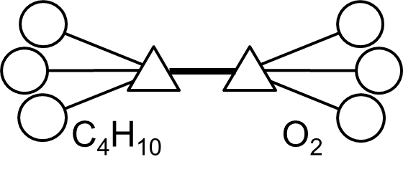
Mass
(g)
Mass
(g)
1 mol = molar mass (in g)
1 mol = molar mass (in g)
Volume
(L or dm³)
1 mol = 22.4 L
COEFFS FROM
1 mol = 22.4 L
Volume
(L or dm³)
MOLE
(mol)
MOLE
(mol)
1 mol = 22.4 dm³
BALANCED EQ.
1 mol = 22.4 dm³
Particle
(at. or m’c)
1 mol = 6.02 x 10²³ part.
1 mol = 6.02 x 10²³ part.
Particle
(at. or m’c)

Slide 32
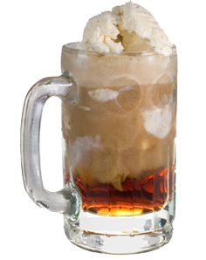
Limiting Reactants (a.k.a., Limiting Reagents)
limiting reactant (LR): the reactant that runs out first
--
Amount of EVERYTHING depends on the LR.
Any reactant you don’t run out
of is an excess reactant (ER).

Slide 33
How to Find the Limiting Reactant
For the generic reaction
R_{A} + R_{B} P,
assume that the amounts
of R_{A} and R_{B} are given.
Should you use R_{A} or R_{B}
in your calculations?
1. Calc. # of mol of R_{A} and R_{B} you have.
2. Divide by the respective coefficients
in balanced equation.
3. Reactant having the smaller
result is the LR.

Slide 34

2 H₂(g) + O₂(g) 2 H₂O(g)
How many g H₂O
are formed?
13 g H₂ 80. g O₂
(
)
.
_
13 g H₂
1 mol H₂
.
= 3.25
= 6.5 mol H₂
(HAVE)
2
2 g H₂
LR
= O₂
(
)
.
80 g O₂
1 mol O₂
_
.
1
= 2.50
= 2.5 mol O₂
(HAVE)
32 g O₂
“Oh, bee- HAVE !”
(And start every
calc. with the LR.)
O₂
H₂O
(
)
(
)
2.5 mol O₂
2 mol H₂O
18 g H₂O
= 90. g H₂O
1 mol O₂
1 mol H₂O

Slide 35

2 Fe(s) + 3 Cl₂(g) 2 FeCl₃(s)
223 g Fe 179 L Cl₂
At STP, what is the limiting reactant?
(
)
.
_
LR
223 g Fe
1 mol Fe
= 4.0 mol Fe
(HAVE)
.
2
= 2.0
55.8 g Fe
= Fe
(
)
.
179 L Cl₂
1 mol Cl₂
_
= 8.0 mol Cl₂
(HAVE)
.
3
= 2.66
22.4 L Cl₂
What mass of FeCl₃
is produced?
(“Oh, bee-HAVE!”)
Fe
FeCl₃
(
)
(
)
2 mol FeCl₃
162.3 g FeCl₃
4.0 mol Fe
= 649 g FeCl₃
STOP
2 mol Fe
1 mol FeCl₃

Slide 36
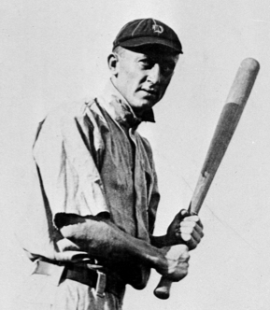
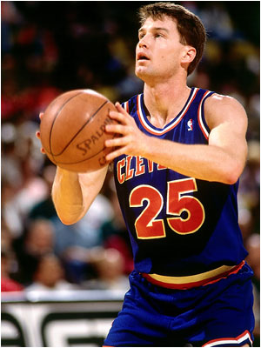
Theoretical Yield, Actual Yield, and Percent Yield
The amount of product we get if the reaction
is perfect is called the theoretical yield.
-- It is found by calculation.
If we ACTUALLY DO the reaction and measure
the actual yield, we will find that this amount is
less than the theoretical yield
(i.e., % yield can never be > 100%).
Highest career BA: Ty Cobb, .366
Highest career FT%: Mark Price, .904

Slide 37
ZnS + O₂ ZnO + SO₂
2
3
2
2
100. g 100. g X g
Assume 81% yield.
(
)
.
_
LR
100 g ZnS
1 mol
= 1.026 mol ZnS
(HAVE)
.
2
= 0.513
97.5 g
(
)
.
100 g O₂
1 mol
_
= 3.125 mol O₂
(HAVE)
.
3
= 1.042
32 g
ZnS
ZnO
(
)
(
)
1.026 mol ZnS
2 mol ZnO
81.4 g ZnO
= 83.5 g ZnO
2 mol ZnS
1 mol ZnO
Actual g ZnO = 83.5 (0.81)
= 68 g ZnO

Slide 38

Automobile air bags inflate with nitrogen
via the decomposition of sodium azide:
2 NaN₃(s) 3 N₂(g) + 2 Na(s)
At STP and a % yield of 85%, what mass sodium azide is
needed to yield 74 L nitrogen?
actual
% yld =
theo
N₂
NaN₃
74 L N₂
74 L N₂
0.85 =
→ theo =
= 87.1 L N₂
theo L N₂
0.85
(
)
(
)
(
)
87.1 L N₂
1 mol N₂
2 mol NaN₃
65 g NaN₃
= 170 g
NaN₃
22.4 L N₂
3 mol N₂
1 mol NaN₃
STOP

