Slide 1
Part 2
The Gas Laws
C L I C K T O R E T U R N

Slide 2
Table of Contents
‘Gas Laws’
Greenhouse Effect
Ozone
Kinetic Molecular Theory
Boyle’s Law
Breathing
Graham’s Law of Diffusion
Charle’s Law
Combined Gas Law
Bernoulli’s Principle
Space Shuttle
Partial Pressures
Ideal vs. Real Gases
Air Pressure
Barometer
Diffusion
Manometer
Vapor Pressure
Self-Cooling Can
Liquid Nitrogen

Slide 3
Lecture Outline – The Gas Laws
Lecture Outline – The Gas Laws
student notes outline
textbook questions
Lecture Outline – The Gas Laws
textbook questions
Keys
text
http://www.unit5.org/chemistry/GasLaws.html

Slide 4
Ideal Gas Law
PV = nRT
Brings together gas properties.
Can be derived from experiment and theory.

Slide 5
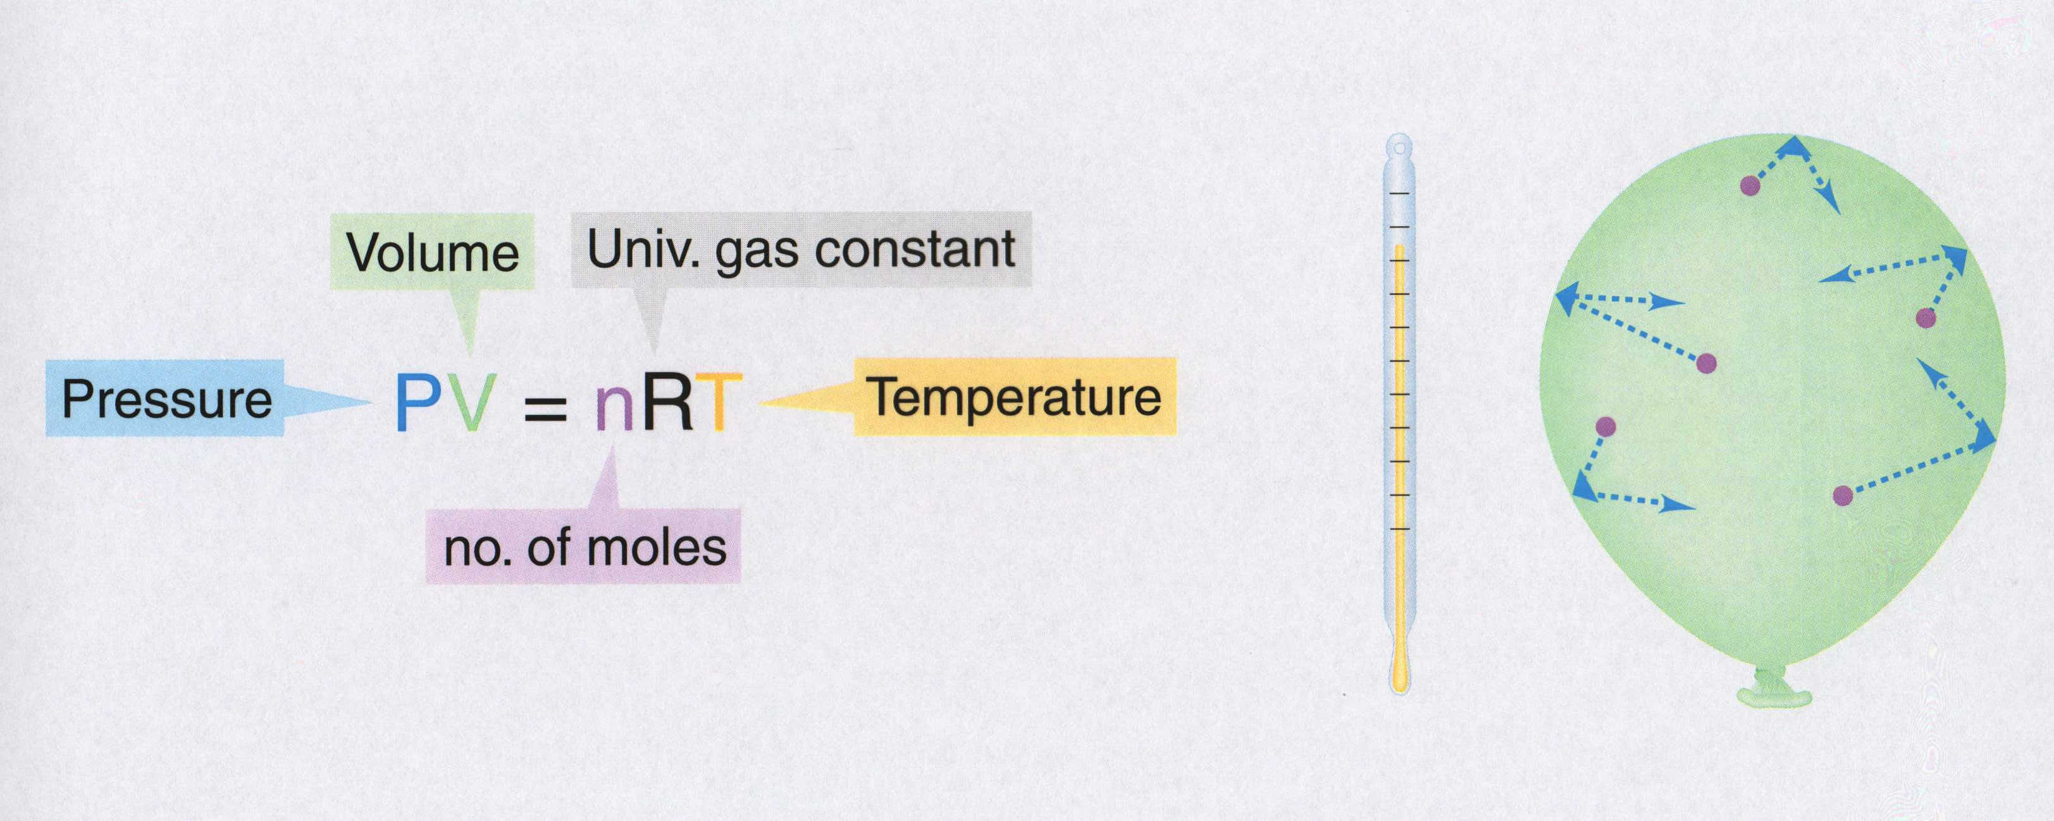

Ideal Gas Equation
Volume
Universal Gas Constant
Pressure
P V = n R T
Temperature
No. of moles
R = 0.0821 atm L / mol K
R = 8.314 kPa L / mol K
Kelter, Carr, Scott, Chemistry A Wolrd of Choices 1999, page 366
Notes:
The ideal gas law allows the calculation of the fourth variable for a gaseous sample if the values of any three of the four variables (P, V, T, n) are known.
• The ideal gas law predicts the final state of a sample of a gas (that is, its final temperature, pressure, volume, and quantity) following any changes in conditions if the parameters (P, V, T, n) are specified for an initial state.
• In cases where two of the variables P, V, and T are allowed to vary for a given sample of gas (n is constant) and the change in the value of the third variable under the new conditions needs to be calculated, the ideal gas needs to be arranged. The ideal gas law is rearranged so that P, V, and T, the quantities that change, are on one side and the constant terms (R and n for a given sample of gas) are on the other:
PV = nR = constant
T
• The quantity PV/T is constant if the total amount of gas is constant.
• The relationship between any two sets of parameters for a sample of gas can be written as
P₁V₁ = P₂V_{2.}
T₁ T₂
• An equation can be solved for any of the quantities P₂, V₂, or T₂ if the initial conditions are known.

Slide 6

PV = nRT
Standard Temperature and Pressure (STP)
T = 0 ºC or 273 K
P = 1 atm = 101.3 kPa = 760 mm Hg
P = pressure
V = volume
T = temperature (Kelvin)
n = number of moles
R = gas constant
Solve for constant (R)
PV
nT
1 mol = 22.4 L @ STP
Recall: 1 atm = 101.3 kPa
Substitute values:
(1 atm) (22.4 L)
(1 mole)(273 K)
= R
R = 0.0821 atm L
mol K
(101.3 kPa)
= 8.31 kPa L
mol K
( 1 atm)
R = 0.0821 atm L / mol K or R = 8.31 kPa L / mol K
Notes:
Any set of relationships between a single quantity (such as V) and several other variables (P, T, n) can be combined into a single expression that describes all the relationships simultaneously.
The following three expressions
V ∝ 1/P (at constant n, T)
V ∝ T ( at constant n, P)
V ∝ n (at constant T, P)
can be combined to give
V ∝ nT or V = constant (nT/P)
• The proportionality constant is called the gas constant, represented by the letter R.
• Inserting R into an equation gives V = RnT = nRT
P P
Multiplying both sides by P gives the following equation, which is known as the ideal gas law:
PV = nRT
• An ideal gas is defined as a hypothetical gaseous substance whose behavior is independent of attractive and repulsive forces and can be completely described by the ideal gas law.
• The form of the gas constant depends on the units used for the other quantities in the expression — if V is expressed in liters (L), P in atmospheres (atm), T in kelvins (K), and n in moles (mol), then
R = 0.082057 (L•atm)/(K•mol).
• R can also have units of J/(K•mol) or cal/(K•mol).
A particular set of conditions were chosen to use as a reference; 0ºC (273.15 K) and 1 atm pressure are referred to as standard temperature and pressure (STP).
The volume of 1 mol of an ideal gas under standard conditions can be calculated using the variant of the ideal gas law:
V = nRT = (1 mol) [0.082057 (L•atm)/(K•mol)] (273.15 K) = 22.41 L
P 1 atm
• The volume of 1 mol of an ideal gas at 0ºC and 1 atm pressure is 22.41 L, called the standard molar volume of an ideal gas.
• The relationships described as Boyle’s, Charles’s, and Avogadro’s laws are simply special cases of the ideal gas law in which two of the four parameters (P, V, T, n) are held fixed.

Slide 7

Ideal Gas Law
What is the volume that 500 g of iodine will occupy under the conditions:
Temp = 300ºC and Pressure = 740 mm Hg?
Step 1) Write down given information.
mass = 500 g iodine
T = 300ºC
P = 740 mm Hg
R = 0.0821 atm . L / mol . K
Step 2) Equation:
PV = nRT
Step 3) Solve for variable
V
=
nRT
P
Step 4) Substitute in numbers and solve
(500 g)(0.0821 atm . L / mol . K)(300ºC)
V
=
740 mm Hg
V =
What MISTAKES did we make in this problem?

Slide 8
What mistakes did we make in this problem?
What is the volume that 500 g of iodine will occupy under the conditions:
Temp = 300ºC and Pressure = 740 mm Hg?
Step 1) Write down given information.
mass = 500 g iodine → Convert mass to gram;
recall iodine is diatomic (I₂)
x mol I₂ = 500 g I₂(1mol I₂ / 254 g I₂)
n = 1.9685 mol I₂
T = 300ºC →Temperature must be converted to Kelvin
T = 300ºC + 273
T = 573 K
P = 740 mm Hg →Pressure needs to have same unit as R;
therefore, convert pressure from mm Hg to atm.
x atm = 740 mm Hg (1 atm / 760 mm Hg)
P = 0.8 atm
R = 0.0821 atm . L / mol . K

Slide 9
Ideal Gas Law
What is the volume that 500 g of iodine will occupy under the conditions:
Temp = 300ºC and Pressure = 740 mm Hg?
Step 1) Write down given information.
mass = 500 g iodine
n = 1.9685 mol I₂
T = 573 K (300ºC)
P = 0.9737 atm (740 mm Hg)
R = 0.0821 atm . L / mol . K
V = ? L
Step 2) Equation: PV = nRT
Step 3) Solve for variable
V
=
nRT
P
Step 4) Substitute in numbers and solve
(1.9685 mol)(0.0821 atm . L / mol . K)(573 K)
V
=
0.9737 atm
V = 95.1 L I₂

Slide 10
Ideal Gas Law
What is the volume that 500 g of iodine will occupy under the conditions:
Temp = 300ºC and Pressure = 740 mm Hg?
Step 1) Write down given information.
mass = 500 g iodine
T = 300ºC
P = 740 mm Hg
R = 0.0821 atm . L / mol . K
Step 2) Equation:
PV = nRT
Step 3) Solve for variable
V
=
nRT
P
Step 4) Substitute in numbers and solve
(500 g)(0.0821 atm . L / mol . K)(300ºC)
V
=
740 mm Hg
V =
What MISTAKES did we make in this problem?

Slide 11
Ideal Gas Law
Ideal Gas Law
Ideal Gas Law
Keys
http://www.unit5.org/chemistry/GasLaws.html

Slide 12
Boyle’s Law
As the pressure on a gas increases
1 atm
As the pressure on a gas increases -
the volume decreases
Pressure and volume are inversely related
2 atm
4 Liters
2 Liters

Slide 13
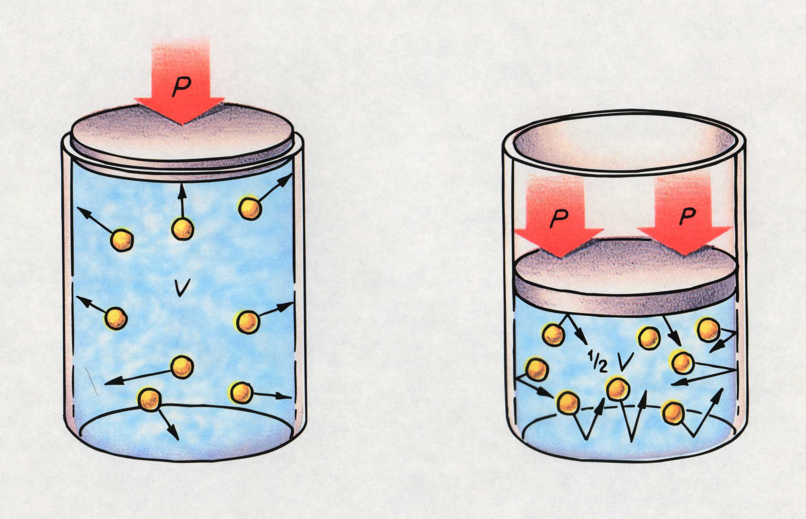
Boyle’s Law
Timberlake, Chemistry 7th Edition, page 253

Slide 14
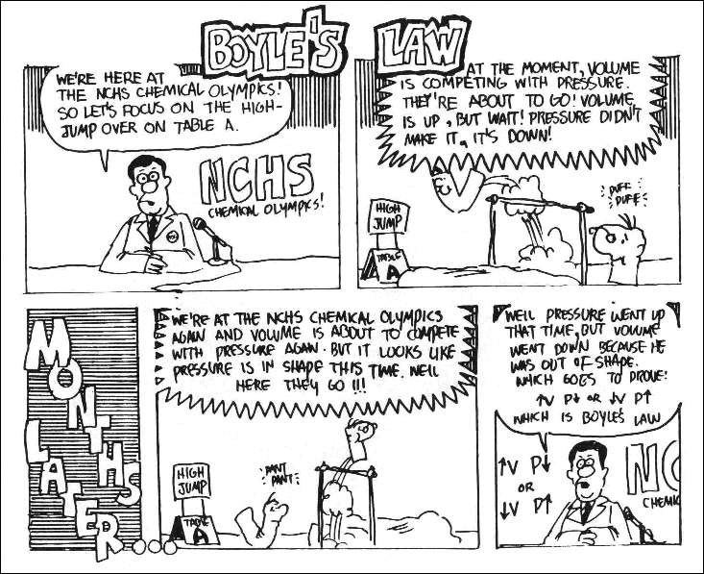

Slide 15
Boyle’s Law
P₁V₁ = P₂V₂
(Temperature is held constant)
Timberlake, Chemistry 7th Edition, page 253
Notes:
When the volume of a gas decreases, its pressure increases as long as there is no change in the temperature or the amount of the gas.

Slide 16
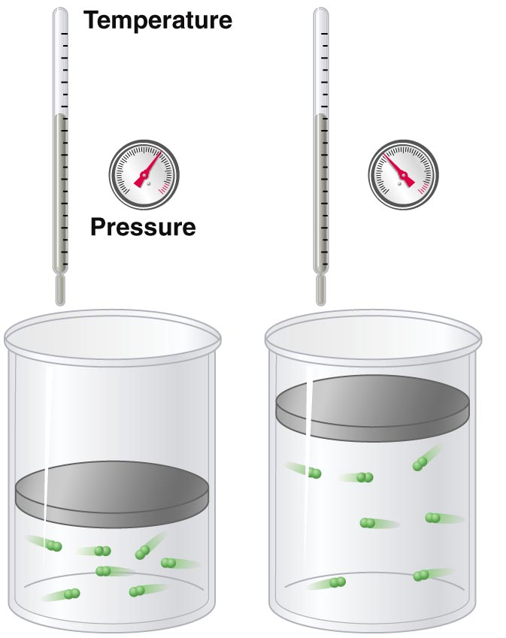
P vs. V (Boyle’s law)
At constant temperature and
amount of gas, pressure
decreases as volume increases
(and vice versa).
P₁V₁ = P₂V₂
Copyright © 2007 Pearson Benjamin Cummings. All rights reserved.

Slide 17
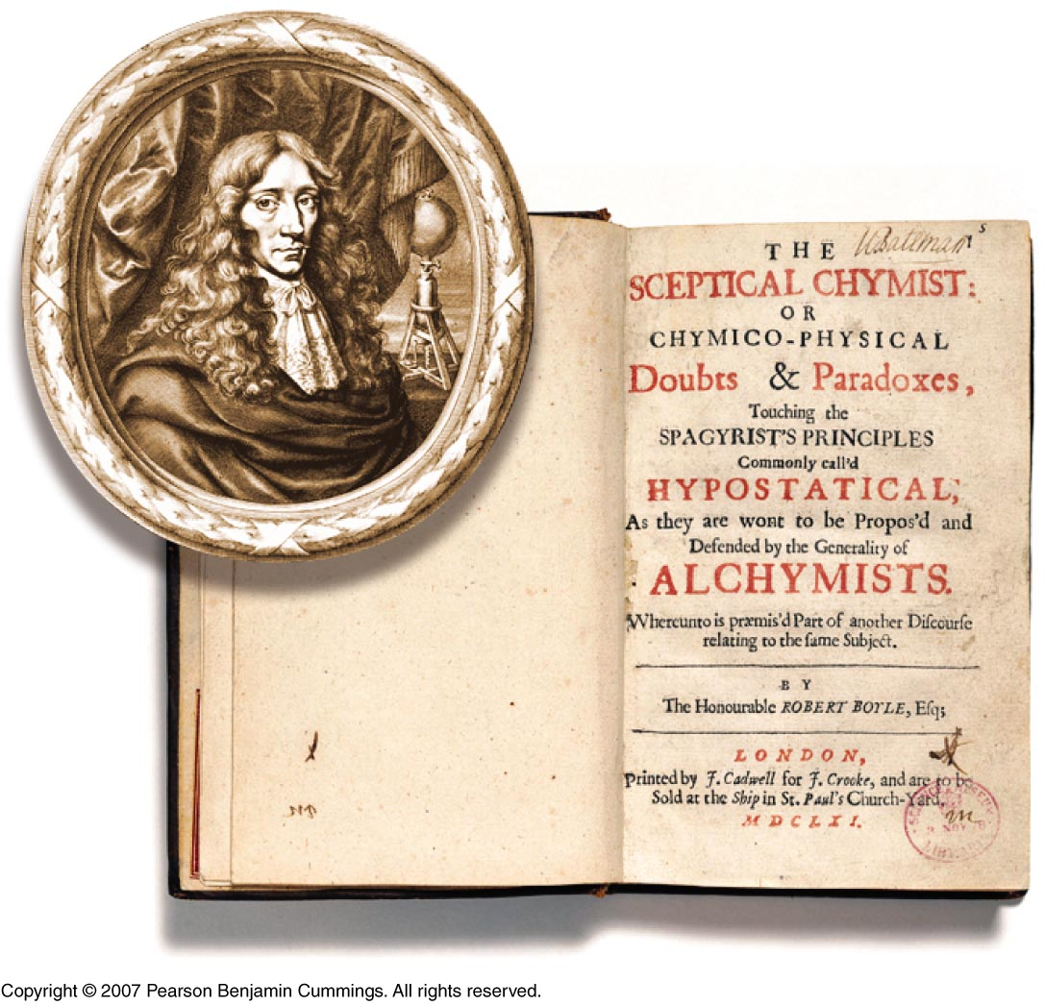
Digital
Text
Copyright © 2007 Pearson Benjamin Cummings. All rights reserved.
Notes:
Robert Boyle (1627-1691) was born in Lismore, Ireland. He was regarded as one of the foremost experimental scientists of his time. It is thought that he was the first to collect gases by displacing water in an inverted flask. He discovered the relationship between the pressure and the volume of a gas in 1660. The relationship, P x V = constant, is known as Boyle´s law and was one of the first attempts to express a scientific principle in a mathematical form. Boyle separated chemistry from the realm of alchemy and established it as a science. On the basis of experiment he defined an element as something that cannot be broken up into smaller substances. Robert Boyle devoted his life to experimental science, taking careful notes of each experiment, enabling other scientists to learn from his work. He is regarded as the father of experimental science.
The Sceptical Chymist or Chymico-Physical Doubts & Paradoxes is the title of Robert Boyle’s masterpiece of scientific literature, published in London in 1661. In the form of a dialogue, the Sceptical Chymist presented Boyle's hypothesis that matter consisted of atoms and clusters of atoms in motion and that every phenomenon was the result of collisions of particles in motion. He appealed to chemists to experiment and asserted that experiments denied the limiting of chemical elements to only the classic four: earth, fire, air, and water. He also pleaded that chemistry should cease to be subservient to medicine or to alchemy, and rise to the status of a science. Importantly, he advocated a rigorous approach to scientific experiment: he believed all theories must be proved experimentally before being regarded as true. For these reasons Robert Boyle has been called the founder of modern chemistry.

Slide 18
Boyle's Law
If n and T are constant, then
PV = (nRT) = k
This means, for example, that
Pressure goes up as Volume goes down.
A bicycle pump is a good example of Boyle's law.
As the volume of the air trapped in the pump is
reduced, its pressure goes up, and air is forced
into the tire.
Robert Boyle
(1627 - 1691)
Son of Early of Cork, Ireland.

Slide 19

As the pressure on a gas increases
As the pressure on a gas increases -
the volume decreases
Pressure and volume are inversely related
1 atm
2 atm
4 Liters
2 Liters

Slide 20
As the pressure on a gas increases -
the volume decreases
Pressure and volume are inversely related
2 atm
2 Liters

Slide 21
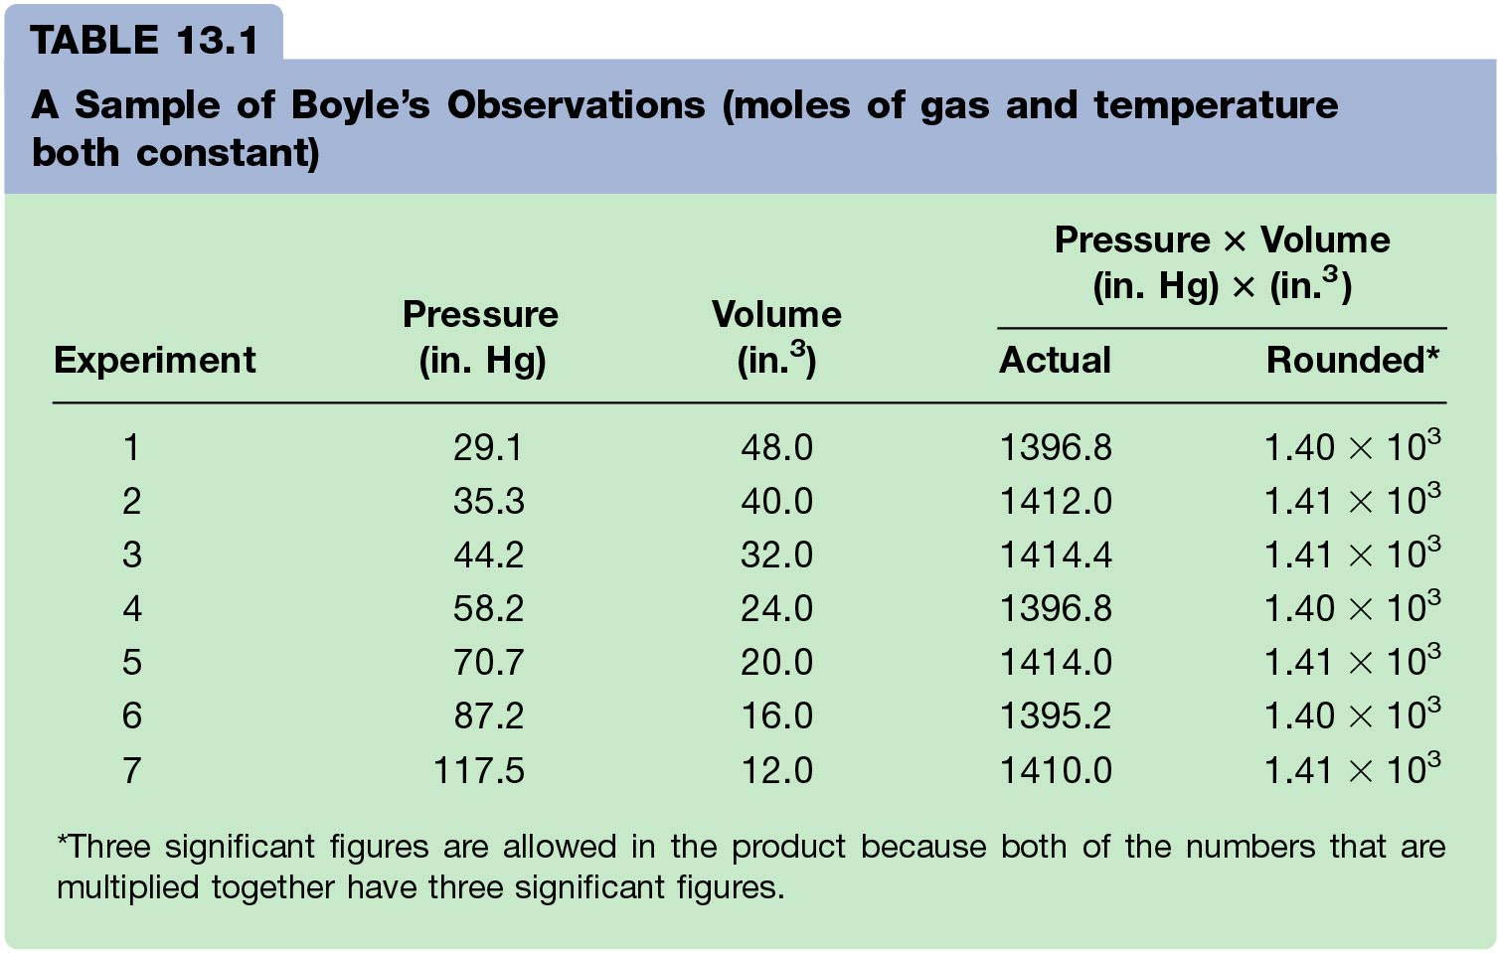
Boyle’s Law Data
Notes:
As the pressure on a gas increases, the volume of the gas decreases because the gas particles are forced closer together.
As the pressure on a gas decreases, the gas volume increases because the gas particles can now move farther apart.
Boyle carried out some experiments that determined the quantitative relationship between the pressure and volume of a gas.
Plots of Boyle’s data showed that a simple plot of V versus P is a hyperbola and reveals an inverse relationship between pressure and volume; as the pressure is doubled, the volume decreases by a factor of two.
Relationship between the two quantities is described by the equation PV = constant.
Dividing both sides by P gives an equation that illustrates the inverse relationship between P and V:
V = constant = constant(1/P) or V ∝ 1/P
P
• A plot of V versus 1/P is a straight line whose slope is equal to the constant.
• Numerical value of the constant depends on the amount of gas used in the experiment and on the temperature at which the experiments are carried out.
• This relationship between pressure and volume is known as Boyle’s law which states that at constant temperature, the volume of a fixed amount of a gas is inversely proportional to its pressure.

Slide 22
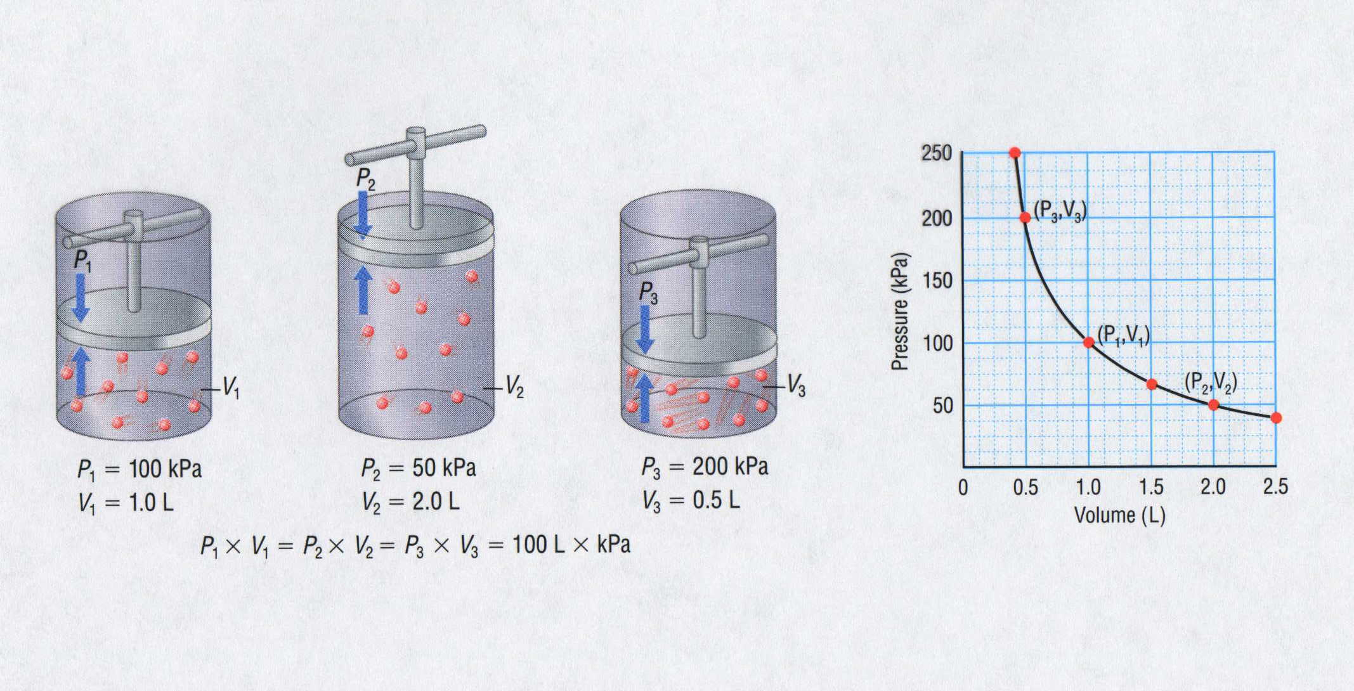
Pressure-Volume Relationship
250
200
(P₃,V₃)
150
Pressure (kPa)
100
(P₁,V₁)
(P₂,V₂)
50
P₁ = 100 kPa
V₁ = 1.0 L
P₂ = 50 kPa
V₂ = 2.0 L
P₃ = 200 kPa
V₃ = 0.5 L
0
0.5
1.0
1.5
2.0
2.5
Volume (L)
P₁ x V₁ = P₂ x V₂ = P₃ x V₃ = 100 L x kPa

Slide 23
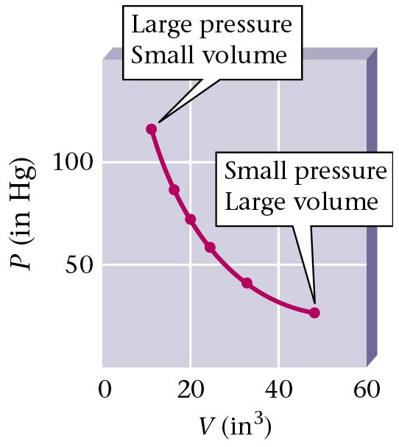
P vs. V (Boyle’s Data)
Zumdahl, Zumdahl, DeCoste, World of Chemistry 2002, page 404

Slide 24
Pressure vs. Volume for a Fixed Amount of Gas
(Constant Temperature)
600
Pressure Volume PV
(Kpa) (mL)
100 500 50,000
150 333 49,950
200 250 50,000
250 200 50,000
300 166 49,800
350 143 50,500
400 125 50,000
450 110 49,500
500
400
300
Volume (mL)
200
100
0 100 200 300 400 500
Pressure (KPa)
Notes:
The pressure for this data was NOT at 1 atm.
Practice with this data: (where Pressure = 1 atmosphere)
Volume Temp (ºC) (K) V/T
63.4 L 500 773 0.0821
55.2 400 673 0.0821
47.0 300 573 0.0821
38.8 200 473 0.0821
As the pressure on a gas increases, the volume of the gas decreases because the gas particles are forced closer together.
As the pressure on a gas decreases, the gas volume increases because the gas particles can now move farther apart.
Boyle carried out some experiments that determined the quantitative relationship between the pressure and volume of a gas.
Plots of Boyle’s data showed that a simple plot of V versus P is a hyperbola and reveals an inverse relationship between pressure and volume; as the pressure is doubled, the volume decreases by a factor of two.
Relationship between the two quantities is described by the equation PV = constant.
Dividing both sides by P gives an equation that illustrates the inverse relationship between P and V:
V = constant = constant(1/P) or V ∝ 1/P
P
• A plot of V versus 1/P is a straight line whose slope is equal to the constant.
• Numerical value of the constant depends on the amount of gas used in the experiment and on the temperature at which the experiments are carried out.
• This relationship between pressure and volume is known as Boyle’s law which states that at constant temperature, the volume of a fixed amount of a gas is inversely proportional to its pressure.

Slide 25
Pressure vs. Reciprocal of Volume for a Fixed Amount of Gas
(Constant Temperature)
0.010
0.008
Pressure Volume 1/V
(Kpa) (mL)
100 500 0.002
150 333 0.003
200 250 0.004
250 200 0.005
300 166 0.006
350 143 0.007
400 125 0.008
450 110 0.009
0.006
1 / Volume (1/L)
0.004
0.002
0 100 200 300 400 500
Pressure (KPa)
Notes:
The pressure for this data was NOT at 1 atm.
Practice with this data: (where Pressure = 1 atmosphere)
Volume Temp (ºC) (K) V/T
63.4 L 500 773 0.0821
55.2 400 673 0.0821
47.0 300 573 0.0821
38.8 200 473 0.0821
As the pressure on a gas increases, the volume of the gas decreases because the gas particles are forced closer together.
As the pressure on a gas decreases, the gas volume increases because the gas particles can now move farther apart.
Boyle carried out some experiments that determined the quantitative relationship between the pressure and volume of a gas.
Plots of Boyle’s data showed that a simple plot of V versus P is a hyperbola and reveals an inverse relationship between pressure and volume; as the pressure is doubled, the volume decreases by a factor of two.
Relationship between the two quantities is described by the equation PV = constant.
Dividing both sides by P gives an equation that illustrates the inverse relationship between P and V:
V = constant = constant(1/P) or V ∝ 1/P
P
• A plot of V versus 1/P is a straight line whose slope is equal to the constant.
• Numerical value of the constant depends on the amount of gas used in the experiment and on the temperature at which the experiments are carried out.
• This relationship between pressure and volume is known as Boyle’s law which states that at constant temperature, the volume of a fixed amount of a gas is inversely proportional to its pressure.

Slide 26
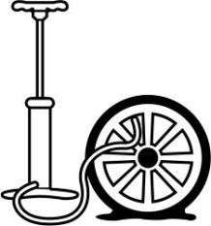
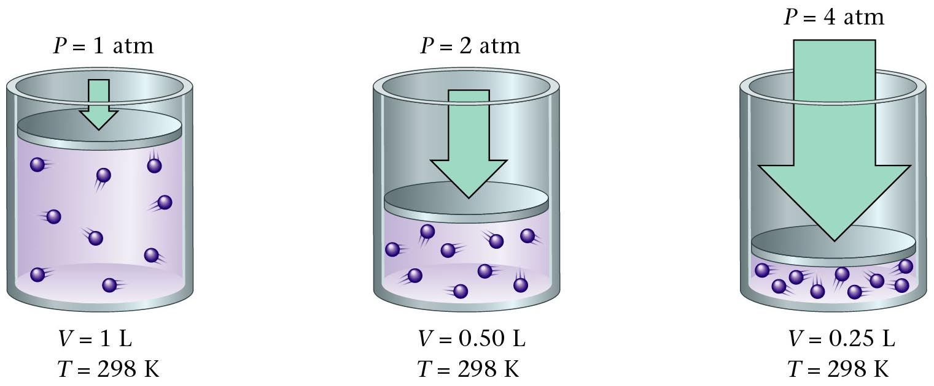
Boyle’s Law Illustrated
Zumdahl, Zumdahl, DeCoste, World of Chemistry 2002, page 404
Notes:
http://images.jupiterimages.com/common/detail/56/84/23298456.jpg

Slide 27
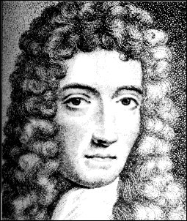
Boyle’s Law
Volume (mL) | Pressure (torr) | P.V (mL.torr)
10.0 20.0 30.0 40.0 | 760.0 379.6 253.2 191.0 | 7.60 x 10³ 7.59 x 10³ 7.60 x 10³ 7.64 x 10³
The pressure and volume of a gas are inversely related
  at constant mass & temp
PV = k
P
V
Courtesy Christy Johannesson www.nisd.net/communicationsarts/pages/chem
Notes:
As the pressure on a gas increases, the volume of the gas decreases because the gas particles are forced closer together.
As the pressure on a gas decreases, the gas volume increases because the gas particles can now move farther apart.
Boyle carried out some experiments that determined the quantitative relationship between the pressure and volume of a gas.
Plots of Boyle’s data showed that a simple plot of V versus P is a hyperbola and reveals an inverse relationship between pressure and volume; as the pressure is doubled, the volume decreases by a factor of two.
Relationship between the two quantities is described by the equation PV = constant.
Dividing both sides by P gives an equation that illustrates the inverse relationship between P and V:
V = constant = constant(1/P) or V ∝ 1/P
P
• A plot of V versus 1/P is a straight line whose slope is equal to the constant.
• Numerical value of the constant depends on the amount of gas used in the experiment and on the temperature at which the experiments are carried out.
• This relationship between pressure and volume is known as Boyle’s law which states that at constant temperature, the volume of a fixed amount of a gas is inversely proportional to its pressure.

Slide 28
Pressure and Volume of a Gas
Boyle’s Law
A quantity of gas under a pressure of 106.6 kPa has a volume
of 380 dm³. What is the volume of the gas at standard
pressure, if the temperature is held constant?
P₁ x V₁ = P₂ x V₂
(106.6 kPa) x (380 dm³) = (103.3 kPa) x (V₂)
V₂ = 392 dm³
V₂ = 400 dm³

Slide 29
PV Calculation (Boyle’s Law)
A quantity of gas has a volume of 120 dm³ when confined
under a pressure of 93.3 kPa at a temperature of 20 ºC.
At what pressure will the volume of the gas be 30 dm³ at
20 ºC?
P₁ x V₁ = P₂ x V₂
(93.3 kPa) x (120 dm³) = (P₂) x (30 dm³)
P₂ = 373.2 kPa

Slide 30
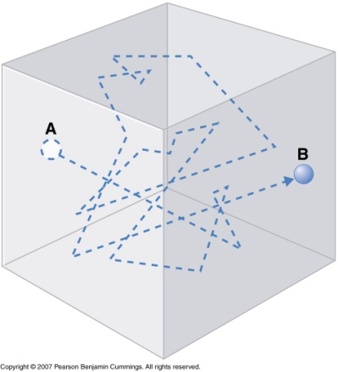
Volume and Pressure
Two-liter flask
One-liter flask
The molecules are
closer together; the
density is doubled.
The average molecules hits the wall
twice as often. The total number of
impacts with the wall is doubled and
the pressure is doubled.
Bailar, Jr, Moeller, Kleinberg, Guss, Castellion, Metz, Chemistry, 1984, page 101

Slide 31
Volume and Pressure
Two-liter flask
One-liter flask
The molecules are
closer together; the
density is doubled.
The average molecules hits the wall
twice as often. The total number of
impacts with the wall is doubled and
the pressure is doubled.
Bailar, Jr, Moeller, Kleinberg, Guss, Castellion, Metz, Chemistry, 1984, page 101

Slide 32

Bell Jar Demonstrations
Effect of Pressure on Volume
(Shaving Cream in a Bell jar)
VIDEO
http://www.unit5.org/chemistry/GasLaws.html

Slide 33
Breathing

Slide 34
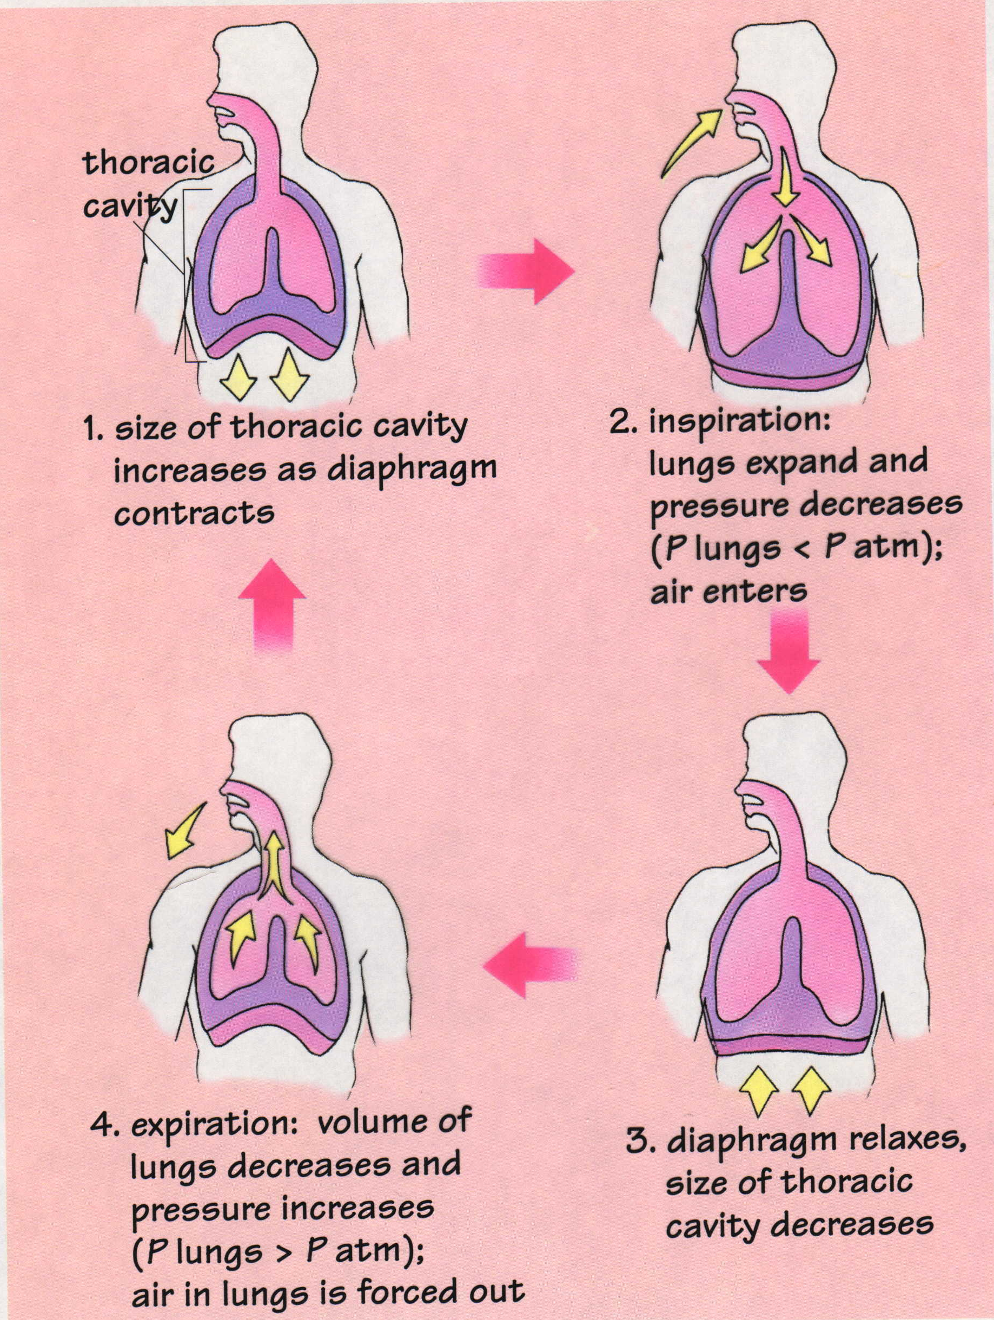
Mechanics of Breathing
Timberlake, Chemistry 7th Edition, page 254
Notes:
MECHANICS OF BREATHING
Gas travels from high pressure to low pressure. This is also responsible for all weather patterns.

Slide 35
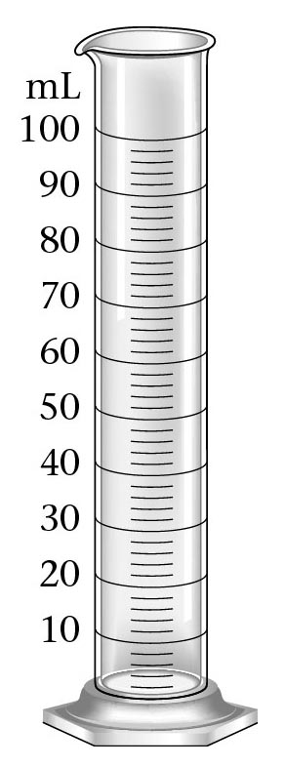
Air Pressure
Water pressure increases
due to greater fluid above
opening.

Slide 36

“One Minute Left”
Notes:
Reader’s Digest Article – April 1997
…Sticking his hand through the hole, Joe pointed down toward the entry. When he looked in again, David had disappeared.
Joe raced back to the opening, searching for signs of movement. Nothing. Don’t panic, David, he thought. Take your time. Joe’s air-pressure gauge dropped past 200 pounds – enough for maybe two minutes.
David groped around the ship’s beams, his pulse racing. Seconds passed, then more. Am I going the right way he wondered. Fear cramped his muscles.
In despair, he fought his way back to the air pocket, snatched off his regulator and gasped the stale, metallic air. “Help! Dad! I’m trapped. Don’t leave me. I don’t want to die!”
After waiting what seemed an eternity at the entry, Joe wedged his flashlight into a crevice as a beacon for his son. It hardly shines through the muddy water, he thought, but I’ve got to try.
Then he swam back up the hull, feeling his way along the rough metal to the smaller hole. David’s cries rang out as he arrived. Reaching in, Joe touched David’s waist. He stared into his son’s blue eyes for a long moment, willing him to understand.
Then Joe stuck his whole arm through the hole and once again pointed down toward the entrance. He felt his son grab his arm tightly, working down to the fingertips. Finally David let go. This is it, Joe thought as the air came hard again from his regulator and the pressure gauge dropped toward zero. If David doesn’t find the entry this time, we will surely die.
Joe swam down to the hole. Kneeling by his flashlight beacon, he waited, his heart beating out the seconds. He sucked but got no more air. The last bubbles rose from his regulator.
He bit fiercely on the rubber mouthpiece, refusing to let his body gasp in reflex. His heart kept time. Four … five … six …
David bumped along blindly, feeling his way along an overhanging ledge. Ahead he saw a faint glow; it was the opening. Dad’s out there!
Shaking with relief, he started to twist his body through the passage. Then his tank screeched and he jerked to a stop, his tank wedged tight. David tugged frantically. “Dad, pull me through!” he yelled.
Lying by the hole, holding his breath, Joe stared. Did something move? It’s David!
He reached out, but the boy had stopped. “Don’t stop now!” Joe screamed around his clenched teeth. He reached in, grabbed David’s shoulder strap and yanked. Metal scraped, held, then came free. David popped out in his arms.
Pulling his son to his chest, Joe flicked open the buckles on their heavy lead weight belts and let them drop. Kicking hard off the bottom and finning frantically, he shot for the surface, hugging his son.
Joe’s lungs screamed for air, and his dive computer flashed “ASCEND SLOWER.” But Joe ignored it. He raced for their lives.
As they rocketed upward, the sea pressure fell. Now Joe’s tank was more pressurized than the water around it, and it shot forth a last bit of air. With that final breath, he revived. Kicking, he exhaled hard so his lungs wouldn’t rupture with the rapid decrease in pressure.
Father and son exploded into the night air, ripped out their mouthpieces and gasped hungrily for air. After three deep breaths Joe tore off David’s mask and searched his face for the frothy blood that signals ruptured lungs. He saw only David’s happy tears, mirroring his own.
Later that night David began to feel painful twinges in his elbow and ankles – symptoms of the bends. At nearby Long Beach Memorial Hospital, both father and son underwent oxygen treatment in its hyperbaric chambers. David’s pain quickly disappeared as the nitrogen bubbles in his tissues dissipated. His father never felt any symptoms.
Joe Meitrell knew it was a miracle they had survived. His son learned something more. Two weeks later, in an essay for his college-entrance exam, David wrote: “I am alive today because of my dad’s willingness to sacrifice himself. He has made me realize the most important things in life are the people you love.”
Relates to the bends = nitrogen sarcosis
Nitrogen is more soluble in the blood stream than oxygen. Nitrogen dissolve more rapidly in your bloodstream than oxygen…and comes out of your bloodstream more rapidly.
When you “pop” your knuckles you are releasing nitrogen gas (absorbed from the air and trapped in your bursa sacks).

Slide 37

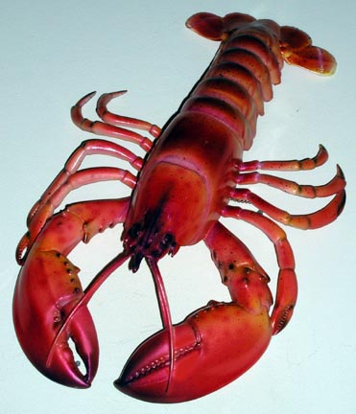
…Sticking his hand through the hole, Joe pointed down toward the entry. When he looked in again, David had disappeared.
Joe raced back to the opening, searching for signs of movement. Nothing. Don’t panic, David, he thought. Take your time. Joe’s air-pressure gauge dropped past 200 pounds – enough for maybe two minutes.
David groped around the ship’s beams, his pulse racing. Seconds passed, then more. Am I going the right way he wondered. Fear cramped his muscles.
In despair, he fought his way back to the air pocket, snatched off his regulator and gasped the stale, metallic air. “Help! Dad! I’m trapped. Don’t leave me. I don’t want to die!”
After waiting what seemed an eternity at the entry, Joe wedged his flashlight into a crevice as a beacon for his son. It hardly shines through the muddy water, he thought, but I’ve got to try.
Then he swam back up the hull, feeling his way along the rough metal to the smaller hole. David’s cries rang out as he arrived. Reaching in, Joe touched David’s waist. He stared into his son’s blue eyes for a long moment, willing him to understand.
Then Joe stuck his whole arm through the hole and once again pointed down toward the entrance. He felt his son grab his arm tightly, working down to the fingertips. Finally David let go. This is it, Joe thought as the air came hard again from his regulator and the pressure gauge dropped toward zero. If David doesn’t find the entry this time, we will surely die.

Slide 38
Joe swam down to the hole. Kneeling by his flashlight beacon, he waited, his heart beating out the seconds. He sucked but got no more air. The last bubbles rose from his regulator.
He bit fiercely on the rubber mouthpiece, refusing to let his body gasp in reflex.
His heart kept time. Four … five … six …
David bumped along blindly, feeling his way along an overhanging ledge. Ahead he saw a faint glow; it was the opening. Dad’s out there!
Shaking with relief, he started to twist his body through the passage. Then his tank screeched and he jerked to a stop, his tank wedged tight. David tugged frantically. “Dad, pull me through!” he yelled.
Lying by the hole, holding his breath, Joe stared. Did something move? It’s David!
He reached out, but the boy had stopped. “Don’t stop now!” Joe screamed around his clenched teeth. He reached in, grabbed David’s shoulder strap and yanked. Metal scraped, held, then came free. David popped out in his arms.
Pulling his son to his chest, Joe flicked open the buckles on their heavy lead weight belts and let them drop. Kicking hard off the bottom and finning frantically, he shot for the surface, hugging his son.
Joe’s lungs screamed for air, and his dive computer flashed “ASCEND SLOWER.” But Joe ignored it. He raced for their lives.

Slide 39


As they rocketed upward, the sea pressure fell. Now Joe’s tank was more pressurized than the water around it, and it shot forth a last bit of air. With that final breath, he revived. Kicking, he exhaled hard so his lungs wouldn’t rupture with the rapid decrease in pressure.
Father and son exploded into the night air, ripped out their mouthpieces and gasped hungrily for air. After three deep breaths Joe tore off David’s mask and searched his face for the frothy blood that signals ruptured lungs. He saw only David’s happy tears, mirroring his own.
Later that night David began to feel painful twinges in his elbow and ankles – symptoms of the bends. At nearby Long Beach Memorial Hospital, both father and son underwent oxygen treatment in its hyperbaric chambers. David’s pain quickly disappeared as the nitrogen bubbles in his tissues dissipated. His father never felt any symptoms.
Joe Meitrell knew it was a miracle they had survived. His son learned something more. Two weeks later, in an essay for his college-entrance exam, David wrote: “I am alive today because of my dad’s willingness to sacrifice himself. He has made me realize the most important things in life are the people you love.”

Slide 40


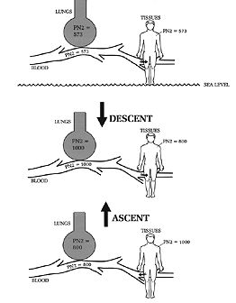
SCUBA Diving
Self Contained Underwater Breathing Apparatus
Rapid rise causes “the bends”
  Nitrogen bubbles out of blood
  rapidly from pressure decrease
Must rise slowly to the surface to avoid the “bends”.

Slide 41
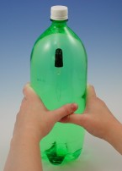
Make a Cartesian Diver
How can scuba divers and submersibles dive down into the water and then come back up? Find out with this easy project.
Materials:
2-liter soda bottle medicine dropper glass or beaker
Procedure:
1. Fill a glass with water and put the medicine dropper in it. Suck enough water into the dropper so that it just barely floats - only a small part of the rubber bulb should be out of the water. This is your diver, and it has neutral buoyancy. That means the water it displaces (pushes aside) equals the weight of the diver. The displaced water pushes up on the diver with the same amount of force that the diver exerts down on the water. This allows the diver to stay in one spot, without floating up or sinking down.
2. Now that your diver is ready with enough water inside to give it neutral buoyancy, fill the soda bottle all the way to the top with water. (You don't want any air between the water and the cap.) Lower the medicine dropper into it and screw the cap on tightly.
3. Squeeze the sides of the bottle. What happens? The diver sinks. Let go of the bottle and it will float back up. Why does it do this? Watch carefully as you make it sink again - what happens to the air inside the dropper?
As you squeeze the bottle (increasing pressure) the air inside the dropper is compressed, allowing room for more water to enter the dropper. (You'll see the water level in the dropper rise as you squeeze the bottle.) As more water enters, the dropper becomes heavier and sinks. Practice getting just the right amount of pressure so your diver hovers in the middle of the bottle.
Submarines and submersibles have ballast tanks that fill up with water to make them dive. When it's time to surface, air is pumped into the tanks, forcing the water out and making the sub float to the top. Scuba divers wear heavy belts of lead to make them sink in the water, but they also have a buoyancy compensator. This is a bag that they inflate with air from their oxygen tank. When it is inflated, it causes them to float up to the surface. While underwater they'll put just enough air in the bag to keep them from floating or sinking.
Of course, most subs and scuba divers are diving in salt water. Try your diver again in a bottle of salt water. Is there any difference in the way it works? Do you need to start out with more water in the dropper than you did before? Remember that salt water is denser than fresh water!
http://www.hometrainingtools.com/articles/oceans-newsletter.html
Notes:
Summary: Density is a measure of mass per volume. Objects that are less dense than water can float in it, but objects that are more dense than water will sink. The diver originally floats because the dropper contains part air and part water. Air is less dense than water, meaning that one liter of air has less mass than one liter of water, thus the diver is initially lighter or less dense than water. When the bottle is squeezed the water level in the dropper increases, which causes the density of the eyedropper to increase to the point that it is more dense than water. This causes it to sink to the bottom of the bottle.

Slide 42
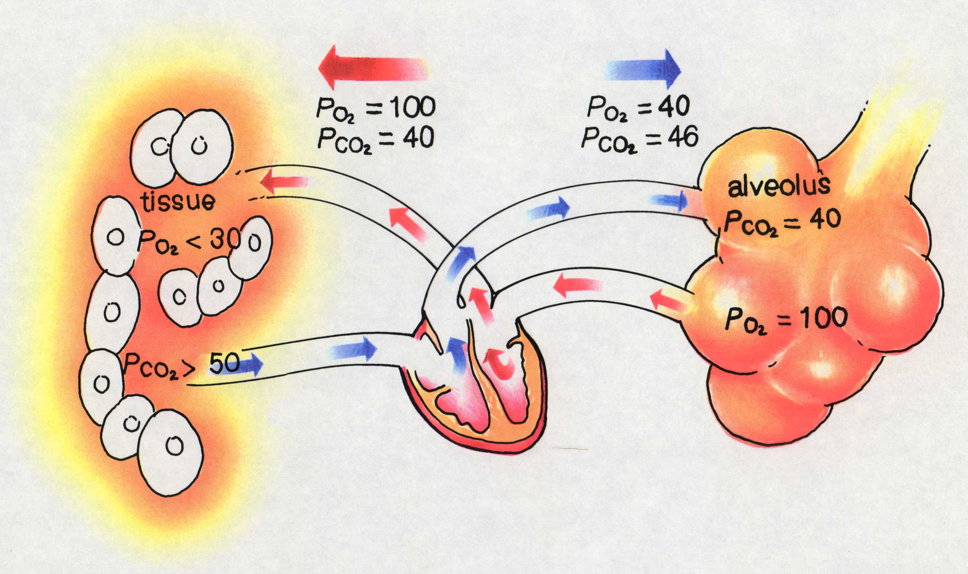
Exchange of Blood Gases
Timberlake, Chemistry 7th Edition, page 273
Notes:
The diffusion of oxygen and carbon dioxide across the membranes of the alveoli and tissues during the exchange of blood gases.
BREATING AND BURNING
“When we breathe in oxygen, it is passed to special molecules in the blood called hemoglobin, which carry it to the muscles where it is needed. There it reacts with food molecules in much the same way as it does when something burns in it, providing carbon dioxide and the energy we need.”
This is the reason you feel warm after a large meal – lots of combustion.
Eyewitness Science “Chemistry” , Dr. Ann Newmark, DK Publishing, Inc., 1993, pg 31

Slide 43
Solubility of Carbon Dioxide in Water
Temperature Pressure Solubility of CO₂
Temperature Effect
0ºC 1.00 atm 0.348 g / 100 mL H₂O
20ºC 1.00 atm 0.176 g / 100 mL H₂O
40ºC 1.00 atm 0.097 g / 100 mL H₂O
60ºC 1.00 atm 0.058 g / 100 mL H₂O
Pressure Effect
0ºC 1.00 atm 0.348 g / 100 mL H₂O
0ºC 2.00 atm 0.696 g / 100 mL H₂O
0ºC 3.00 atm 1.044 g / 100 mL H₂O
Notice that higher temperatures decrease the solubility and that higher pressures increase the solubility.
Corwin, Introductory Chemistry 4th Edition, 2005, page 370

Slide 44
Vapor Pressure of Water
Temp. Vapor Temp. Vapor Temp. Vapor
(ºC) Pressure (ºC) Pressure (ºC) Pressure
(mm Hg) (mm Hg) (mm Hg)
0 4.6 21 18.7 35 41.2
6.5 22 19.8 40 55.3
10 9.2 23 21.1 50 71.9
10.5 24 22.4 55 92.5
14 12.0 25 23.8 35 118.0
13.6 26 25.2 40 149.4
14.5 27 26.7 40 233.7
18 15.5 28 28.4 55 355.1
19 16.5 29 30.0 35 525.8
20 17.5 30 31.8 40 760.0
Corwin, Introductory Chemistry 4th Edition, 2005, page 584

Slide 45
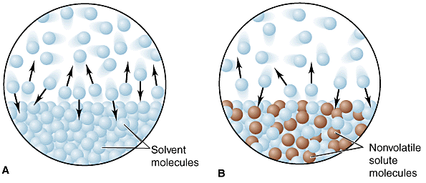
Notes:
http://www.chem.ufl.edu/~itl/2045/lectures/lec_i.html

Slide 46
Solvent
molecules
Nonvolatile
solute
molecules
Notes:
http://www.chem.ufl.edu/~itl/2045/lectures/lec_i.html

Slide 47
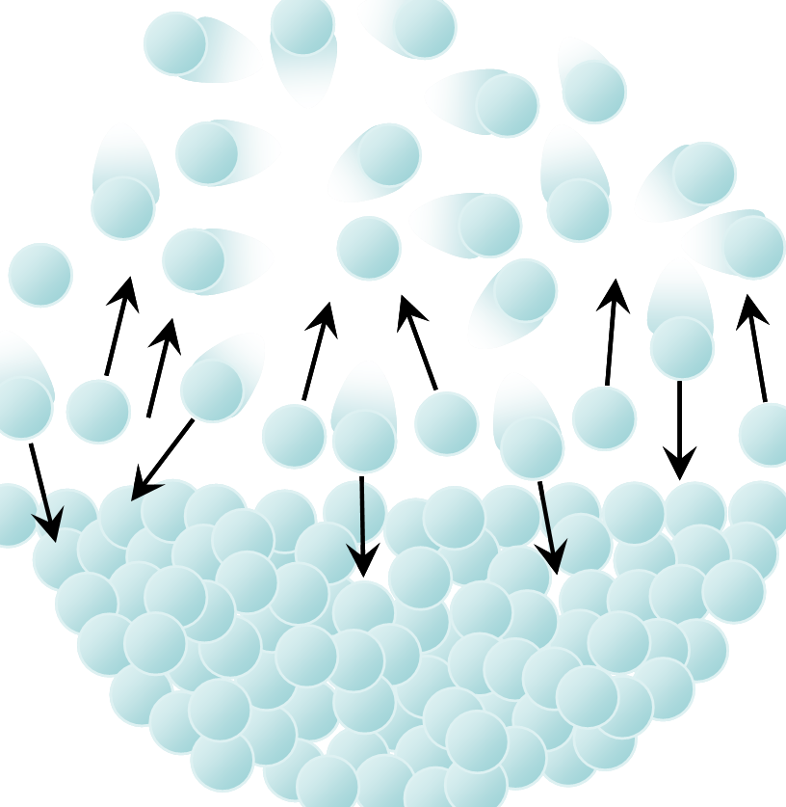
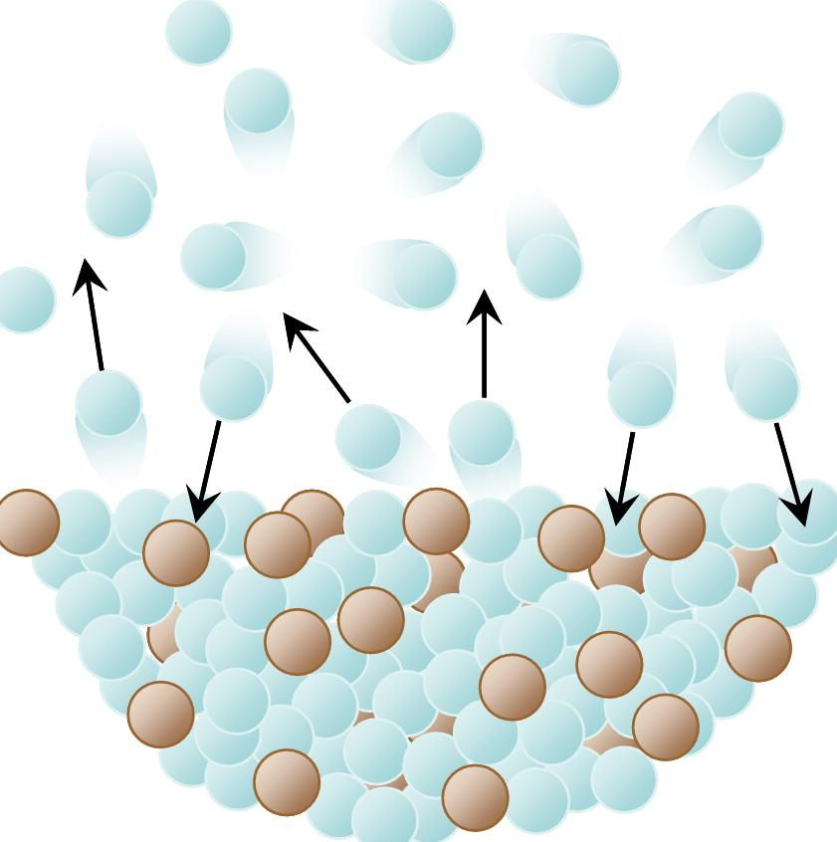
Solvent
molecules
Nonvolatile
solute
molecules
Notes:
http://www.chem.ufl.edu/~itl/2045/lectures/lec_i.html

Slide 48
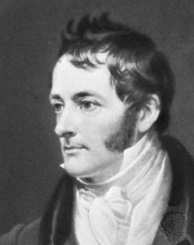
Henry’s Law
Henry’s law states that the solubility of oxygen gas is proportional
to the partial pressure of the gas above the liquid.
EXAMPLE:
Calculate the solubility of oxygen gas in water at 25ºC and a partial pressure
of 1150 torr.
The solubility of oxygen in water is 0.00414 g / 100 mL at 25ºC and 760 torr.
solubility x pressure factor = new greater solubility
1150 torr
0.00414 g / 100 mL
= 0.00626 g / 100 mL
760 torr
Note: 1 torr = 1 mm Hg
Corwin, Introductory Chemistry 4th Edition, 2005, page 370

Slide 49
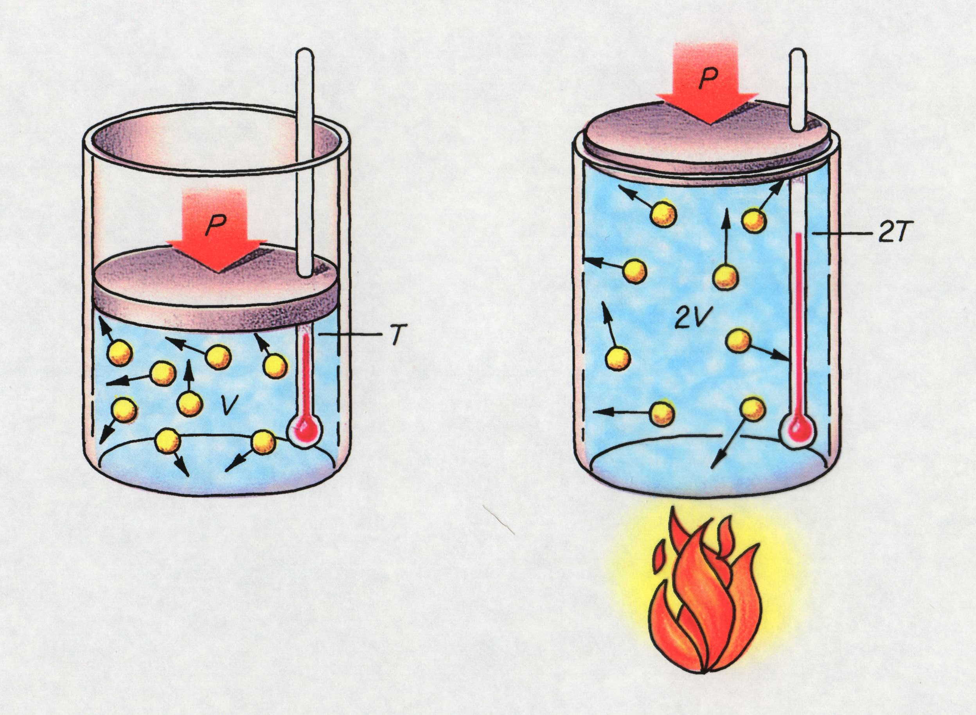
Charles’ Law
V₁ V₂
=
T₁ T₂
Timberlake, Chemistry 7th Edition, page 259
(Pressure is held constant)

Slide 50
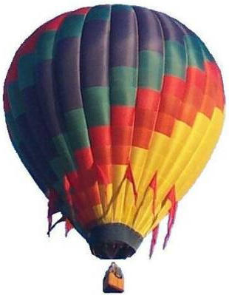
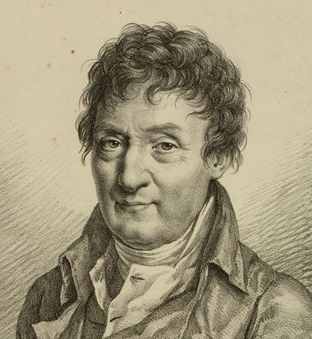
Charles' Law
If n and P are constant, then
V = (nR/P) = kT
This means, for example, that
Temperature goes up as Pressure goes up.
V and T are directly related.
A hot air balloon is a good example of Charles's law.
V₁ V₂
Jacques Charles
(1746 - 1823)
Isolated boron and studied gases.
Balloonist.
=
T₁ T₂
(Pressure is held constant)
Notes:
http://www.balloon-rides-ny.com/DylanBalloon.jpg

Slide 51
Temperature
Raising the temperature of a gas increases the pressure if the volume is held constant.
The molecules hit the walls harder.
The only way to increase the temperature at constant pressure is to increase the volume.

Slide 52
300 K
If you start with 1 liter of gas at 1 atm pressure and 300 K
and heat it to 600 K one of 2 things happen

Slide 53
600 K
300 K
Either the volume will increase to 2 liters at 1 atm.

Slide 54
300 K
600 K
the pressure will increase to 2 atm.

Slide 55
Charles’ Law
V₁ V₂
=
T₁ T₂
(Pressure is held constant)
Timberlake, Chemistry 7th Edition, page 259
Notes:
The Kelvin temperature of a gas is directly related to the volume of the gas when there is no change in pressure or amount.

Slide 56
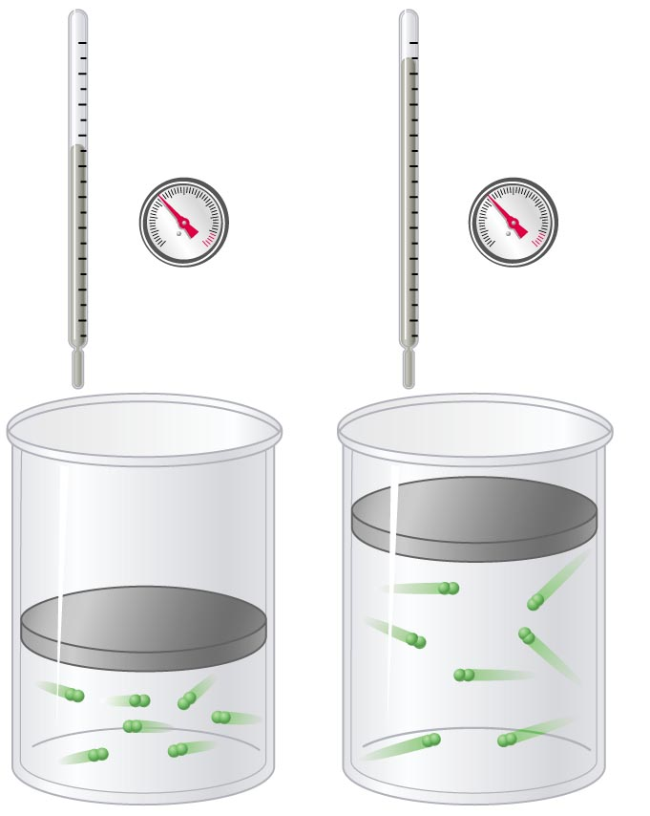
V vs. T (Charles’ law)
At constant pressure and
amount of gas, volume
increases as temperature increases
(and vice versa).
V₁ V₂
=
T₁ T₂
(Pressure is held constant)
Copyright © 2007 Pearson Benjamin Cummings. All rights reserved.

Slide 57
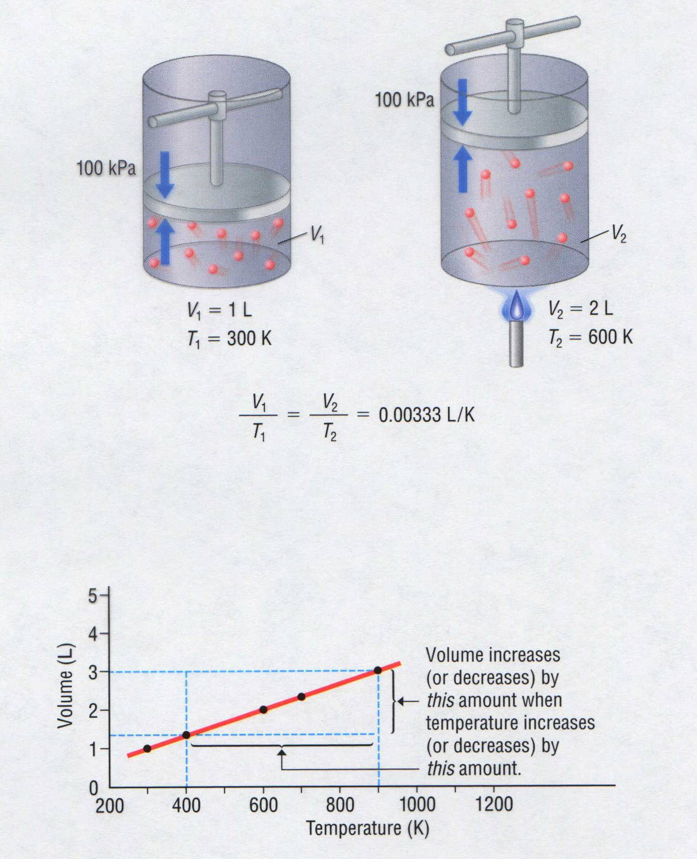
Charles’ Law

Slide 58
Charles’ Law
Volume (mL) | Temperature (K) | V / T (mL / K)
40.0 44.0 47.7 51.3 | 273.2 298.2 323.2 348.2 | 0.146 0.148 0.148 0.147
The volume and absolute temperature (K) of a gas are directly related
  at constant mass & pressure
V
T
Courtesy Christy Johannesson www.nisd.net/communicationsarts/pages/chem
Notes:
Hot air rises and gases expand when heated.
Charles carried out experiments to quantify the relationship between the temperature and volume of a gas and showed that a plot of the volume of a given sample of gas versus temperature (in ºC) at constant pressure is a straight line.
Gay-Lussac showed that a plot of V versus T was a straight line that could be extrapolated to –273.15ºC at zero volume, a theoretical state.
The slope of the plot of V versus T varies for the same gas at different pressures, but the intercept remains constant at –273.15ºC.
Plots of V versus T for different amounts of varied gases are straight lines with different slopes but the same intercept on the T axis.
Significance of the invariant T intercept in plots of V versus T was recognized by Thomson (Lord Kelvin), who postulated that –273.15ºC was the lowest possible temperature that could theoretically be achieved, and he called it absolute zero (0 K).
Charles’s and Gay-Lussac’s findings can be stated as: At constant pressure, the volume of a fixed amount of a gas is directly proportional to its absolute temperature
(in K).
This relationship is referred to as Charles’s law and is stated mathematically as
V = (constant) [T (in K)] or V ∝ T (in K, at constant P).

Slide 59
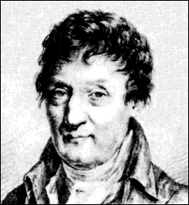
Charles’ Law
The volume and absolute temperature (K) of a gas are directly related
  at constant mass & pressure
V
T
Courtesy Christy Johannesson www.nisd.net/communicationsarts/pages/chem
Notes:
Hot air rises and gases expand when heated.
Charles carried out experiments to quantify the relationship between the temperature and volume of a gas and showed that a plot of the volume of a given sample of gas versus temperature (in ºC) at constant pressure is a straight line.
Gay-Lussac showed that a plot of V versus T was a straight line that could be extrapolated to –273.15ºC at zero volume, a theoretical state.
The slope of the plot of V versus T varies for the same gas at different pressures, but the intercept remains constant at –273.15ºC.
Plots of V versus T for different amounts of varied gases are straight lines with different slopes but the same intercept on the T axis.
Significance of the invariant T intercept in plots of V versus T was recognized by Thomson (Lord Kelvin), who postulated that –273.15ºC was the lowest possible temperature that could theoretically be achieved, and he called it absolute zero (0 K).
Charles’s and Gay-Lussac’s findings can be stated as: At constant pressure, the volume of a fixed amount of a gas is directly proportional to its absolute temperature
(in K).
This relationship is referred to as Charles’s law and is stated mathematically as
V = (constant) [T (in K)] or V ∝ T (in K, at constant P).

Slide 60
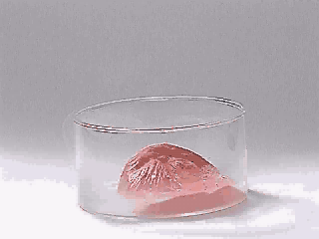
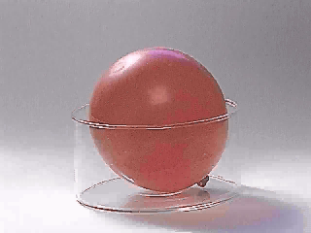
Charles’ Law
Courtesy Christy Johannesson www.nisd.net/communicationsarts/pages/chem

Slide 61
Volume vs. Kelvin Temperature of a Gas at Constant Pressure
Trial Temperature (T) Volume (V)
ºC K mL
10.0 283 100
50.0 323 114
100.0 373 132
200.0 473 167
180
160
140
120
100
80
60
40
20
0
Volume (mL)
Trial Ratio: V / T
  0.35 mL / K
  0.35 mL / K
  0.35 mL / K
  0.35 mL / K
origin
(0,0 point)
0 100 200 300 400 500 Temperature (K)
-273 -200 100 0 100 200 Temperature (ºC)
Notes:
The pressure for this data was NOT at 1 atm.
Practice with this data: (where Pressure = 1 atmosphere)
Volume Temp (ºC) (K) V/T
63.4 L 500 773 0.0821
55.2 400 673 0.0821
47.0 300 573 0.0821
38.8 200 473 0.0821
Hot air rises and gases expand when heated.
Charles carried out experiments to quantify the relationship between the temperature and volume of a gas and showed that a plot of the volume of a given sample of gas versus temperature (in ºC) at constant pressure is a straight line.
Gay-Lussac showed that a plot of V versus T was a straight line that could be extrapolated to –273.15ºC at zero volume, a theoretical state.
The slope of the plot of V versus T varies for the same gas at different pressures, but the intercept remains constant at –273.15ºC.
Plots of V versus T for different amounts of varied gases are straight lines with different slopes but the same intercept on the T axis.
Significance of the invariant T intercept in plots of V versus T was recognized by Thomson (Lord Kelvin), who postulated that –273.15ºC was the lowest possible temperature that could theoretically be achieved, and he called it absolute zero (0 K).
Charles’s and Gay-Lussac’s findings can be stated as: At constant pressure, the volume of a fixed amount of a gas is directly proportional to its absolute temperature
(in K).
This relationship is referred to as Charles’s law and is stated mathematically as
V = (constant) [T (in K)] or V ∝ T (in K, at constant P).

Slide 62
Volume vs. Kelvin Temperature of a Gas at Constant Pressure
Trial Temperature (T) Volume (V)
ºC K mL
10.0 283 100
50.0 323 114
100.0 373 132
200.0 473 167
180
160
140
120
100
80
60
40
20
0
180
160
140
120
100
80
60
40
20
0
Volume (mL)
Trial Ratio: V / T
  0.35 mL / K
  0.35 mL / K
  0.35 mL / K
  0.35 mL / K
origin
(0,0 point)
0 100 200 300 400 500 Temperature (K)
-273 -200 100 0 100 200 Temperature (ºC)
Notes:
The pressure for this data was NOT at 1 atm.
Practice with this data: (where Pressure = 1 atmosphere)
Volume Temp (ºC) (K) V/T
63.4 L 500 773 0.0821
55.2 400 673 0.0821
47.0 300 573 0.0821
38.8 200 473 0.0821
Hot air rises and gases expand when heated.
Charles carried out experiments to quantify the relationship between the temperature and volume of a gas and showed that a plot of the volume of a given sample of gas versus temperature (in ºC) at constant pressure is a straight line.
Gay-Lussac showed that a plot of V versus T was a straight line that could be extrapolated to –273.15ºC at zero volume, a theoretical state.
The slope of the plot of V versus T varies for the same gas at different pressures, but the intercept remains constant at –273.15ºC.
Plots of V versus T for different amounts of varied gases are straight lines with different slopes but the same intercept on the T axis.
Significance of the invariant T intercept in plots of V versus T was recognized by Thomson (Lord Kelvin), who postulated that –273.15ºC was the lowest possible temperature that could theoretically be achieved, and he called it absolute zero (0 K).
Charles’s and Gay-Lussac’s findings can be stated as: At constant pressure, the volume of a fixed amount of a gas is directly proportional to its absolute temperature
(in K).
This relationship is referred to as Charles’s law and is stated mathematically as
V = (constant) [T (in K)] or V ∝ T (in K, at constant P).

Slide 63
Volume vs. Kelvin Temperature of a Gas at Constant Pressure
Trial Temperature (T) Volume (V)
ºC K mL
10.0 283 100
50.0 323 114
100.0 373 132
200.0 473 167
160
160
140
140
120
120
100
100
80
80
Volume (mL)
Trial Ratio: V / T
1 0.35 mL / K
2 0.35 mL / K
3 0.35 mL / K
4 0.35 mL / K
60
60
40
40
20
20
origin
(0,0 point)
0 100 200 300 400 500 Temperature (K)
-273 -200 100 0 100 200 Temperature (ºC)
absolute zero
Notes:
The pressure for this data was NOT at 1 atm.
Practice with this data: (where Pressure = 1 atmosphere and n = 1 mole)
Volume Temp (ºC) (K) V/T
63.4 L 500 773 0.0821
55.2 400 673 0.0821
47.0 300 573 0.0821
38.8 200 473 0.0821
Data Set 2: Volume-Temperature Data for a Gas at a Constant Pressure
Volume Temp (ºC) (K) V/T
1094 L 273 546 2.00
747 100 373 2.01
568 10 283 2.01
545 1 274 1.99
545 0 273 2.00
546 -1 272 2.01
403 -73 200 2.02
199 -173 100 1.99
100 -223 50 2.00
Hot air rises and gases expand when heated.
Charles carried out experiments to quantify the relationship between the temperature and volume of a gas and showed that a plot of the volume of a given sample of gas versus temperature (in ºC) at constant pressure is a straight line.
Gay-Lussac showed that a plot of V versus T was a straight line that could be extrapolated to –273.15ºC at zero volume, a theoretical state.
The slope of the plot of V versus T varies for the same gas at different pressures, but the intercept remains constant at –273.15ºC.
Plots of V versus T for different amounts of varied gases are straight lines with different slopes but the same intercept on the T axis.
Significance of the invariant T intercept in plots of V versus T was recognized by Thomson (Lord Kelvin), who postulated that –273.15ºC was the lowest possible temperature that could theoretically be achieved, and he called it absolute zero (0 K).
Charles’s and Gay-Lussac’s findings can be stated as: At constant pressure, the volume of a fixed amount of a gas is directly proportional to its absolute temperature
(in K).
This relationship is referred to as Charles’s law and is stated mathematically as
V = (constant) [T (in K)] or V ∝ T (in K, at constant P).

Slide 64
Plot of V vs. T (Different Gases)
High temperature
Large volume
He
6
5
Low temperature
Small volume
CH₄
4
V (L)
3
H₂O
2
H₂
1
N₂O
-200
-100
0
100
200
300
-273 ºC
T (ºC)
Zumdahl, Zumdahl, DeCoste, World of Chemistry 2002, page 408

Slide 65
Plot of V vs. T (Kelvin)
He
6
5
CH₄
4
V (L)
3
H₂O
2
H₂
1
N₂O
73
173
273
373
473
573
0
T (K)
Zumdahl, Zumdahl, DeCoste, World of Chemistry 2002, page 408

Slide 66
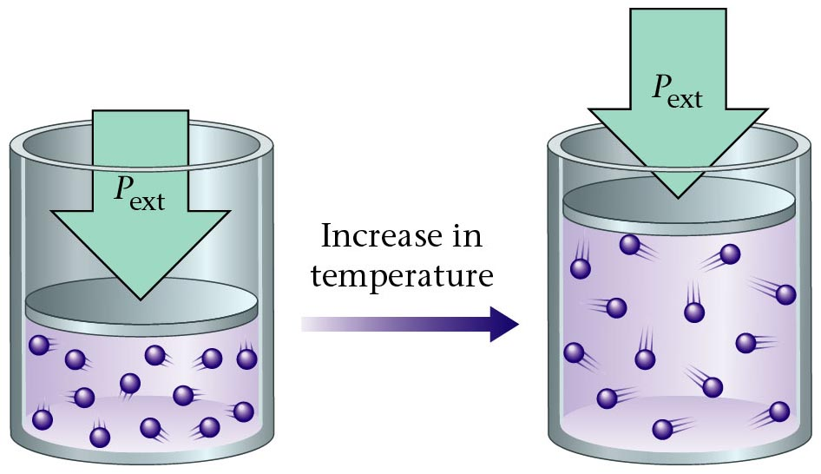
Charles' Law
Zumdahl, Zumdahl, DeCoste, World of Chemistry 2002, page 428

Slide 67
Temperature and Volume of a Gas
Charles’ Law
At constant pressure, by what fraction of its volume will a
quantity of gas change if the temperature changes from
0 ºC to 50 ºC?
1
273 K
X
323 K
T₁ = 0 ºC + 273 = 273 K
T₂ = 50 ºC + 273 = 323 K
V₁ = 1
V₂ = X
=
X = 323 / 273
V₁ = V₂
or 1.18 x larger
T₁ T₂

Slide 68
VT Calculation (Charles’ Law)
At constant pressure, the volume of a gas is increased from
150 dm³ to 300 dm³ by heating it. If the original temperature
of the gas was 20 ºC, what will its final temperature be (ºC)?
150 dm³
293 K
300 dm³
T₂
T₁ = 20 ºC + 273 = 293 K
T₂ = X K
V₁ = 150 dm³
V₂ = 300 dm³
=
T₂ = 586 K
ºC = 586 K - 273
T₂ = 313 ºC

Slide 69

Temperature and the Pressure of a Gas
High in mountains, Richard checked the pressure of his car tires and
observed that they has 202.5 kPa of pressure. That morning, the
temperature was -19 ºC. Richard then drove all day, traveling through the
desert in the afternoon. The temperature of the tires increased to 75 ºC
because of the hot roads. What was the new tire pressure? Assume the
volume remained constant. What is the percent increase in pressure?
P₁ = 202.5 kPa
P₂ = X kPa
T₁ = -19 ºC + 273 = 254 K
T₂ = 75 ºC + 273 = 348 K
202.5 kPa
254 K
P₂
348 K
=
P₂ = 277 kPa
% increase = 277 kPa - 202.5 kPa x 100 %
202.5 kPa
or 37% increase
Notes:
Image of tire: http://media.canada.com/6c8714d8-471c-4ede-8876-90dda09eae8f/increasepressuretrips.jpg Photograph by : CanWest News Service
Density of nitrogen gas = 1.251 g/L
Air’s density = 1.2 g/L

Slide 70
Gas Laws with One Term Constant
Gas Laws with One Term Constant
Gas Laws with One Term Constant
Keys
http://www.unit5.org/chemistry/GasLaws.html

Slide 71
Combined Gas Law

Slide 72
The Combined Gas Law
When measured at STP, a quantity of gas has a volume of 500 dm³. What volume will it occupy at 0 ºC and 93.3 kPa?
(101.3 kPa) x (500 dm³) = (93.3 kPa) x (V₂)
273 K
273 K
(101.3) x (500) = (93.3) x (V₂)
P₁ = 101.3 kPa
T₁ = 273 K
V₁ = 500 dm³
P₂ = 93.3 kPa
T₂ = 0 ºC + 273 = 273 K
V₂ = X dm³
V₂ = 542.9 dm³

Slide 73
The Combined Gas Law
When measured at STP, a quantity of gas has a volume of 500 dm³. What volume will it occupy at 0 ºC and 93.3 kPa?
P₁ x V₁
T₁
P₂ x V₂
T₂
(101.3 kPa) x (500 dm³) = (93.3 kPa) x (V₂)
=
273 K
273 K
P₁ = 101.3 kPa
T₁ = 273 K
V₁ = 500 dm³
P₂ = 93.3 kPa
T₂ = 0 ºC + 273 = 273 K
V₂ = X dm³
V₂ = 542.9 dm³

Slide 74
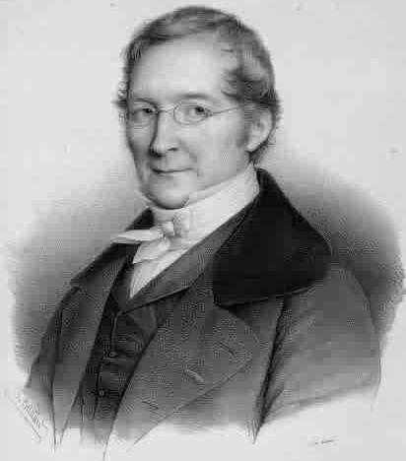
Gay-Lussac’s Law
Temperature (K) | Pressure (torr) | P/T (torr/K)
248 | 691.6 | 2.79
273 | 760.0 | 2.78
298 | 828.4 | 2.78
373 | 1,041.2 | 2.79
The pressure and absolute temperature (K) of a gas are directly related
  at constant mass & volume
P
T
Courtesy Christy Johannesson www.nisd.net/communicationsarts/pages/chem
Notes:
Joseph Louis Gay-Lussac (1788-1850, France) His experiments led him to propose in 1808 the Law of Combining Volumes, which states that the volume of gases involved in a chemical reaction are in a small whole number ratio.

Slide 75
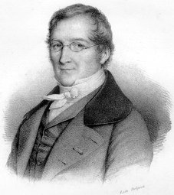
Gay-Lussac’s Law
The pressure and absolute temperature (K) of a gas are directly related
  at constant mass & volume
P
T
Courtesy Christy Johannesson www.nisd.net/communicationsarts/pages/chem

Slide 76
Combined Gas Law
P
T
V
T
PV
T
PV
= k
(COMBINED GAS LAW)
(Gay-Lussac’s LAW)
(CHARLES’ LAW)
(BOYLE’S LAW)
P₁V₁
T₁
P₂V₂
T₂
=
P₁V₁T₂ = P₂V₂T₁
Courtesy Christy Johannesson www.nisd.net/communicationsarts/pages/chem

Slide 77
The Combined Gas Law
The Combined Gas Law
V
T
P
The Combined Gas Law
Keys
http://www.unit5.org/chemistry/GasLaws.html

Slide 78
Gas Law Calculations
Boyle’s Law
PV = k
Charles’ Law
V
T
= k
P and V
change
n, R, T are
constant
Ideal
Gas Law
PV = nRT
T and V
change
P, n, R are
constant
P, V, and T change
n and R are constant
Combined
Gas Law
PV
T
= k

Slide 79
Ideal vs. Real Gases
No gas is ideal.
As the temperature of a gas increases and the
pressure on the gas decreases the gas acts
more ideally.

Slide 80
Real Gases Do Not Behave Ideally
CH₄
N₂
2.0
H₂
PV
nRT
CO₂
1.0
Ideal
gas
0
0
200
400
600
800
1000
P (atm)
Notes:
Postulates of the kinetic molecular theory of gases ignore both the volume occupied by the molecules of a gas and all interactions between molecules, whether attractive or repulsive.
• In reality, all gases have nonzero molecular volumes and the molecules of real gases interact with one another in ways that depend on the structure of the molecules and differ for each gaseous substance.
For an ideal gas, a plot of PV/nRT versus P gives a horizontal line with an intercept of 1 on the PV/nRT axis.
• Real gases show significant deviations from the behavior expected for an ideal gas, particularly at high pressures, but at low pressures (less than 1 atm) and at higher temperatures, real gases approximate ideal gas behavior.
Real gases behave differently from ideal gases at high pressures and low temperatures because the basic assumptions behind the ideal gas law — that gas molecules have negative volume and that intermolecular interactions are negligible — are no longer valid.
• Molecules of an ideal gas are assumed to have zero volume; volume available to them for motion is the same as the volume of the container.
Molecules of a real gas have small but measurable volumes.
– At low pressures, gaseous molecules are far apart.
– As pressure increases, intermolecular distances become smaller and smaller and the volume occupied by the molecules becomes significant compared with the volume of the container.
– Total volume occupied by gas is greater than the volume predicted by the ideal gas law, and at very high pressures, the experimentally measured value of PV/nRT is greater than the value predicted by the ideal gas law.
Molecules are attracted to one another by a combination of forces that are important for gases at low temperatures and high pressures where intermolecular distances are shorter.
– As the intermolecular distances decrease, the pressure exerted by the gas on the container wall decreases and the observed pressure is less than expected.
– At low temperatures, the ratio of PV/nRT is lower than predicted for an ideal gas.
– At high pressures, the effect of nonzero molecular volume predominates.
– At high temperatures, molecules have sufficient kinetic energy to overcome intermolecular attractive forces and the effects of nonzero molecular volume predominates.

Slide 81
Equation of State of an Ideal Gas
Robert Boyle (1662) found that at fixed temperature
  Pressure and volume of a gas is inversely proportional
    PV = constant Boyle’s Law
J. Charles and Gay-Lussac (circa 1800) found that
at fixed pressure
  Volume of gas is proportional to change in temperature
Volume
He
CH₄
H₂O
H₂
-273.15 ºC
Temp
All gases extrapolate to zero volume at a temperature
corresponding to –273.15 ºC (absolute zero).

Slide 82
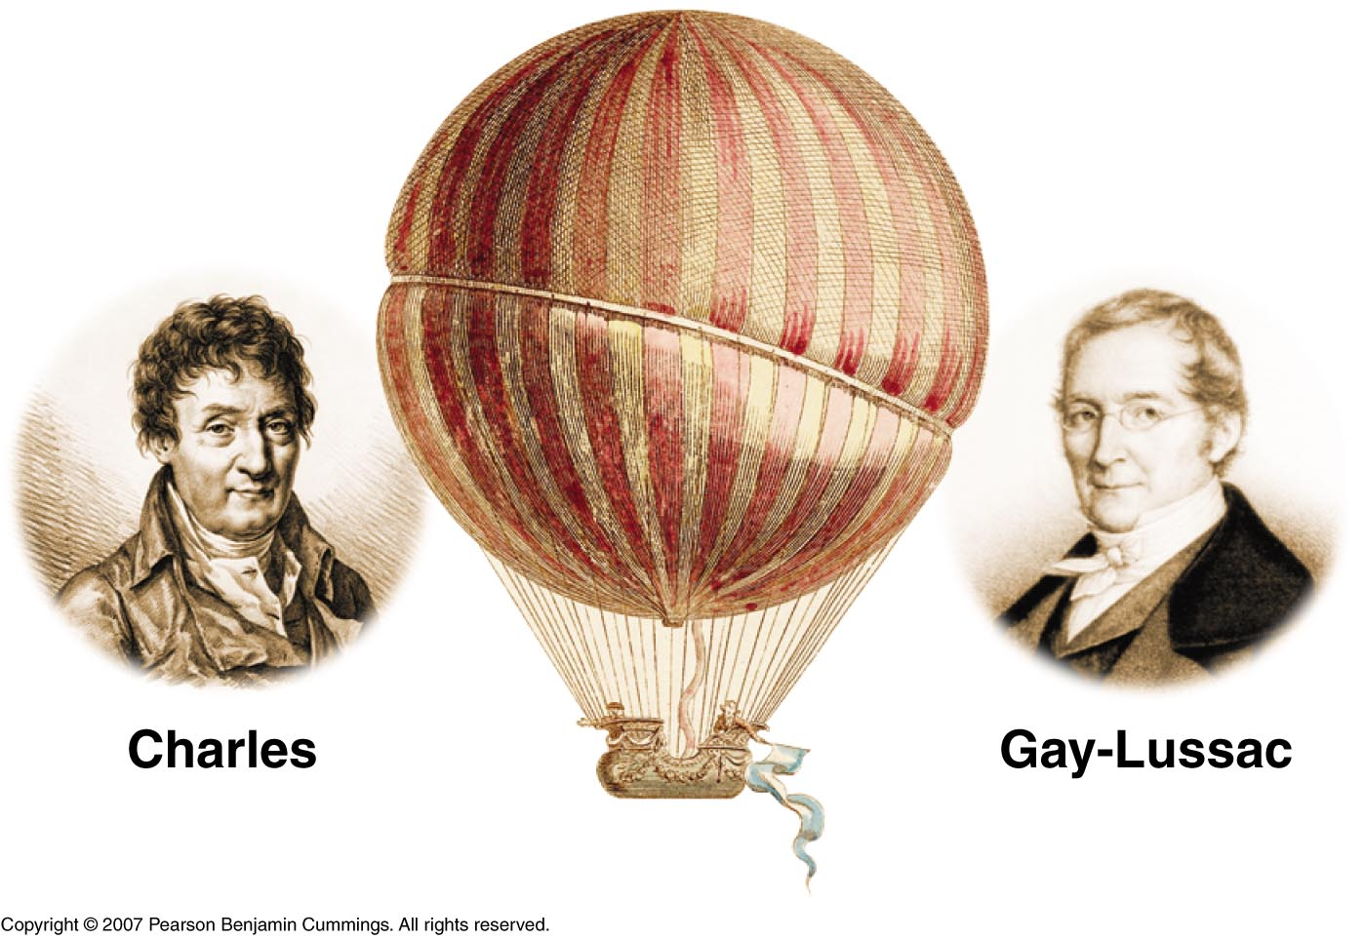
V₁ V₂
P₁ P₂
=
=
T₁ T₂
T₁ T₂
(Pressure is held constant)
(Volume is held constant)
Copyright © 2007 Pearson Benjamin Cummings. All rights reserved.
Notes:
GAY-LUSSAC -- SCIENTIST
Joseph Louis Gay-Lussac, by virtue of his skill and diligence as an experimentalist, and by his demonstration of the power of the scientific method, deserves recognition as a great scientist. Born on December 6, 1778, Joseph was the eldest of five children. His father, Antoine Gay, was a lawyer who, to distinguish himself from other people in the Limoges region with the last name of Gay, used the surname Gay-Lussac from the name of some family property near St Leonard(4) The French Revolution affected many of what were to become the French scientific elite. Gay-Lussac was sent to Paris at the age of fourteen when his father was arrested. After having had private lessons and attending a boarding school, the Ecole Polytechnique and the civil engineering school, Gay-Lussac became an assistant to Berthollet who was himself a co-worker of Lavoisier. Gay-Lussac thus got the chance to become part of the group of famous men who spent time at Berthollet's country house near Arcueil. Here among the Arcueil Society he received his training in chemical research(4).
With the encouragement of Berthollet and LaPlace, Gay-Lussac at the age of 24 conducted his first major research in the winter of 1801-1802. He settled some conflicting evidence about the expansion properties of different gases. By excluding water vapor from the apparatus and by making sure that the gases themselves were free of moisture, he obtained results that were more accurate than had been obtained previously by others. He concluded that equal volumes of all gases expand equally with the same increase in temperature. While Jacques Charles discovered this volume-temperature relationship fifteen years earlier, he had not published it. Unlike Gay-Lussac, Charles did not measure the coefficient of expansion. Also, because of the presence of water in the apparatus and the gases themselves, Charles obtained results that indicated unequal expansion for the gases that were water soluble(16,19).
Gay-Lussac, like his mentor Berthollet, was interested in how chemical reactions take place. Working with the mathematical physicist, LaPlace, Gay-Lussac made quantitative measurements on capillary action. The goal was to support LaPlace 's belief in his Newtonian theory of chemical affinity. In 1814 this theoretical bent continued as Gay-Lussac and LaPlace sought to determine if chemistry could be reduced to applied mathematics. The approach was to ask whether the conditions of chemical reactions could be reduced simply to, as LaPlace had suggested, considerations of heat(4).
As with his mentor before him, Gay-Lussac was consulted by industry and supported by the government. "Napoleonic science sharpened the appetites of young men by holding up the prospects of recognition and reward"(5). Gay-Lussac and Thenard, the laboratory boy turned professor, isolated the element boron nine days before Davy's group did (but Davy was the first to publish(1).) Gay-Lussac led his group into the isolation of plant alkaloids for potential medical use (8) and he was instrumental in developing the industrial production of oxalic acid from the fusion of sawdust with alkali.(17) His most important contribution to industry was, in 1827, the refinement of the lead chamber process for the production of sulfuric acid, the industrial chemical produced in largest volume in the world. The tall absorbtion towers were known as Gay-Lussac Towers. The process is:
SO2 (g) + NO2 (g) -------> SO3 (g) + NO (g) This reaction was carried out in a lead-lined chamber in which the sulfur trioxide was then dissolved in water to produce sulfuric acid. Gay-Lussac's contribution was a process for recycling the nitrogen monoxide after oxidizing it to NO2. Sulfuric acid was produced this way well into the twentieth century, when it was replaced by catalytic oxidation of SO2 in the "Contact Process".(13) While Gay-Lussac was a great theoretical scientist, he was also respected by his colleagues for his careful, elegant, experimental work. Wanting to know why and how something happened was important to Gay-Lussac, but he preferred knowing much about a limited subject rather than proposing broad new theories which might be wrong . He devised many new types of apparatus such as the portable barometer, an improved pipette and burette and, when working at the Mint, a new apparatus for quickly and accurately estimating the purity of silver which was the only legal measure in France until 1881(5). His work on iodine is considered a model of chemical research(16). His precise measurement of the thermal expansion of gases mentioned above was used by Lord Kelvin in the development of the absolute temperature scale and Third Law of Thermodynamics and by Clausius in the development of the Second Law(9). He and Thenard improved existing methods of elemental analysis and developed volumetric procedures for measuring acids and alkalis(16). His quantification of the effect of light on the reaction of chlorine with hydrogen elevated photochemistry from mere artifice into a theoretical science which culminated, fifty years after his death, in the quantum theory(10). An example of his dedication to meticulous experimenting is his decision to undertake a balloon flight to a record setting height of 23,000 feet to test an hypotheses on earth's magnetic field and the composition of the air(20).
The work for which Gay-Lussac is most remembered in high school and university courses of general chemistry is his Law of Combining Volumes: "The compounds of gaseous substances with each other are always formed in very simple ratios by volume"(11). If we follow the development of this law we can see the scientific method at work, in all its beauty and nobility, and with its pitfalls, resting as it does on the frailty of human nature.
Gay-Lussac began with a statement of intent: "I hope by this means to give proof of an idea advanced by several distinguished chemists--that we are perhaps not far removed from the time when we shall be able to submit the bulk of chemical formula to calculation"(11).
The events that culminated in the presentation of his memoir at Arcueil began with his balloon flight and measurements of the composition of the air. These studies led him to criticize a man ten years his elder--the scientist-explorer Alexander von Humbolt, who had also published measurements on the composition of the air. But in an illustration of the nobility of science, Humbolt, far from becoming angry with Gay-Lussac, saw that he had something to learn about precision in scientific research. The two became collaborators and friends and, in fact, eventually traveled together throughout Europe for a year in 1805, going to Rome, Switzerland and Berlin(3). Before that trip they worked on finding the ratio in which hydrogen and oxygen combine to form water. They needed this fact in order to find the percent of oxygen in the air. They came up with the remarkably accurate results of a volume ratio of 100 of oxygen to 200 of hydrogen.
What is surprising is that four years passed before Gay-Lussac published his now famous results. In the interim, during their trip together, he worked with Humbolt on measuring the earth's magnetic intensity. In 1807 he worked on a series of experiments to find out if there is a general relationship between the specific heats of gases and their densities(3).
Gay-Lussac looked at some previous data collected by Davy. This consisted of analysis of the proportions by weight of elements in three different oxides of nitrogen, as follows:
Proportions by WeightNitrogenOxygenNitrous oxide63.3036.70Nitrous gas44.0555.95Nitric Acid29.5070.50
Next Gay-Lussac "reduces these proportions to volumes", using the specific gravities of the gases relative to hydrogen:
Proportions by VolumeNitrogenOxygenNitrous oxide10049.5Nitrous gas100108.9Nitric acid100204.7
Now he can accept (by what today we call the 5% rule) that "the first and last of these proportions differ only slightly from 100:50 and 100:200" (11), but he recognizes that the second is significantly different from 100:100. He also knew that Berthollet had obtained the proportions by volume of H and N in ammonia, while Gay-Lussac, himself, had obtained those of sulfurous gas and oxygen in sulfuric acid and that these are indeed simple whole numbers. So he does an analytical experiment. He reacts 100 volumes of nitrous gas with "the new combustible substance from potash"(11) (presumably potassium) and he finds that the volume of the gas decreases by 50% and the remnant is all nitrogen. The reaction presumably is:
4K (s) + 2NO (g) -------> 2K2O + N2 He can now write: Proportions by VolumeNitrogenOxygenNitrous oxide10050Nitrous gas100100Nitric acid100200
In modern terms these three compounds are N2O, NO, and NO2. So Gay-Lussac has used the scientific method: Question, Hypothesis, Experiment (including careful measurement, reproducibility, independent observations in other laboratories) to devise an explanation of how gases combine--the resulting Law of Combining Volumes was announced at a meeting of the Societe Philomatique in Paris on December 31, 1808. As Crosland writes in his article in the Dictionary of Scientific Biography, "For Gay-Lussac, himself, the law provided a vindication of his belief in regularities in the physical world, which it was the business of the scientist to discover". Crosland adds that "These neat ratios do not, however, correspond exactly to his experimental results. He deduced his law from a few fairly clear cases... and glossed over discrepancies in some of the others. The simple reaction between hydrogen and chlorine, which is often used today as an elementary illustration of the law, was not discovered until 1809 and was included only as a footnote when this memoir was printed". Now comes the pitfall; not Gay-Lussac's at first but John Dalton's. In the second part of his "New System of Chemical Philosophy" Dalton criticized the accuracy of Gay-Lussac's measurements, experiments and generalizations. This was ironic since Dalton was more speculator than experimentalist, sometimes accepting large standard deviations, as in the case of the atomic weight of sulfur, for which he accepted values ranging from 12 to 22 based on his own experiments. Nevertheless, he had the gall to claim that the ratio of volumes of H and O in water was 1:1.97 which, he said, was not a simple whole number ratio, thereby invalidating Gay-Lussac's Law. Thus he was unable to "admit the French doctrine" as he called it(7).
It is instructive to trace Dalton's thought processes. In a paper read before the Literary and Philosophical Society in Manchester in 1802 (before the Law of Combining Volumes) Dalton stated that: "The particles of one gas are not elastic or repulsive to the particles of another gas but only to the particles of their own kind." In his New System of Chemical Philosophy, Part I (in 1808 after Gay-Lussac's Law), he set out a number of rules for combinations of atoms: "When only one combination of two bodies can be obtained, it must be presumed to be a binary one, unless some cause appear to the contrary" (6). Consequently, hydrogen peroxide not yet having been discovered (it was isolated by Thenard in 1818(16)), Dalton was forced to conclude that the formula of water was HO. Although others of his contemporaries, including Berzelius and Avogadro were quite comfortable with Gay-Lussac's Law and used it to their advantage, Dalton stubbornly rejected it. Like atoms could not stick together. They would repel each other as like charges do. Furthermore, atoms combined in simple proportions by weight according to Dalton's Law of Multiple Proportions, and Dalton could not see how the same proportions could apply to combining volumes(12). Avogadro had the answer: equal volumes of gases at the same temperature and pressure contain the same number of particles. To the latter, who had used electricity extensively in his studies of the halogens, it must have seemed preposterous to believe that gases such as oxygen, hydrogen and chlorine could be diatomic in nature. Two like atoms and two like charges were bound to repel each other; even though a cornerstone of Avogadro's work was the production of two volumes of HCl from one each of hydrogen and chlorine. So Avogadro's work was consigned to obscurity for fifty years, until his compatriot, Cannizzaro brought it to light in a pamphlet distributed at the end of the Karlsruhe Conference in December 1860(7) after Gay-Lussac, Berzelius and Dalton were dead.
In the end Dalton did bow under the weight of the evidence and accept the Law of Combining Volumes. But neither he nor Gay-Lussac nor Berzelius ever accepted Avogadro's Law; not even when Gaudin in 1833 clearly showed how it could be applied to explain the formation of water(15), not even with the background of Cavendish eudiometer experiments(14).
The stubborn blindness of Dalton and Berzelius and Gay-Lussac is a clear example of a common pitfall in the practice of science. Roger Bacon might have recognized it as the third "Cause of Error": popular prejudice(2), but it also has elements of Bacon's first cause of error, namely, submission to faulty and unworthy authority. We see that science has the pitfalls of human frailty as well as beauty and nobility.
References
1. Asimov, I., The Search for the Elements, Fawcett World Library, N.Y. 1962, pp.64 -- 65. 2. Bacon, R., Opus Majus, 1266, trans. Burke, R.B., Univ. Pennsylvania Press, Philadelphia, PA , 1928, p.4.
3. Crosland, M.P., Gay-Lussac, Gillispie, C.C., ed., Dictionary of Scientific Biography, Scribner, N.Y.,N.Y., 1972, p. 319.
4. Crosland, M. P. , Gay - Lussac: Scientist and Bourgeois. Cambridge University Press, Cambridge, England, 1978, p. 48 -- 50.
5. Ibid... p. 258 -- 260.
6. Dalton, John., A New System of Chemical Philosophy, Part 1, Bickerstaff, London, England, excerpted in ref.18 , pp. 768 -- 780.
7. Farber, E., The Evolution of Chemistry, Ronald Press, N.Y. 1952, pp. 130 -- 133.
8. Ibid ... p.162.
9. Ibid ... p. 206 & p. 222.
10. Ibid ... p. 227.
11. Gay Lussac, J.L., Mem. de la Soc. d'Arcuel, 1809, translation reprinted in ref. 19, pp. 804 -- 818.
12. Mason, S.F., A Short History of the Sciences, Macmillan, N.Y., N.Y., 1956, pp. 453 -- 454.
13. Oxtoby, D.W. and Nachtrieb, N.H., Principles of Modern Chemistry, Saunders, N.Y., 1986, p. 697.
14. Partington, J.R., A Short History of Chemistry, Dover, N.Y., N.Y., 1989,. pp. 138 -- 139.
15. Ibid... p. 210.
16. Ibid ... p. 223.
17. Ibid ... 226.
18. Schwartz, G. and Bishop, P.W., (ed.) The Development of Modern Science, Vol. 1, Basic Books, N.Y., N.Y., 1958.
19. Schwartz, G. and Bishop, P.W., (ed.) The Development of Modern Science, Vol. 2, Basic Books, N.Y., N.Y., 1958.
20. Ibid ... p. 22.
http://www.woodrow.org/teachers/chemistry/institutes/1992/Gay-Lussac.html

Slide 83
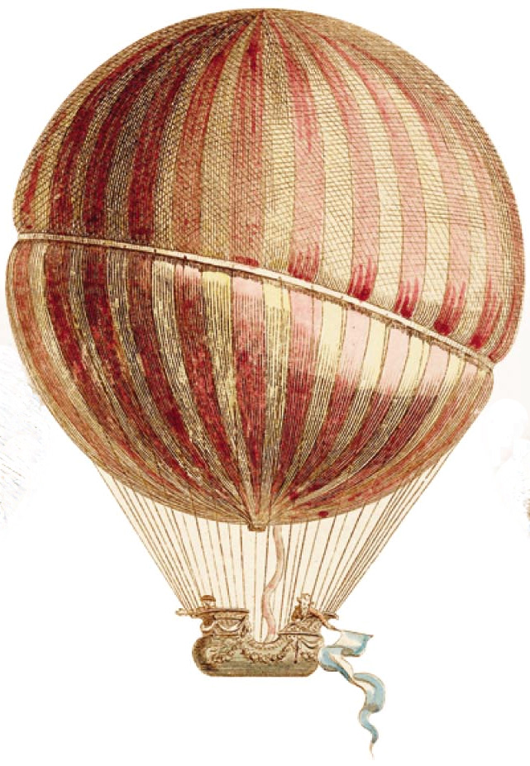
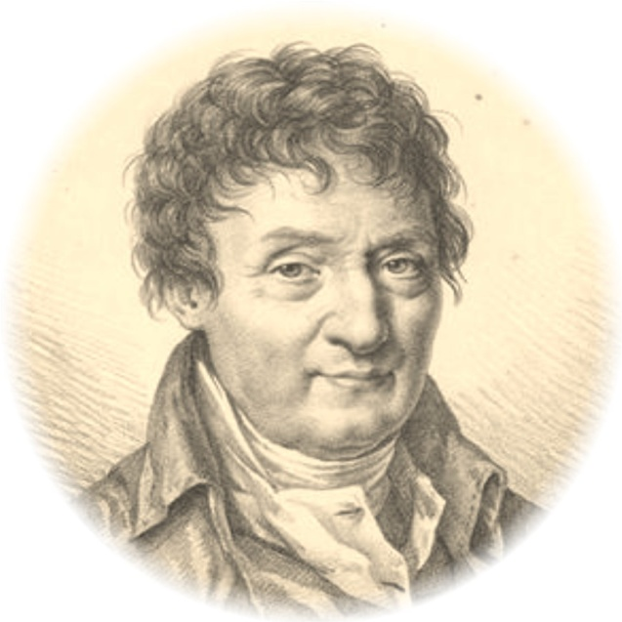
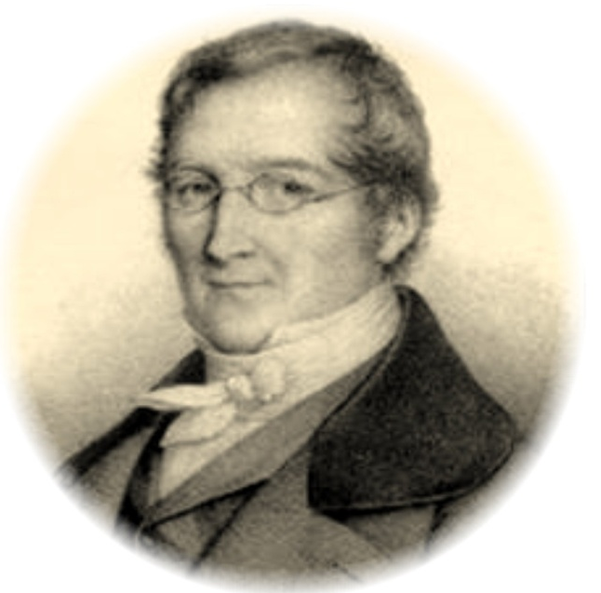
Charles
Gay-Lussac
V₁ V₂
P₁ P₂
=
=
T₁ T₂
T₁ T₂
(Pressure is held constant)
(Volume is held constant)
Copyright © 2007 Pearson Benjamin Cummings. All rights reserved.
Notes:
GAY-LUSSAC -- SCIENTIST
Joseph Louis Gay-Lussac, by virtue of his skill and diligence as an experimentalist, and by his demonstration of the power of the scientific method, deserves recognition as a great scientist. Born on December 6, 1778, Joseph was the eldest of five children. His father, Antoine Gay, was a lawyer who, to distinguish himself from other people in the Limoges region with the last name of Gay, used the surname Gay-Lussac from the name of some family property near St Leonard(4) The French Revolution affected many of what were to become the French scientific elite. Gay-Lussac was sent to Paris at the age of fourteen when his father was arrested. After having had private lessons and attending a boarding school, the Ecole Polytechnique and the civil engineering school, Gay-Lussac became an assistant to Berthollet who was himself a co-worker of Lavoisier. Gay-Lussac thus got the chance to become part of the group of famous men who spent time at Berthollet's country house near Arcueil. Here among the Arcueil Society he received his training in chemical research(4).
With the encouragement of Berthollet and LaPlace, Gay-Lussac at the age of 24 conducted his first major research in the winter of 1801-1802. He settled some conflicting evidence about the expansion properties of different gases. By excluding water vapor from the apparatus and by making sure that the gases themselves were free of moisture, he obtained results that were more accurate than had been obtained previously by others. He concluded that equal volumes of all gases expand equally with the same increase in temperature. While Jacques Charles discovered this volume-temperature relationship fifteen years earlier, he had not published it. Unlike Gay-Lussac, Charles did not measure the coefficient of expansion. Also, because of the presence of water in the apparatus and the gases themselves, Charles obtained results that indicated unequal expansion for the gases that were water soluble(16,19).
Gay-Lussac, like his mentor Berthollet, was interested in how chemical reactions take place. Working with the mathematical physicist, LaPlace, Gay-Lussac made quantitative measurements on capillary action. The goal was to support LaPlace 's belief in his Newtonian theory of chemical affinity. In 1814 this theoretical bent continued as Gay-Lussac and LaPlace sought to determine if chemistry could be reduced to applied mathematics. The approach was to ask whether the conditions of chemical reactions could be reduced simply to, as LaPlace had suggested, considerations of heat(4).
As with his mentor before him, Gay-Lussac was consulted by industry and supported by the government. "Napoleonic science sharpened the appetites of young men by holding up the prospects of recognition and reward"(5). Gay-Lussac and Thenard, the laboratory boy turned professor, isolated the element boron nine days before Davy's group did (but Davy was the first to publish(1).) Gay-Lussac led his group into the isolation of plant alkaloids for potential medical use (8) and he was instrumental in developing the industrial production of oxalic acid from the fusion of sawdust with alkali.(17) His most important contribution to industry was, in 1827, the refinement of the lead chamber process for the production of sulfuric acid, the industrial chemical produced in largest volume in the world. The tall absorbtion towers were known as Gay-Lussac Towers. The process is:
SO2 (g) + NO2 (g) -------> SO3 (g) + NO (g) This reaction was carried out in a lead-lined chamber in which the sulfur trioxide was then dissolved in water to produce sulfuric acid. Gay-Lussac's contribution was a process for recycling the nitrogen monoxide after oxidizing it to NO2. Sulfuric acid was produced this way well into the twentieth century, when it was replaced by catalytic oxidation of SO2 in the "Contact Process".(13) While Gay-Lussac was a great theoretical scientist, he was also respected by his colleagues for his careful, elegant, experimental work. Wanting to know why and how something happened was important to Gay-Lussac, but he preferred knowing much about a limited subject rather than proposing broad new theories which might be wrong . He devised many new types of apparatus such as the portable barometer, an improved pipette and burette and, when working at the Mint, a new apparatus for quickly and accurately estimating the purity of silver which was the only legal measure in France until 1881(5). His work on iodine is considered a model of chemical research(16). His precise measurement of the thermal expansion of gases mentioned above was used by Lord Kelvin in the development of the absolute temperature scale and Third Law of Thermodynamics and by Clausius in the development of the Second Law(9). He and Thenard improved existing methods of elemental analysis and developed volumetric procedures for measuring acids and alkalis(16). His quantification of the effect of light on the reaction of chlorine with hydrogen elevated photochemistry from mere artifice into a theoretical science which culminated, fifty years after his death, in the quantum theory(10). An example of his dedication to meticulous experimenting is his decision to undertake a balloon flight to a record setting height of 23,000 feet to test an hypotheses on earth's magnetic field and the composition of the air(20).
The work for which Gay-Lussac is most remembered in high school and university courses of general chemistry is his Law of Combining Volumes: "The compounds of gaseous substances with each other are always formed in very simple ratios by volume"(11). If we follow the development of this law we can see the scientific method at work, in all its beauty and nobility, and with its pitfalls, resting as it does on the frailty of human nature.
Gay-Lussac began with a statement of intent: "I hope by this means to give proof of an idea advanced by several distinguished chemists--that we are perhaps not far removed from the time when we shall be able to submit the bulk of chemical formula to calculation"(11).
The events that culminated in the presentation of his memoir at Arcueil began with his balloon flight and measurements of the composition of the air. These studies led him to criticize a man ten years his elder--the scientist-explorer Alexander von Humbolt, who had also published measurements on the composition of the air. But in an illustration of the nobility of science, Humbolt, far from becoming angry with Gay-Lussac, saw that he had something to learn about precision in scientific research. The two became collaborators and friends and, in fact, eventually traveled together throughout Europe for a year in 1805, going to Rome, Switzerland and Berlin(3). Before that trip they worked on finding the ratio in which hydrogen and oxygen combine to form water. They needed this fact in order to find the percent of oxygen in the air. They came up with the remarkably accurate results of a volume ratio of 100 of oxygen to 200 of hydrogen.
What is surprising is that four years passed before Gay-Lussac published his now famous results. In the interim, during their trip together, he worked with Humbolt on measuring the earth's magnetic intensity. In 1807 he worked on a series of experiments to find out if there is a general relationship between the specific heats of gases and their densities(3).
Gay-Lussac looked at some previous data collected by Davy. This consisted of analysis of the proportions by weight of elements in three different oxides of nitrogen, as follows:
Proportions by WeightNitrogenOxygenNitrous oxide63.3036.70Nitrous gas44.0555.95Nitric Acid29.5070.50
Next Gay-Lussac "reduces these proportions to volumes", using the specific gravities of the gases relative to hydrogen:
Proportions by VolumeNitrogenOxygenNitrous oxide10049.5Nitrous gas100108.9Nitric acid100204.7
Now he can accept (by what today we call the 5% rule) that "the first and last of these proportions differ only slightly from 100:50 and 100:200" (11), but he recognizes that the second is significantly different from 100:100. He also knew that Berthollet had obtained the proportions by volume of H and N in ammonia, while Gay-Lussac, himself, had obtained those of sulfurous gas and oxygen in sulfuric acid and that these are indeed simple whole numbers. So he does an analytical experiment. He reacts 100 volumes of nitrous gas with "the new combustible substance from potash"(11) (presumably potassium) and he finds that the volume of the gas decreases by 50% and the remnant is all nitrogen. The reaction presumably is:
4K (s) + 2NO (g) -------> 2K2O + N2 He can now write: Proportions by VolumeNitrogenOxygenNitrous oxide10050Nitrous gas100100Nitric acid100200
In modern terms these three compounds are N2O, NO, and NO2. So Gay-Lussac has used the scientific method: Question, Hypothesis, Experiment (including careful measurement, reproducibility, independent observations in other laboratories) to devise an explanation of how gases combine--the resulting Law of Combining Volumes was announced at a meeting of the Societe Philomatique in Paris on December 31, 1808. As Crosland writes in his article in the Dictionary of Scientific Biography, "For Gay-Lussac, himself, the law provided a vindication of his belief in regularities in the physical world, which it was the business of the scientist to discover". Crosland adds that "These neat ratios do not, however, correspond exactly to his experimental results. He deduced his law from a few fairly clear cases... and glossed over discrepancies in some of the others. The simple reaction between hydrogen and chlorine, which is often used today as an elementary illustration of the law, was not discovered until 1809 and was included only as a footnote when this memoir was printed". Now comes the pitfall; not Gay-Lussac's at first but John Dalton's. In the second part of his "New System of Chemical Philosophy" Dalton criticized the accuracy of Gay-Lussac's measurements, experiments and generalizations. This was ironic since Dalton was more speculator than experimentalist, sometimes accepting large standard deviations, as in the case of the atomic weight of sulfur, for which he accepted values ranging from 12 to 22 based on his own experiments. Nevertheless, he had the gall to claim that the ratio of volumes of H and O in water was 1:1.97 which, he said, was not a simple whole number ratio, thereby invalidating Gay-Lussac's Law. Thus he was unable to "admit the French doctrine" as he called it(7).
It is instructive to trace Dalton's thought processes. In a paper read before the Literary and Philosophical Society in Manchester in 1802 (before the Law of Combining Volumes) Dalton stated that: "The particles of one gas are not elastic or repulsive to the particles of another gas but only to the particles of their own kind." In his New System of Chemical Philosophy, Part I (in 1808 after Gay-Lussac's Law), he set out a number of rules for combinations of atoms: "When only one combination of two bodies can be obtained, it must be presumed to be a binary one, unless some cause appear to the contrary" (6). Consequently, hydrogen peroxide not yet having been discovered (it was isolated by Thenard in 1818(16)), Dalton was forced to conclude that the formula of water was HO. Although others of his contemporaries, including Berzelius and Avogadro were quite comfortable with Gay-Lussac's Law and used it to their advantage, Dalton stubbornly rejected it. Like atoms could not stick together. They would repel each other as like charges do. Furthermore, atoms combined in simple proportions by weight according to Dalton's Law of Multiple Proportions, and Dalton could not see how the same proportions could apply to combining volumes(12). Avogadro had the answer: equal volumes of gases at the same temperature and pressure contain the same number of particles. To the latter, who had used electricity extensively in his studies of the halogens, it must have seemed preposterous to believe that gases such as oxygen, hydrogen and chlorine could be diatomic in nature. Two like atoms and two like charges were bound to repel each other; even though a cornerstone of Avogadro's work was the production of two volumes of HCl from one each of hydrogen and chlorine. So Avogadro's work was consigned to obscurity for fifty years, until his compatriot, Cannizzaro brought it to light in a pamphlet distributed at the end of the Karlsruhe Conference in December 1860(7) after Gay-Lussac, Berzelius and Dalton were dead.
In the end Dalton did bow under the weight of the evidence and accept the Law of Combining Volumes. But neither he nor Gay-Lussac nor Berzelius ever accepted Avogadro's Law; not even when Gaudin in 1833 clearly showed how it could be applied to explain the formation of water(15), not even with the background of Cavendish eudiometer experiments(14).
The stubborn blindness of Dalton and Berzelius and Gay-Lussac is a clear example of a common pitfall in the practice of science. Roger Bacon might have recognized it as the third "Cause of Error": popular prejudice(2), but it also has elements of Bacon's first cause of error, namely, submission to faulty and unworthy authority. We see that science has the pitfalls of human frailty as well as beauty and nobility.
References
1. Asimov, I., The Search for the Elements, Fawcett World Library, N.Y. 1962, pp.64 -- 65. 2. Bacon, R., Opus Majus, 1266, trans. Burke, R.B., Univ. Pennsylvania Press, Philadelphia, PA , 1928, p.4.
3. Crosland, M.P., Gay-Lussac, Gillispie, C.C., ed., Dictionary of Scientific Biography, Scribner, N.Y.,N.Y., 1972, p. 319.
4. Crosland, M. P. , Gay - Lussac: Scientist and Bourgeois. Cambridge University Press, Cambridge, England, 1978, p. 48 -- 50.
5. Ibid... p. 258 -- 260.
6. Dalton, John., A New System of Chemical Philosophy, Part 1, Bickerstaff, London, England, excerpted in ref.18 , pp. 768 -- 780.
7. Farber, E., The Evolution of Chemistry, Ronald Press, N.Y. 1952, pp. 130 -- 133.
8. Ibid ... p.162.
9. Ibid ... p. 206 & p. 222.
10. Ibid ... p. 227.
11. Gay Lussac, J.L., Mem. de la Soc. d'Arcuel, 1809, translation reprinted in ref. 19, pp. 804 -- 818.
12. Mason, S.F., A Short History of the Sciences, Macmillan, N.Y., N.Y., 1956, pp. 453 -- 454.
13. Oxtoby, D.W. and Nachtrieb, N.H., Principles of Modern Chemistry, Saunders, N.Y., 1986, p. 697.
14. Partington, J.R., A Short History of Chemistry, Dover, N.Y., N.Y., 1989,. pp. 138 -- 139.
15. Ibid... p. 210.
16. Ibid ... p. 223.
17. Ibid ... 226.
18. Schwartz, G. and Bishop, P.W., (ed.) The Development of Modern Science, Vol. 1, Basic Books, N.Y., N.Y., 1958.
19. Schwartz, G. and Bishop, P.W., (ed.) The Development of Modern Science, Vol. 2, Basic Books, N.Y., N.Y., 1958.
20. Ibid ... p. 22.
http://www.woodrow.org/teachers/chemistry/institutes/1992/Gay-Lussac.html

Slide 84
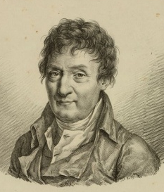
Kelvin Temperature Scale
Kelvin temperature (K) is given by
K = ºC + 273.15
where K is the temperature in Kelvin, ºC is temperature in Celcius
Using the ABSOLUTE scale, it is now possible to write Charles’ Law as
V / T = constant Charles’ Law
Gay-Lussac also showed that at fixed volume
P / T = constant
Combining Boyle’s law, Charles’ law, and Gay-Lussac’s law, we have
P V / T = constant
Charles
Gay-Lussac

Slide 85
Dalton’s Law of
Partial Pressures
Notes:
John Dalton (1766 - 1844)

Slide 86
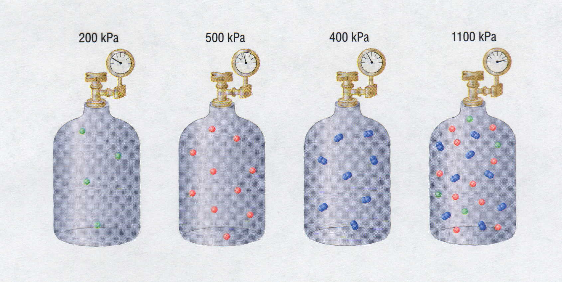
Partial Pressures
200 kPa
500 kPa
400 kPa
? kPa
+
+
=
1100 kPa
Notes:
PARTIAL PRESSURES
Dalton’s law of partial pressures states that the sum of the partial pressures of gases sum to the total pressure of the gases when combined.
The ideal gas law assumes that all gases behave identically and that their behavior is independent of attractive and repulsive forces.
If the volume and temperature are held constant, the ideal gas equation can be arranged to show that the pressure of a sample of gas is directly proportional to the number of moles of gas present:
P = n(RT/V) = n(constant)
Nothing in the equation depends on the nature of the gas, only on the quantity.
The total pressure exerted by a mixture of gases at a given temperature and volume is the sum of the pressures exerted by each of the gases alone.
If the volume, temperature, and number of moles of each gas in a mixture is known, then the pressure exerted by each gas individually, which is its partial pressure, can be calculated.
Partial pressure is the pressure the gas would exert if it were the only one present (at the same temperature and volume).
The total pressure exerted by a mixture of gases is the sum of the partial pressures of component gases.
This law is known as Dalton’s law of partial pressures and can be written mathematically as
P_{t} = P₁ + P₂ + P₃ - - - + P_{i}
where P_{t} is the total pressure and the other terms are the partial pressures of the individual gases.
For a mixture of two ideal gases, A and B, the expression for the total pressure can be written as
P_{t} = P_{A} + P_{B} = n_{A}(RT/V) + n_{B}(RT/V) = (n_{A} + n_{B}) (RT/V).
• More generally, for a mixture of i components, the total pressure is given by
P_{t} = (n₁ + n₂ + n₃ + - - - +n_{i}) (RT/V).
• The above equation makes it clear that, at constant temperature and volume, the pressure exerted by a gas depends on only the total number of moles of gas present, whether the gas is a single chemical species or a mixture of gaseous species.

Slide 87

Dalton’s Law of Partial Pressures
& Air Pressure
8 mm Hg
P
590 mm Hg
Ar
P
P
P
P
P
P
N₂
Total
= + + +
O₂
N₂
CO₂
Ar
149 mm Hg
P
P
149 590 3 8 mm Hg
O₂
Total
= + + +
3 mm Hg
P
P_{Total} = 750 mm Hg
CO₂
EARTH

Slide 88
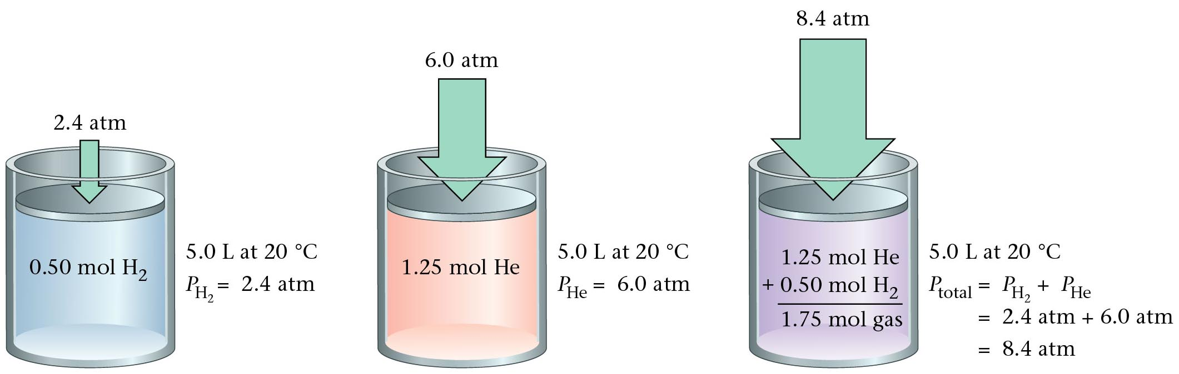
Dalton’s Partial Pressures
Zumdahl, Zumdahl, DeCoste, World of Chemistry 2002, page 421

Slide 89
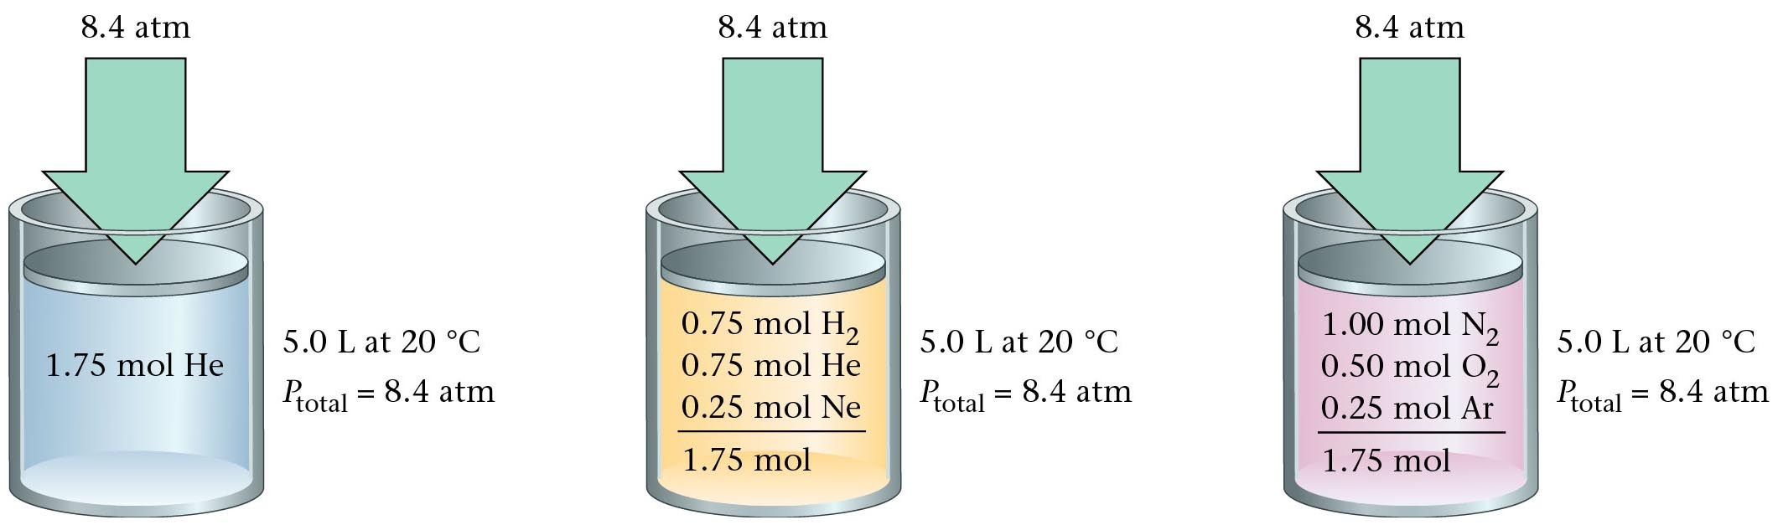
Dalton’s Law
Zumdahl, Zumdahl, DeCoste, World of Chemistry 2002, page 422

Slide 90
Dalton’s Law Applied
Suppose you are given four containers – three filled with noble gases.
The first 1 L container is filled with argon and exerts a pressure of 2 atm.
The second 3 liter container is filled with krypton and has a pressure of
380 mm Hg. The third 0.5 L container is filled with xenon and has a
pressure of 607.8 kPa. If all these gases were transferred into an empty
2 L container…what would be the pressure in the “new” container?
What would the pressure of argon be if transferred to 2 L container?
P_{T} = P_{Ar} + P_{Kr} + P_{Xe}
P₁ x V₁ = P₂ x V₂
P_{T} = P_{Ar} + P_{Kr} + P_{Xe}
P_{T} = 2 + 0.5 + 6
(2 atm) (1L) = (X atm) (2L)
P_{T} = 2 + 380 + 607.8
P_{T} = 8.5 atm
P_{Ar} = 1 atm
P_{T} = 989.8
P_{total} = ?
P_{Ar} = 2 atm
P_{Kr} = 380 mm Hg
P_{Kr} = 0.5 atm
P_{xe}
6 atm
P_{xe}
607.8 kPa
V = 1 liter V = 2 liters
V = 3 liters V = 0.5 liter

Slide 91
…just add them up
P_{total} = ?
P_{Ar} = 2 atm
P_{Kr} = 380 mm Hg
P_{Kr} = 0.5 atm
P_{xe}
6 atm
P_{xe}
607.8 kPa
V = 1 liter V = 3 liters V = 0.5 liter V = 2 liters
Dalton’s Law of Partial Pressures
“Total Pressure = Sum of the Partial Pressures”
P_{T} = P_{Ar} + P_{Kr} + P_{Xe} + …
P₁ x V₁ = P₂ x V₂
P₁ x V₁ = P₂ x V₂
(0.5 atm) (3L) = (X atm) (2L)
(6 atm) (0.5 L) = (X atm) (2L)
P_{Kr} = 0.75 atm
P_{xe} = 1.5 atm
P_{T} = 1 atm + 0.75 atm + 1.5 atm
P_{T} = 3.25 atm

Slide 92
Dalton’s Law of Partial Pressures
In a gaseous mixture, a gas’s partial pressure is the one the gas would exert
if it were by itself in the container.
The mole ratio in a mixture of gases determines each gas’s partial pressure.
Total pressure of mixture (3.0 mol He and 4.0 mol Ne) is 97.4 kPa.
Find partial pressure of each gas
3 mol He
7 mol gas
P_{He} =
?
(97.4 kPa)
=
41.7 kPa
4 mol Ne
7 mol gas
P_{Ne} =
?
(97.4 kPa)
=
55.7 kPa

Slide 93
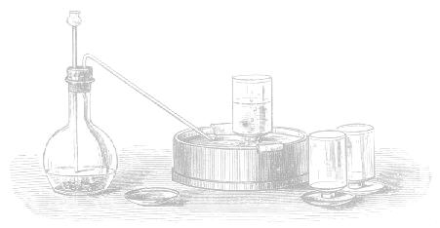
Dalton’s Law:
the total pressure exerted by a mixture of
gases is the sum of all the partial pressures
P_{Z} = P_{A,Z} + P_{B,Z} + …

Slide 94
80.0 g each of He, Ne, and Ar are in a container.
The total pressure is 780 mm Hg.
Find each gas’s partial pressure.
P_{He} = ²⁰/₂₆
of total
Total:
26 mol gas
P_{Ne} = ⁴/₂₆
of total
P_{Ar} = ²/₂₆
of total

Slide 95
Dalton’s Law: P_{Z} = P_{A,Z} + P_{B,Z} + …
Two 1.0 L containers, A and B, contain gases under 2.0 and 4.0 atm, respectively.
Both gases are forced into Container B. Find total pres. of mixture in B.
A
B
 | P_{X} | V_{X} | V_{Z} | P_{X,Z}
A | 2.0 atm | 1.0 L |  | 2.0 atm
B | 4.0 atm | 1.0 L |  | 4.0 atm
1.0 L
Total = 6.0 atm

Slide 96
Two 1.0 L containers, A and B, contain gases under 2.0 and 4.0 atm, respectively.
Both gases are forced into Container Z (^{w}/vol. 2.0 L). Find total pres. of mixture in Z.
A
B
Z
 | P_{X} | V_{X} | V_{Z} | P_{X,Z}
A
B
P_{A}V_{A} = P_{Z}V_{Z}
2.0 atm
1.0 L
1.0 atm
2.0 atm (1.0 L) = X atm (2.0 L)
2.0 L
X = 1.0 atm
4.0 atm
1.0 L
2.0 atm
P_{B}V_{B} = P_{Z}V_{Z}
4.0 atm (1.0 L) = X atm (2.0 L)
Total = 3.0 atm

Slide 97
Find total pressure of mixture in Container Z.
A
B
C
Z
1.3 L 2.6 L 3.8 L 2.3 L
3.2 atm 1.4 atm 2.7 atm X atm
 | P_{X} | V_{X} | V_{Z} | P_{X,Z}
A
B
C
P_{A}V_{A} = P_{Z}V_{Z}
3.2 atm (1.3 L) = X atm (2.3 L)
3.2 atm
1.3 L
1.8 atm
X = 1.8 atm
P_{B}V_{B} = P_{Z}V_{Z}
1.4 atm
2.6 L
2.3 L
1.6 atm
1.4 atm (2.6 L) = X atm (2.3 L)
2.7 atm
3.8 L
4.5 atm
P_{C}V_{C} = P_{Z}V_{Z}
2.7 atm (3.8 L) = X atm (2.3 L)
Total = 7.9 atm
Notes:
Example of Dalton’s law of partial pressures. Must use Boyle’s law to account for new volume each gas is contained in.

Slide 98
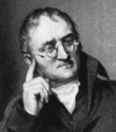
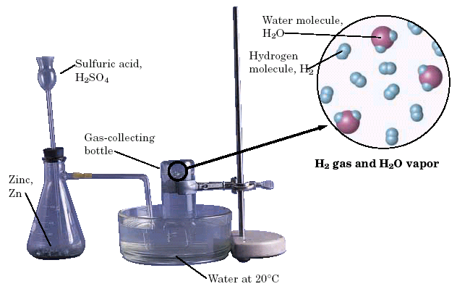
Dalton’s Law
The total pressure of a mixture of gases equals the sum of the partial pressures of the individual gases.
P_{total} = P₁ + P₂ + ...
When a H₂ gas is collected by water displacement, the gas in the collection bottle is actually a mixture of H₂ and water vapor.
Courtesy Christy Johannesson www.nisd.net/communicationsarts/pages/chem

Slide 99
Dalton’s Law
Hydrogen gas is collected over water at 22.5°C. Find the pressure of the dry gas if the atmospheric pressure is 94.4 kPa.
The total pressure in the collection bottle is equal to atmospheric pressure and is a mixture of H₂ and water vapor.
GIVEN:
P_{H2} = ?
P_{total} = 94.4 kPa
P_{H2O} = 2.72 kPa
WORK:
P_{total} = P_{H2} + P_{H2O}
94.4 kPa = P_{H2} + 2.72 kPa
P_{H2} = 91.7 kPa
Look up water-vapor pressure on p.899 for 22.5°C.
Sig Figs: Round to least number of decimal places.
Courtesy Christy Johannesson www.nisd.net/communicationsarts/pages/chem

Slide 100
Dalton’s Law
A gas is collected over water at a temp of 35.0°C when the barometric pressure is 742.0 torr. What is the partial pressure of the dry gas?
The total pressure in the collection bottle is equal to barometric pressure and is a mixture of the “gas” and water vapor.
GIVEN:
P_{gas} = ?
P_{total} = 742.0 torr
P_{H2O} = 42.2 torr
WORK:
P_{total} = P_{gas} + P_{H2O}
742.0 torr = P_{H2} + 42.2 torr
P_{gas} = 699.8 torr
Look up water-vapor pressure on p.899 for 35.0°C.
Sig Figs: Round to least number of decimal places.
Courtesy Christy Johannesson www.nisd.net/communicationsarts/pages/chem

Slide 101
Dalton's Law of Partial Pressures
Dalton's Law of Partial Pressures
Dalton's Law of Partial Pressures
Keys
http://www.unit5.org/chemistry/GasLaws.html

Slide 102
Dalton’s Law of Partial Pressures
Container A (with volume 1.23 dm³) contains a gas under 3.24 atm of pressure. Container B (with volume 0.93 dm³) contains a gas under 2.82 atm of pressure. Container C (with volume 1.42 dm³) contains a gas under 1.21 atm of pressure. If all of these gases are put into Container D (with volume 1.51 dm³), what is the pressure in Container D?
P_{x}
V_{x}
P_{D}
V_{D}
1.51 dm³
A
3.24 atm
1.23 dm³
2.64 atm
1.51 dm³
B
2.82 atm
0.93 dm³
1.74 atm
1.51 dm³
C
1.21 atm
1.42 dm³
1.14 atm
1.51 dm³
P_{T} = P_{A} + P_{B} + P_{C}
TOTAL
5.52 atm
(P_{A})(V_{A}) = (P_{D})(V_{D})
(P_{B})(V_{B}) = (P_{D})(V_{D})
(P_{C})(V_{A}) = (P_{D})(V_{D})
(3.24 atm)(1.23 dm³) = (x atm)(1.51 dm³)
(2.82 atm)(0.93 dm³) = (x atm)(1.51 dm³)
(1.21 atm)(1.42 dm³) = (x atm)(1.51 dm³)
(P_{A}) = 2.64 atm
(P_{B}) = 1.74 atm
(P_{C}) = 1.14 atm

Slide 103
Dalton’s Law of Partial Pressures
Container A (with volume 150 mL) contains a gas under an unknown pressure. Container B (with volume 250 mL) contains a gas under 628 mm Hg of pressure. Container C (with volume 350 mL) contains a gas under 437 mm Hg of pressure. If all of these gases are put into Container D (with volume 300 mL), giving it 1439 mm Hg of pressure, find the original pressure of the gas in Container A.
P_{x}
V_{x}
P_{D}
V_{D}
STEP 4)
STEP 3)
300 mL
A
P_{A}
150 mL
406 mm Hg
300 mL
STEP 2)
B
628 mm Hg
250 mL
523 mm Hg
300 mL
STEP 1)
C
437 mm Hg
350 mL
510 mm Hg
300 mL
TOTAL
P_{T} = P_{A} + P_{B} + P_{C}
1439 mm Hg
STEP 1)
(P_{C})(V_{C}) = (P_{D})(V_{D})
STEP 2)
(P_{B})(V_{B}) = (P_{D})(V_{D})
STEP 3)
1439
-510
-523
406 mm Hg
STEP 4)
(P_{A})(V_{A}) = (P_{D})(V_{D})
(437)(350) = (x)(300)
(628)(250) = (x)(300)
(P_{A})(150 mL) = (406 mm Hg)(300 mL)
(P_{C}) = 510 mm Hg
(P_{B}) = 523 mm Hg
812 mm Hg
(P_{A}) = 812 mm Hg

Slide 104
Table of Partial Pressures of Water
Vapor Pressure of Water
Temperature Pressure
Temperature Pressure
Temperature Pressure
(ºC) (kPa)
0 0.6
5 0.9
8 1.1
10 1.2
12 1.4
14 1.6
16 1.8
18 2.1
20 2.3
(ºC) (kPa)
21 2.5
22 2.6
23 2.8
24 3.0
25 3.2
26 3.4
27 3.6
28 3.8
29 4.0
(ºC) (kPa)
30 4.2
35 5.6
40 7.4
50 12.3
60 19.9
70 31.2
80 47.3
90 70.1
100 101.3

Slide 105
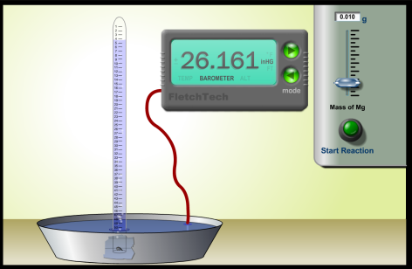
Reaction of Mg with HCl
Reaction of Magnesium with Hydrochloric Acid
Reaction of Magnesium with Hydrochloric Acid
Simulation – JAVA applet by Mr. Fletcher (CHEMFILES.COM)
Keys
http://www.unit5.org/chemistry/GasLaws.html

Slide 106
Mole Fraction
χ
The ratio of the number of moles of a given component in a mixture to the total number of moles in the mixture.

Slide 107
The partial pressure of oxygen was observed to be 156 torr in air with total atmospheric pressure of 743 torr. Calculate the mole fraction of O₂ present.

Slide 108
The mole fraction of nitrogen in the air is 0.7808. Calculate the partial pressure of N₂ in air when the atmospheric pressure is 760. torr.
0.7808 X 760. torr = 593 torr

Slide 109
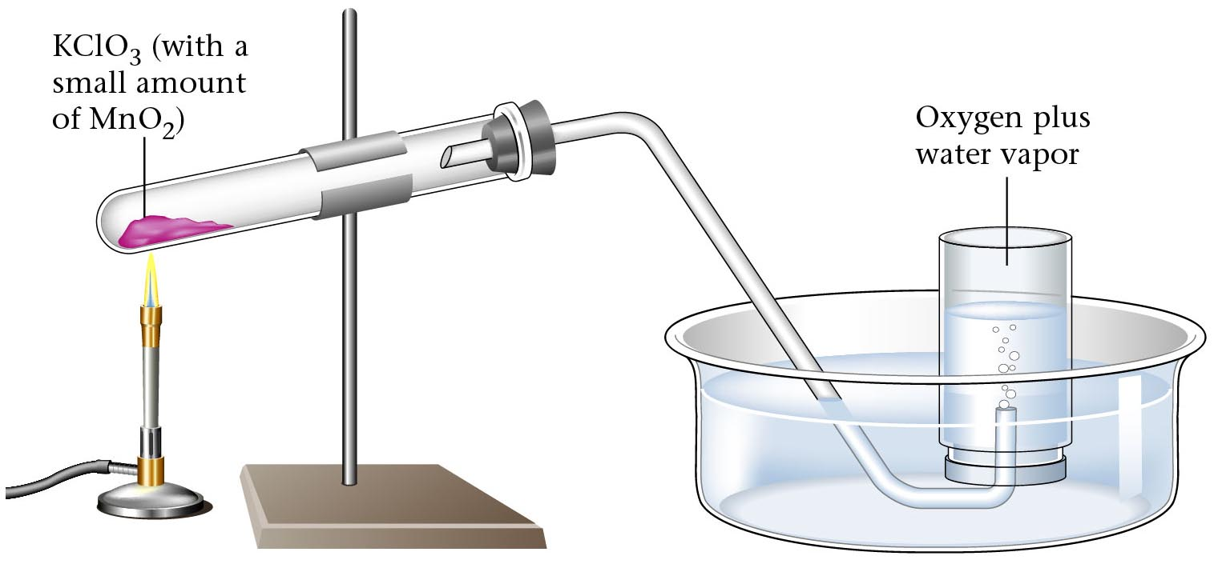
The production of oxygen by thermal decomposition
KClO₃ (with a
small amount
of MnO₂)
Oxygen plus
water vapor
Zumdahl, Zumdahl, DeCoste, World of Chemistry 2002, page 423

Slide 110
The Gas Laws

Slide 111
Gas Law Calculations
Boyle’s Law
Bernoulli’s
Principle
Avogadro’s Law
P₁V₁ = P₂V₂
Fast moving fluids…
create low pressure
Add or remove gas
Manometer
Charles’ Law
Combined
Ideal
Gas Law
PV = nRT
V₁ = V₂
T₁ = T₂
P₁V₁ = P₂V₂
Big = small + height
T₁ = T₂
Gay-Lussac
Graham’s Law
P₁ = P₂
Density
T₁ = T₂
P₁ = P₂
diffusion vs. effusion
T₁D₁ = T₂D₂
Dalton’s Law
Partial Pressures
P_{T} = P_{A} + P_{B}
1 atm = 760 mm Hg = 101.3 kPa
R = 0.0821 L atm / mol K
Notes:
Any set of relationships between a single quantity (such as V) and several other variables (P, T, n) can be combined into a single expression that describes all the relationships simultaneously.
The following three expressions
V ∝ 1/P (at constant n, T)
V ∝ T ( at constant n, P)
V ∝ n (at constant T, P)
can be combined to give
V ∝ nT or V = constant (nT/P)
• The proportionality constant is called the gas constant, represented by the letter R.
• Inserting R into an equation gives V = RnT = nRT
P P
Multiplying both sides by P gives the following equation, which is known as the ideal gas law:
PV = nRT
• An ideal gas is defined as a hypothetical gaseous substance whose behavior is independent of attractive and repulsive forces and can be completely described by the ideal gas law.
• The form of the gas constant depends on the units used for the other quantities in the expression — if V is expressed in liters (L), P in atmospheres (atm), T in kelvins (K), and n in moles (mol), then
R = 0.082057 (L•atm)/(K•mol).
• R can also have units of J/(K•mol) or cal/(K•mol).
A particular set of conditions were chosen to use as a reference; 0ºC (273.15 K) and 1 atm pressure are referred to as standard temperature and pressure (STP).
The volume of 1 mol of an ideal gas under standard conditions can be calculated using the variant of the ideal gas law:
V = nRT = (1 mol) [0.082057 (L•atm)/(K•mol)] (273.15 K) = 22.41 L
P 1 atm
• The volume of 1 mol of an ideal gas at 0ºC and 1 atm pressure is 22.41 L, called the standard molar volume of an ideal gas.
• The relationships described as Boyle’s, Charles’s, and Avogadro’s laws are simply special cases of the ideal gas law in which two of the four parameters (P, V, T, n) are held fixed.

Slide 112
History of Science
Gas Laws
Gay-Lussac’s law
Dalton announces
his atomic theory
Avagadro’s particle
Number theory
Boyle’s law
Charles’s law
1650
1700
1750
1800
1850
Mogul empire in India
(1526-1707)
Constitution of the United States signed
U.S. Congress bans
importation of slaves
United States Bill of Rights ratified
Latin American countries gain independence
(1791- 1824)
Napoleon is emperor(1804- 12)
Haiti declares independence
Herron, Frank, Sarquis, Sarquis, Schrader, Kulka, Chemistry, Heath Publishing,1996, page 220

Slide 113
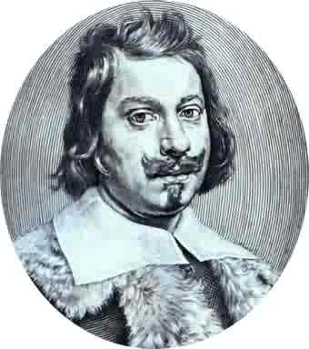
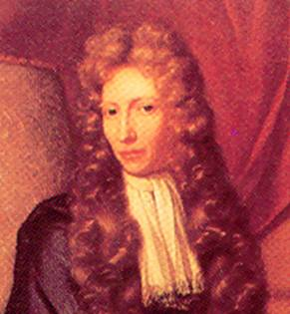


Scientists
Evangelista Torricelli (1608-1647)
  Published first scientific explanation of a vacuum.
  Invented mercury barometer.
Robert Boyle (1627- 1691)
  Volume inversely related to pressure (temperature remains constant)
Jacques Charles (1746 -1823)
  Volume directly related to temperature (pressure remains constant)
Joseph Gay-Lussac (1778-1850)
  Pressure directly related to temperature (volume remains constant)

Slide 114
Apply the Gas Law
The pressure shown on a tire gauge doubles as twice the volume of air is added at the same temperature.
A balloon over the mouth of a bottle containing air begins to inflate as it stands in the sunlight.
An automobile piston compresses gases.
An inflated raft gets softer when some of the gas is allowed to escape.
A balloon placed in the freezer decreases in size.
A hot air balloon takes off when burners heat the air under its open end.
When you squeeze an inflated balloon, it seems to push back harder.
A tank of helium gas will fill hundreds of balloons.
Model: When red, blue, and white ping-pong balls are shaken in a box, the effect is the same as if an equal number of red balls were in the box.
Avogadro’s principle
Charles’ law
Boyle’s law
Avogadro’s principle
Charles’ law
Charles’ law
Boyle’s law
Boyle’s law
Dalton’s law

Slide 115
Gas Law Problems
A gas occupies 473 cm³ at 36°C. Find its volume at 94°C.
CHARLES’ LAW
GIVEN:
V₁ = 473 cm³
T₁ = 36°C = 309 K
V₂ = ?
T₂ = 94°C = 367 K
T↑
V↑
WORK:
P₁V₁T₂ = P₂V₂T₁
(473 cm³)(367 K)=V₂(309 K)
V₂ = 562 cm³
Courtesy Christy Johannesson www.nisd.net/communicationsarts/pages/chem

Slide 116
Gas Law Problems
A gas occupies 100. mL at 150. kPa. Find its volume at 200. kPa.
BOYLE’S LAW
GIVEN:
V₁ = 100. mL
P₁ = 150. kPa
V₂ = ?
P₂ = 200. kPa
P↑
V↓
WORK:
P₁V₁T₂ = P₂V₂T₁
(150.kPa)(100.mL)=(200.kPa)V₂
V₂ = 75.0 mL
Courtesy Christy Johannesson www.nisd.net/communicationsarts/pages/chem

Slide 117
Gas Law Problems
A gas occupies 7.84 cm³ at 71.8 kPa & 25°C. Find its volume at STP.
COMBINED GAS LAW
P↑ T↓
V↓
GIVEN:
V₁ = 7.84 cm³
P₁ = 71.8 kPa
T₁ = 25°C = 298 K
V₂ = ?
P₂ = 101.325 kPa
T₂ = 273 K
WORK:
P₁V₁T₂ = P₂V₂T₁
(71.8 kPa)(7.84 cm³)(273 K)
=(101.325 kPa) V₂ (298 K)
V₂ = 5.09 cm³
Courtesy Christy Johannesson www.nisd.net/communicationsarts/pages/chem

Slide 118
Gas Law Problems
A gas’ pressure is 765 torr at 23°C. At what temperature will the pressure be 560. torr?
GAY-LUSSAC’S LAW
GIVEN:
P₁ = 765 torr
T₁ = 23°C = 296K
P₂ = 560. torr
T₂ = ?
P↓
T↓
WORK:
P₁V₁T₂ = P₂V₂T₁
(765 torr)T₂ = (560. torr)(309K)
T₂ = 226 K = -47°C
Courtesy Christy Johannesson www.nisd.net/communicationsarts/pages/chem

Slide 119
The Combined Gas Law
(This “gas law” comes from “combining” Boyle’s, Charles’, and Gay-Lussac’s law)
P = pressure (any unit will work)
V = volume (any unit will work)
T = temperature (must be in Kelvin)
1 = initial conditions
2 = final conditions

Slide 120
A gas has volume of 4.2 L at 110 kPa.
If temperature is constant, find pressure of gas when
the volume changes to 11.3 L.
P₁V₁ P₂V₂
P₁V₁ P₂V₂
=
=
(temperature is constant)
T₁ T₂
110 kPa (4.2 L) = P₂ (11.3 L)
(substitute into equation)
P₂ = 40.9 kPa

Slide 121
Original temp. and vol. of gas are 150ºC and 300 dm³. Final vol. is 100 dm³.
Find final temp. in ºC, assuming constant pressure.
T₁ = 150ºC
+ 273 = 423 K
P₁V₁ P₂V₂
V₁ V₂
300 dm³ 100 dm³
=
=
=
T₁ T₂
T₁ T₂
423 K T₂
Cross-multiply and divide
300 dm³ (T₂) = 423 K (100 dm³)
T₂ = 141 K
- 132ºC
K - 273 = ºC

Slide 122
A sample of methane occupies 126 cm³ at -75ºC and 985 mm Hg.
Find its volume at STP.
T₁ = -75ºC
+ 273 = 198 K
P₁V₁ P₂V₂
985 mm Hg (126 cm³) 760 mm Hg (V₂)
=
=
T₁ T₂
198 K 273 K
Cross-multiply and divide:
985 (126) (273) = 198 (760) V₂
V₂ = 225 cm³

Slide 123
Density of Gases
Density formula for any substance:
For a sample of gas, mass is constant, but pres. and/or temp.
changes cause gas’s vol. to change. Thus, its density will change, too.
ORIG. VOL.
NEW VOL.
ORIG. VOL.
NEW VOL.
If V (due to P or T ), then… D
If V (due to P or T ), then… D
Density of Gases Equation:
** As always, T’s must be in K.
Notes:
The ideal gas law can be used to calculate molar masses of gases from experimentally measured gas densities.
Rearrange the ideal gas law to obtain
n = P
V RT
The left side has the units of moles per unit volume, mol/L.
The number of moles of a substance equals its mass (in grams) divided by its molar mass (M, in grams per mole):
n (in moles) = m (in grams)
M (in grams/mole)
Substituting this expression for n in the preceding equation gives
m = P
MV RT
Because m/V is the density d of a substance, m/V can be replaced by d and the equation rearranged to give
d = PM
RT
The distance between molecules in gases is large compared to the size of the molecules, so their densities are much lower than the densities of liquids and solids.
Gas density is usually measured in grams per liter (g/L) rather than grams per milliliter (g/mL).

Slide 124
Density of Gases
Density formula for any substance:
For a sample of gas, mass is constant, but pres. and/or temp.
changes cause gas’s vol. to change. Thus, its density will change, too.
Because mass is constant, any
value can be put into the equation:
lets use 1 g for mass.
For gas #1:
Take reciprocal of both sides:
Substitute into equation
“new” values for V₁ and V₂
For gas #2:

Slide 125
A sample of gas has density 0.0021 g/cm³ at –18ºC and 812 mm Hg.
Find density at 113ºC and 548 mm Hg.
T₁ = –18ºC
+ 273 = 255 K
T₂ = 113ºC
+ 273 = 386 K
P₁ P₂
812 mm Hg 548 mm Hg
=
=
T₁D₁ T₂D₂
255 K (0.0021 g/cm³) 386 K (D₂)
Cross multiply and divide (drop units)
812 (386)(D₂) = 255 (0.0021)(548)
D₂ = 9.4 x 10^{–4} g/cm³

Slide 126
A gas has density 0.87 g/L at 30ºC and 131.2 kPa.
Find density at STP.
T₁ = 30ºC
+ 273 = 303 K
P₁ P₂
131.2 kPa 101.3 kPa
=
=
T₁D₁ T₂D₂
303 K (0.87 g/L) 273 K (D₂)
Cross multiply and divide (drop units)
131.2 (273)(D₂) = 303 (0.87)(101.3)
D₂ = 0.75 g/L

Slide 127
Find density of argon at STP.
m
V
39.9 g
22.4 L
D =
=
1.78 ^{g}/_{L}
1 mole of Ar = 39.9 g Ar = 6.02 x 10²³ atoms Ar = 22.4 L @ STP

Slide 128
Find density of nitrogen dioxide at 75ºC and 0.805 atm.
D of NO₂ @ STP…
T₂ = 75ºC + 273 = 348 K
1 (348) (D₂) = 273 (2.05) (0.805) → D₂ = 1.29 g/L

Slide 129
A gas has mass 154 g and density 1.25 g/L at 53ºC and 0.85 atm.
What vol. does sample occupy at STP?
Find D at STP.
T₁ = 53ºC + 273 = 326 K
0.85 (273) (D₂) = 326 (1.25) (1) → D₂ = 1.756 g/L
Find vol. when gas has that density.

Slide 130
Density and the Ideal Gas Law
Combining the formula for density with the Ideal
Gas law, substituting and rearranging algebraically:
M = Molar Mass
P = Pressure
R = Gas Constant
T = Temperature in Kelvin
Notes:
The ideal gas law can be used to calculate molar masses of gases from experimentally measured gas densities.
Rearrange the ideal gas law to obtain
n = P
V RT
The left side has the units of moles per unit volume, mol/L.
The number of moles of a substance equals its mass (in grams) divided by its molar mass (M, in grams per mole):
n (in moles) = m (in grams)
M (in grams/mole)
Substituting this expression for n in the preceding equation gives
m = P
MV RT
Because m/V is the density d of a substance, m/V can be replaced by d and the equation rearranged to give
d = PM
RT
The distance between molecules in gases is large compared to the size of the molecules, so their densities are much lower than the densities of liquids and solids.
Gas density is usually measured in grams per liter (g/L) rather than grams per milliliter (g/mL).

Slide 131
Density of Gases
Density of Gases
Table
Density of Gases
Table
Keys
http://www.unit5.org/chemistry/GasLaws.html

Slide 132
Diffusion

Slide 133
Pinhole
Gas
Vacuum

Slide 134
Pinhole
Gas
Vacuum

Slide 135


Diffusion vs. Effusion
Diffusion - The tendency of the molecules of a given substance to move from regions of higher concentration to regions of lower concentration
Examples: A scent spreading throughout a room
or people entering a theme park
Effusion - The process by which gas particles under pressure pass through a tiny hole
Examples: Air slowly leaking out of a tire or
helium leaking out of a balloon
Notes:
Diffusion is the gradual mixing of gases due to the motion of their component particles even in the absence of mechanical agitation such as stirring.
Result is a gas mixture with uniform composition
The rate of diffusion of a gaseous substance is inversely proportional to the square root of its molar mass (rate ∝ 1/ √M) and is referred to as Graham’s law.
• The ratio of the diffusion rates of two gases is the square root of the inverse ratio of their molar masses.
If r is the diffusion rate and M is the molar mass, then
r₁/r₂ = √ M₂/M₁
• If M₁ < M₂, then gas #1 will diffuse more rapidly than gas #2.
Effusion is the escape of a gas through a small (usually microscopic) opening into an evacuated space.
• Rates of effusion of gases are inversely proportional to the square root of their molar masses.
• Heavy molecules effuse through a porous material more slowly than light molecules.

Slide 136
Graham’s Law
Diffusion
  Spreading of gas molecules throughout a container until evenly distributed.
    e.g. perfume bottle spills
Effusion
  Passing of gas molecules through a tiny opening in a container
    e.g. helium gas leaks out of a balloon
Courtesy Christy Johannesson www.nisd.net/communicationsarts/pages/chem

Slide 137
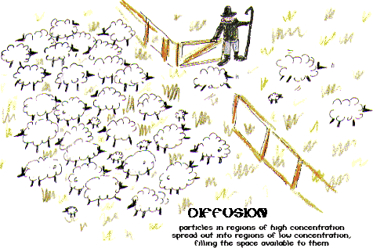
Effusion
Particles in regions of high concentration
spread out into regions of low concentration,
filling the space available to them.

Slide 138
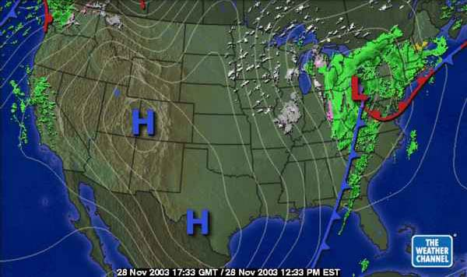
Weather & Air Pressure
HIGH pressure = good weather
LOW pressure = bad weather
Notes:
http://www.challengers101.com/images/Pressure27.jpg

Slide 139


Weather and Diffusion
LOW
Air Pressure
HIGH
Air Pressure
Map showing tornado risk in the U.S.
Highest
High

Slide 140

Hurricane Bonnie, Atlantic Ocean
STS-47

Slide 141

Hurricane Wilma
October 19, 2005
88.2 kPa in eye
Notes:
NOAA Satellite and Information Service

Slide 142

To use Graham’s Law, both gases must be at same temperature.
diffusion: particle movement from
high to low concentration
NET MOVEMENT
effusion: diffusion of gas particles
through an opening
For gases, rates of diffusion & effusion obey Graham’s law:
more massive = slow; less massive = fast
Notes:
http://images.google.com/imgres?imgurl=http://www.indiana.edu/~phys215/lecture/lecnotes/lecgraphics/diffusion2.gif&imgrefurl=http://www.indiana.edu/~phys215/lecture/lecnotes/diff.html&h=480&w=640&sz=622&hl=en&start=1&tbnid=-d6cgg2umyDy0M:&tbnh=103&tbnw=137&prev=/images%3Fq%3Ddiffusion%26gbv%3D2%26hl%3Den

Slide 143
Graham’s Law of Diffusion

Slide 144
Graham’s Law
Speed of diffusion/effusion
  Kinetic energy is determined by the temperature of the gas.
  At the same temp & KE, heavier molecules move more slowly.
    Larger m ⇒ smaller v
KE = ½mv²
Courtesy Christy Johannesson www.nisd.net/communicationsarts/pages/chem
Notes:
Graham’s law states that the ratio of the rates of diffusion or effusion of two gases is the square root of the inverse ratio of their molar masses.
– Relationship is based on the postulate that all gases at the same temperature have the same average kinetic energy
• The expression for the average kinetic energy of two gases with different molar masses is
KE = ½M₁υ²_{rms1} = ½M₂υ²_{rms2}.
Multiplying both sides by 2 and rearranging gives
υ²_{rms2} = M₁.
υ²_{rms1} M₂
Taking the square root of both sides gives
υ_{rms2}/υ_{rms1} = √ M₁/M₂ .
• Thus the rate at which a molecule diffuses or effuses is directly related to the speed at which it moves.
Gaseous molecules have a speed of hundreds of meters per second (hundreds of miles per hour).
• The effect of molar mass on these speeds is dramatic.
• Molecules with lower masses have a wider distribution of speeds.
• Postulates of the kinetic molecular theory lead to the following equation, which directly relates molar mass, temperature, and rms speed:
υ_{rms} = √ 3RT/M
υ_{rms} has units of m/s, the units of molar mass M are kg/mol, temperature T is expressed in K, and the ideal gas constant R has the value 8.3144 J/(K•mol).
• The average distance traveled by a molecule between collisions is the mean free path; the denser the gas, the shorter the mean free path.
• As density decreases, the mean free path becomes longer because collisions occur less frequently.

Slide 145
Derivation of Graham’s Law
The average kinetic energy of gas molecules depends on the temperature:
where m is the mass and v is the speed
Consider two gases:

Slide 146
Graham’s Law
Consider two gases at same temp.
Gas 1: KE₁ = ½ m₁ v₁²
Gas 2: KE₂ = ½ m₂ v₂²
Since temp. is same, then… KE₁ = KE₂
½ m₁ v₁² = ½ m₂ v₂²
m₁ v₁² = m₂ v₂²
Divide both sides by m₁ v₂²…
Take square root of both sides to get Graham’s Law:

Slide 147
On average, carbon dioxide travels at 410 m/s at 25ºC.
Find the average speed of chlorine at 25ºC.
**Hint: Put whatever you’re looking for in the numerator.

Slide 148
At a certain temperature fluorine gas travels at 582 m/s
and a noble gas travels at 394 m/s.
What is the noble gas?

Slide 149
CH₄ moves 1.58 times faster than which noble gas?
Governing relation:

Slide 150
HCl and NH₃ are released at same time from opposite ends
of 1.20 m horizontal tube. Where do gases meet?
HCl
NH₃
1.20 m
Velocities are relative; pick easy #s:
DISTANCE = RATE x TIME
So HCl dist. = 1.000 m/s (0.487 s) = 0.487 m

Slide 151

Graham’s Law
Consider two gases at same temp.
Gas 1: KE₁ = ½ m₁ v₁²
Gas 2: KE₂ = ½ m₂ v₂²
Since temp. is same, then… KE₁ = KE₂
½ m₁ v₁² = ½ m₂ v₂²
m₁ v₁² = m₂ v₂²
Divide both sides by m₁ v₂²…
“mouse in the house”
Take square root of both sides to get Graham’s Law:

Slide 152

Gas Diffusion and Effusion
Graham's law
governs effusion and
diffusion of gas molecules.
Rate of effusion is inversely
proportional to its molar mass.
Thomas Graham
(1805 - 1869)
Notes:
THOMAS GRAHAM
Thomas Graham was born in Glasgow, Scotland, on December 21, 1805. His father was a prosperous manufacturer who wanted his son to become a minister of the Church of Scotland. Graham entered the University of Glasgow in 1819 at the age of 14. While there, he was strongly influenced by the chemistry lectures of Thomas Thomson to enter the field. After receiving his M.A. at Glasgow in 1826, he worked for two years with Thomas Charles Hope at the University of Edinburgh. He then returned to Glasgow, where he privately taught mathematics and chemistry for one year. In 1829, he became an assistant at a school to teach workingmen science and then in 1830 he became a professor of chemistry at Anderson's College (later the Royal College of Science and Technology) in Glasgow.
In 1834 Graham became a fellow of the Royal Society and three years later moved to London to become professor of chemistry at the recently founded University College (now a part the University of London). In 1841 he helped to found the Chemical Society of London, which was the first national chemistry society setting an example for the formation of similar societies in France (1857), Germany (1867), and the United States (1876). Graham became the first president of the Chemical Society of London. In 1844 with the death of Dalton, Graham was generally acnowledged to be the leading chemist in England. He remained at the University College for 20 years until 1854, when he was appointed master of the mint (a post that Newton had occupied and that ceased to exist at Graham's death.) He remained there until his death on September 16, 1869.
Graham never really overcame a certain nervousness and hesitancy. However, this did not seem to affect his ability as a teacher since he made up for these deficiencies by being conscientious, organized, logical, and accurate. When he became master of the mint, it was generally expected that he would treat the position as a sinecure, but Graham took the position so seriously that he stopped all his research for several years while he organized the operation of the mint. For his work Graham received several awards including the Royal Medal of the Royal Society twice (1837 and 1863), the Copley Medal of the Royal Society (1862), and the Prix Jecker of the Paris Academy of Sciences (1862). In addition his textbook, Elements of Chemistry, was widely used in both England and in Europe.
Scientific Work
Graham's work mainly can be described now as being physical chemistry. However, his interests were extremely varied and included the following:
diffusion of gases (Graham's law)
the absorption of gases by charcoal
solubility of gases
colloids and emulsions
phosphorus compounds including phosphine and inorganic phosphates
the aurora borealis
the absorption of hydrogen gas by palladium metal
the determination of the formulas of the three phosphoric acids
the adulteration of coffee (in an article in the Journal of the Chemical Society of London in 1857 titled " Report on the Mode of Detecting Vegetable Substances mixed with coffee for the Purpose of Adulteration"
the production of alcohol during bread-making (enough for Graham to burn and ignite gunpowder.)
His three major areas of contribution are in the diffusion of gases, colloid chemistry (Graham is often considered the father of colloid chemistry), and the determination of the formulas of the PxOy polyatomic ions. In addition, Graham's work with the absorption of hydrogen gas by palladium metal has taken on more significance in light of the cold fusion controversy.
Graham's interest in gases developed at a very early age and continued throughout his life. As a university student of fourteen, he once asked his professor Thomas Thomson, " Don't you think, Doctor, that when liquids absorb gases the gases themselves become liquids?" It was suggested by colleagues of Graham that this remark so impressed the usually irascible Thomson that he was very solicitous of Graham for the rest of his life.
Graham's first experiment with gases dealt with the diffusion of different gases into the atmosphere. Gases were arranged separately in a cylindrical container with a tube opening to the atmosphere. The tube was bent in a right angle, with the tip pointing up or down depending on whether the gas was more or less dense than air. After several hours to allow for diffusion, the cylinder was placed in a pneumatic trough and water was allowed to enter to replace the gas that had diffused out. In this way Graham could measure how much of a particular gas diffused out of the tube in a given amount of time by how much water replaced the gas. In 1833 Graham published an article, " On the Law of the Diffusion of Gases," in which he explicitly stated what we now call Graham's Law:
The diffusion or spontaneous intermixture of two gases in contact is effected by an interchange in position of indefinitely minute volumes of the gases, which volumes are not necessarily of equal magnitude, being, in the case of each gas, inversely proportional to the square root of the density of that gas. Graham also worked on the diffusion of gases into gases other than air. In addition, he replaced the tube opening with a porous plate made of graphite or unglazed porcelain. Prior to 1833 when Graham published his work on phosphate compounds, it was thought that there were two forms of phosphoric acid which produced a variety of salts. The common form, what we now know is Na2HPO4, (for clarity, the modern formula of the salt will be given in parentheses) gave a yellow precipitate with silver nitrate and left the solution acidic. The second form resulted from heating the phosphate salt (Na2HPO4) above 350 degrees C. This form gave a white precipitate with silver nitrate and a neutral solution. Unfortunately, at the time the dualistic formalism for writing salts tended to confuse the understanding of these and other phosphorus compounds. For example, potassium sulfate was written as KO*SO3 and the potassium acid sulfate compound (which we know as KHSO4) was written as KO*2SO3 and the hydrogen was believed to be similar to the water of hydration. Similarly the formula for potassium carbonate was written KO*2CO2 and potassium bichromate was thought to be KO*2CrO3. The phosphate compounds were more complicated because pyrophosphate (Na4P2O7) and the neutral phosphate (Na2HPO4) both appeared to be 2NaO*P2O5. However, Graham found that when crystals of the neutral phosphate were heated, all but one of the water molecules in the crystal were readily lost (these were the water of hydration) and the last unit of water was not lost until the temperature was much higher. The salt that was formed from the pyrophosphate gave the white precipitate with silver nitrate. The difference between the two phosphate salts was the one water molecule. Graham then concluded that the water might play the role of a base in a salt. Continuing in this way Graham determined that there were really three phosphate salts of sodium (Na3PO4, Na2HPO4, NaH2PO4) as well as sodium pyrophosphate (Na4P2O7) and sodium metaphosphate (NaPO3).
Graham's work on colloids was largely overlooked when it was first published mainly because he introduced a vocabulary that was different from his colleagues. Colloids are solutions in which the dispersed particles are between 10-7 and 10-4 cm in diameter and cannot be separated by filtration or gravity alone. (Graham was the first to use terms gel, sol, and colloid). He also used a "dialyzer" which he developed to separate colloids (which dialyzed slowly) from crystalloids (which dialyzed rapidly). He prepared colloids of silicic acid, ferric oxide, and other hydrous metal oxides. He stated that colloids and crystalloids "appear like different worlds of matter". However, he also he recognized that "in nature there are no abrupt transitions, and the distinctions of class are never absolute."
Graham was also the first to observe that palladium metal is able to absorb large amounts of hydrogen gas, especially at lower temperatures. In addition he observed that when the palladium with hydrogen dissolved in it is exposed to the atmosphere, then the metal is likely to become hot and suddenly discharge the gas. This mechanism was offered as a possible explanation for the energy released during the "cold fusion" controversy several years ago.
Bibliography
R.A.Gortner, Colloids in Chemistry, Journal of Chemical Education, 1934, 29, 279-283.
A. Ruckstuhl, Thomas Graham's Study of the Diffusion of Gases, 1951, 34, 594-596.
T. Graham, On the Molecular Mobility of Gases, Journal of the Chemical Society of London, 1864, 17, 334-339.
T. Graham, Chemical Report on the Mode of Detecting Vegetable Substances Mixed with Coffee for the Purpose of Adulteration, Journal of the Chemical Society of London, 1857, 9, 33-51.
T. Graham, On the Properties of Silicic Acid and Other Analogous Colloidal Substances, Journal of the Chemical Society of London, 1864, 17, 318-323.
G. Kauffman in C.C.Gillispie, Dictionary of Scientific Biography, Charles Scribner's Sons (1972), 492-494.
T.E.Thorpe, Essays in Historical Chemistry, MacMillan, 1894, 206-293.
A. Ihde, The Development of Modern Chemistry, 2nd Edition, Dover Publications, 1964, 199-200.
http://www.woodrow.org/teachers/chemistry/institutes/1992/Graham.html

Slide 153
Graham’s Law
Graham’s Law
  Rate of diffusion of a gas is inversely related to the square root of its molar mass.
  The equation shows the ratio of Gas A’s speed to Gas B’s speed.
Courtesy Christy Johannesson www.nisd.net/communicationsarts/pages/chem

Slide 154

Graham’s Law
The rate of diffusion/effusion is proportional to the mass of the molecules
  The rate is inversely proportional to the square root of the molar mass of the gas
80 g
250 g
S T A R T
F I N I S H
Large molecules move slower than small molecules

Slide 155
2
17
He
Cl
4.0026
35.453
Find the relative rate of diffusion of helium
and chlorine gas
Step 1) Write given information
GAS 1 = helium
He
GAS 2 = chlorine
Cl₂
M₁ = 4.0 g
M₂ = 71.0 g
v₁ = x
v₂ = x
Step 2) Equation
Step 3) Substitute into equation and solve
v₁
71.0 g
4.21
=
v₂
4.0 g
1
He diffuses 4.21 times faster than Cl₂

Slide 156
9
10
F
Ne
18.9984
20.1797
If fluorine gas diffuses at a rate of 363 m/s at a certain temperature, what is the rate of diffusion of neon gas at the same temperature?
Step 1) Write given information
GAS 1 = fluorine
F₂
GAS 2 = Neon
Ne
M₁ = 38.0 g
M₂ = 20.18 g
v₁ = 363 m/s
v₂ = x
Step 2) Equation
Step 3) Substitute into equation and solve
363 m/s
20.18 g
=
498 m/s
v₂
38.0 g
Rate of diffusion of Ne = 498 m/s

Slide 157
18
Ar
39.948
Find the molar mass of a gas that diffuses about 4.45 times faster than argon gas.
What gas is this?
Hydrogen gas: H₂
Step 1) Write given information
GAS 1 = unknown
?
GAS 2 = Argon
Ar
M₁ = x g
M₂ = 39.95 g
v₁ = 4.45
v₂ = 1
Step 2) Equation
Step 3) Substitute into equation and solve
4.45
39.95 g
=
2.02 g/mol
1
x g
1
H
1.00794

Slide 158


Where should the NH₃ and the HCl meet in the tube if it is approximately 70 cm long?
41.6 cm from NH₃
28.4 cm from HCl
Stopper
Clamps
1 cm diameter
Stopper
Cotton plug
70-cm glass tube
Cotton plug
Ammonium hydroxide (NH₄OH) is ammonia (NH₃) dissolved in water (H₂O)
NH₃(g) + H₂O(l) NH₄OH(aq)
Notes:
Image (upper right) Copyright © 2007 Pearson Benjamin Cummings. All rights reserved

Slide 159
Graham’s Law of Diffusion
NH₄Cl(s)
HCl NH₃
100 cm
100 cm
Choice 1: Both gases move at the same speed and meet
in the middle.

Slide 160
Diffusion
NH₄Cl(s)
HCl NH₃
81.1 cm
118.9 cm
Choice 2: Lighter gas moves faster; meet closer to
heavier gas.

Slide 161
Calculation of Diffusion Rate
NH₃
V₁ = X
M₁ = 17 amu
HCl
V₂ = X
M₂ = 36.5 amu
Substitute values into equation
V₁ moves 1.465x for each 1x move of V₂
NH₃ HCl
1.465 x + 1x = 2.465
200 cm / 2.465 = 81.1 cm for x

Slide 162
Calculation of Diffusion Rate
V₁ m₂
V₂ m₁
NH₃
V₁ = X
M₁ = 17 amu
HCl
V₂ = X
M₂ = 36.5 amu
=
Substitute values into equation
V₁ 36.5
V₂ 17
V₁ moves 1.465x for each 1x move of v₂
=
NH₃ HCl
V₁
V₂
1.465
=
1.465 x + 1x = 2.465
200 cm / 2.465 = 81.1 cm for x

Slide 163

Copyright © 2007 Pearson Benjamin Cummings. All rights reserved.

Slide 164
Graham’s Law
35
36
Br
Kr
79.904
83.80
Determine the relative rate of diffusion for krypton and bromine.
The first gas is “Gas A” and the second gas is “Gas B”.
Relative rate mean find the ratio “v_{A}/v_{B}”.
Kr diffuses 1.381 times faster than Br₂.
Courtesy Christy Johannesson www.nisd.net/communicationsarts/pages/chem

Slide 165
Graham’s Law
1
8
H
O
1.00794
15.9994
A molecule of oxygen gas has an average speed of 12.3 m/s at a given temp and pressure. What is the average speed of hydrogen molecules at the same conditions?
Put the gas with the unknown speed as
“Gas A”.
Courtesy Christy Johannesson www.nisd.net/communicationsarts/pages/chem

Slide 166
Graham’s Law
1
8
H
H₂ = 2 g/mol
O
1.0
15.9994
An unknown gas diffuses 4.0 times faster than O₂. Find its molar mass.
The first gas is “Gas A” and the second gas is “Gas B”.
The ratio “v_{A}/v_{B}” is 4.0.
Square both sides to get rid of the square root sign.
Courtesy Christy Johannesson www.nisd.net/communicationsarts/pages/chem

Slide 167
Graham's Law
Graham's Law
Graham's Law
Keys
http://www.unit5.org/chemistry/GasLaws.html

Slide 168
Practice Problems for the Gas Laws
Practice Problems for the Gas Laws
Practice Problems for the Gas Laws
Keys
http://www.unit5.org/chemistry/GasLaws.html

Slide 169
Gas Laws Review / Mole
Gas Laws Review/Mole
Key
Gas Laws Review/Mole
Keys
http://www.unit5.org/chemistry/GasLaws.html

Slide 170
Gas Laws Practice Problems
P₁V₁T₂ = P₂V₂T₁
1) Work out each problem on scratch paper.
2) Click ANSWER to check your answer.
3) Click NEXT to go on to the next problem.
CLICK TO START
Courtesy Christy Johannesson www.nisd.net/communicationsarts/pages/chem

Slide 171
QUESTION #1
Ammonia gas occupies a volume of 450. mL
at 720. mm Hg. What volume will it occupy at
standard pressure?
ANSWER
Courtesy Christy Johannesson www.nisd.net/communicationsarts/pages/chem

Slide 172
ANSWER #1
BOYLE’S LAW
V₂ = 426 mL
V₁ = 450. mL
P₁ = 720. mm Hg
V₂ = ?
P₂ = 760. mm Hg
P₁V₁ = P₂V₂
T₁
T₂
BACK TO PROBLEM
NEXT
Courtesy Christy Johannesson www.nisd.net/communicationsarts/pages/chem

Slide 173
QUESTION #2
A gas at STP is cooled to -185°C.
What pressure in atmospheres will it have at this temperature (volume remains constant)?
ANSWER
Courtesy Christy Johannesson www.nisd.net/communicationsarts/pages/chem

Slide 174
ANSWER #2
GAY-LUSSAC’S LAW
P₂ = 0.32 atm
P₁ = 1 atm
T₁ = 273 K
P₂ = ?
T₂ = -185°C
= 88 K
V₁
V₂
P₁ = P₂
T₁
T₂
BACK TO PROBLEM
NEXT
Courtesy Christy Johannesson www.nisd.net/communicationsarts/pages/chem

Slide 175
QUESTION #3
Helium occupies 3.8 L at -45°C.
What volume will it occupy at 45°C?
ANSWER
Courtesy Christy Johannesson www.nisd.net/communicationsarts/pages/chem

Slide 176
ANSWER #3
CHARLES’ LAW
P₁V₁T₂ = P₂V₂T₁
V₂ = 5.3 L
V₁ = 3.8 L
T₁ = -45°C (228 K)
V₂ = ?
T₂ = 45°C (318 K)
BACK TO PROBLEM
NEXT
Courtesy Christy Johannesson www.nisd.net/communicationsarts/pages/chem

Slide 177
QUESTION #4
Chlorine gas has a pressure of 1.05 atm at 25°C.
What pressure will it exert at 75°C?
ANSWER
Courtesy Christy Johannesson www.nisd.net/communicationsarts/pages/chem

Slide 178
ANSWER #4
GAY-LUSSAC’S
LAW
P₂ = 1.23 atm
P₁ = 1.05 atm
T₁ = 25°C = 298 K
P₂ = ?
T₂ = 75°C = 348 K
V₁
V₂
P₁ = P₂
T₁
T₂
BACK TO PROBLEM
NEXT
Courtesy Christy Johannesson www.nisd.net/communicationsarts/pages/chem

Slide 179
QUESTION #5
A gas occupies 256 mL at 720 torr and 25°C.
What will its volume be at STP?
ANSWER
Courtesy Christy Johannesson www.nisd.net/communicationsarts/pages/chem

Slide 180
ANSWER #5
V₁ = 256 mL
P₁ = 720 torr
T₁ = 25°C = 298 K
V₂ = ?
P₂ = 760. torr
T₂ = 273 K
COMBINED
GAS LAW
V₂ = 220 mL
P₁V₁ = P₂V₂
T₁
T₂
BACK TO PROBLEM
NEXT
Courtesy Christy Johannesson www.nisd.net/communicationsarts/pages/chem

Slide 181
QUESTION #6
A gas occupies 1.5 L at 850 mm Hg and 15°C.
At what pressure will this gas occupy 2.5 L at
30.0°C?
ANSWER
Courtesy Christy Johannesson www.nisd.net/communicationsarts/pages/chem

Slide 182
ANSWER #6
COMBINED
GAS LAW
P₂ = 540 mm Hg
V₁ = 1.5 L
P₁ = 850 mm Hg
T₁ = 15°C = 288 K
P₂ = ?
V₂ = 2.5 L
T₂ = 30.0°C = 303 K
P₁V₁ = P₂V₂
T₁
T₂
BACK TO PROBLEM
NEXT
Courtesy Christy Johannesson www.nisd.net/communicationsarts/pages/chem

Slide 183
QUESTION #7
At 27°C, fluorine occupies a volume of 0.500 dm³.
To what temperature in degrees Celsius should
it be lowered to bring the volume to 200. mL?
ANSWER
Courtesy Christy Johannesson www.nisd.net/communicationsarts/pages/chem

Slide 184
ANSWER #7
CHARLES’ LAW
P₁V₁T₂ = P₂V₂T₁
T₂ = -153°C
(120 K)
T₁ = 27ºC = 300. K
V₁ = 0.500 dm³
T₂ = ?°C
V₂ = 200. mL = 0.200 dm³
BACK TO PROBLEM
NEXT
Courtesy Christy Johannesson www.nisd.net/communicationsarts/pages/chem

Slide 185
QUESTION #8
A gas occupies 125 mL at 125 kPa. After being
heated to 75°C and depressurized to 100.0 kPa,
it occupies 0.100 L. What was the original
temperature of the gas?
ANSWER
Courtesy Christy Johannesson www.nisd.net/communicationsarts/pages/chem

Slide 186
ANSWER #8
COMBINED
GAS LAW
P₁V₁T₂ = P₂V₂T₁
T₁ = 544 K
(271°C)
V₁ = 125 mL
P₁ = 125 kPa
T₂ = 75°C = 348 K
P₂ = 100.0 kPa
V₂ = 0.100 L = 100. mL
T₁ = ?
BACK TO PROBLEM
NEXT
Courtesy Christy Johannesson www.nisd.net/communicationsarts/pages/chem

Slide 187
QUESTION #9
A 3.2-L sample of gas has a pressure of 102 kPa.
If the volume is reduced to 0.65 L, what pressure
will the gas exert?
ANSWER
Courtesy Christy Johannesson www.nisd.net/communicationsarts/pages/chem

Slide 188
ANSWER #9
BOYLE’S LAW
P₂ = 502 kPa
V₁ = 3.2 L
P₁ = 102 kPa
V₂ = 0.65 L
P₂ = ?
P₁V₁ = P₂V₂
T₁
T₂
BACK TO PROBLEM
NEXT
Courtesy Christy Johannesson www.nisd.net/communicationsarts/pages/chem

Slide 189
QUESTION #10
A gas at 2.5 atm and 25°C expands to 750 mL after being cooled to 0.0°C and depressurized to 122 kPa. What was the original volume of the gas?
ANSWER
Courtesy Christy Johannesson www.nisd.net/communicationsarts/pages/chem

Slide 190
ANSWER #10
COMBINED
GAS LAW
V₁ = 390 mL
P₁ = 2.5 atm
T₁ = 25°C = 298 K
V₂ = 750 mL
T₂ = 0.0°C = 273 K
P₂ = 122 kPa = 1.20 atm
V₁ = ?
P₁V₁ = P₂V₂
T₁
T₂
BACK TO PROBLEM
EXIT
Courtesy Christy Johannesson www.nisd.net/communicationsarts/pages/chem

Slide 191
Review Problems for the Gas Laws
Review Problems for the Gas Laws
Review Problems Mixed Review
Gas Laws Calculations
Review Problems for the Gas Laws
Review Problems Mixed Review
Gas Laws Calculations
Keys 2
http://www.unit5.org/chemistry/GasLaws.html

Slide 192
Gas Review Problems
1) A quantity of gas has a volume of 200 dm³ at 17ºC and 106.6 kPa.
To what temperature (ºC) must the gas be cooled for its volume to be
reduced to 150 dm³ at a pressure of 98.6 kPa?
Answer
6) Iron (II) sulfide reacts with hydrochloric acid as follows:
FeS(s) + 2 HCl(aq) --> FeCl₂(aq) + H₂S(g)
What volume of H₂S, measured at 30ºC and 95.1 kPa, will
be produced when 132 g of FeS reacts?
Answer
2) A quantity of gas exerts a pressure of 98.6 kPa at a temperature of
22ºC. If the volume remains unchanged, what pressure will it exert at -8ºC?
Answer
7) What is the density of nitrogen gas at STP
(in g/dm³ and kg/m³)?
Answer
3) A quantity of gas has a volume of 120 dm³ when confined under a
pressure of 93.3 kPa at a temperature of 20ºC. At what pressure will
the volume of the gas be 30 dm³ at 20ºC?
Answer
8) A sample of gas at STP has a density of 3.12 x 10⁻³ g/cm³.
What will the density of the gas be at room temperature (21ºC)
and 100.5 kPa?
Answer
4) What is the mass of 3.34 dm³ sample of chlorine gas if the volume
was determined at 37ºC and 98.7 kPa?
The density of chlorine gas at STP is 3.17 g/dm³.
Answer
9) Suppose you have a 1.00 dm³ container of oxygen gas at
202.6 kPa and a 2.00 dm³ container of nitrogen gas at 101.3 kPa.
If you transfer the oxygen to the container holding the nitrogen,
a) what pressure would the nitrogen exert?
b) what would be the total pressure exerted by the mixture?
Answer
5) In an airplane flying from San Diego to Boston, the temperature and
pressure inside the 5.544-m³ cockpit are 25ºC and 94.2 kPa, respectively.
How many moles of air molecules are present?
Answer
10) Given the following information:
The velocity of He = 528 m/s.
The velocity of an UNKNOWN gas = 236 m/s
What is the unknown gas?
Answer

Slide 193
Gas Review Problem #1
1) A quantity of gas has a volume of 200 dm³ at 17ºC and 106.6 kPa.
To what temperature (ºC) must the gas be cooled for its volume to be
reduced to 150 dm³ at a pressure of 98.6 kPa?
Write given information:
V₁ = V₂ =
T₁ = T₂ =
P₁ = P₂ =
200 dm³
150 dm³
17 ºC
+ 273 = 290 K
_______
106.6 kPa
98.6 kPa
Write equation:
Substitute into equation:
Solve for T₂:
Recall: ºC + 273 = K
Therefore: Temperature = -71ºC
P₁xV₁ P₂xV₂
T₁ T₂
=
(101.6 kPa)x(200 dm³) (98.6 kPa)x(150 dm³)
290 K T₂
=
T₂ = 201 K

Slide 194
Gas Review Problem #2
2) A quantity of gas exerts a pressure of 98.6 kPa at a temperature of 22ºC.
If the volume remains unchanged, what pressure will it exert at -8ºC?
Write given information:
V₁ = V₂ =
T₁ = T₂ =
P₁ = P₂ =
constant
constant
22 ºC
+ 273 = 295 K
-8 ºC
+ 273 = 265 K
98.6 kPa
_________
P₁xV₁ P₂xV₂
T₁ T₂
Write equation:
Volume is constant...cancel it out from equation:
Substitute into equation:
Solve for P₂:
=
P₁ P₂
T₁ T₂
=
98.6 kPa P₂
295 K 265 K
To solve, cross multiply and divide:
=
(P₂)(295 K)
=
(98.6 kPa)(265 K)
(295 K)
(295 K)
P₂ = 88.6 kPa
(98.6 kPa)(265)
(295)
P₂ =

Slide 195
Gas Review Problem #4
What is the mass of 3.34 dm³ sample of chlorine gas if the volume
was determined at 37ºC and 98.7 kPa?
The density of chlorine gas at STP is 3.17 g/dm³.
Write given information:
V₁ = V₂ =
T₁ = T₂ =
P₁ = P₂ =
R = Density =
n =
Cl₂ =
Two approaches to solve this problem.
METHOD 1: Combined Gas Law & Density
Write equation:
Substitute into equation:
Solve for V₂:
Density = 3.17 g/dm³ @ STP
Recall:
Substitute into equation:
Solve for mass:
3.34 L
__________
37 ºC
+ 273 = 310 K
273 K
98.7 kPa
101.3 kPa
8.314 kPa L / mol K
3.17 g/dm³
___________
71 g/mol
P₁xV₁ P₂xV₂
=
T₁ T₂
(98.7 kPa)x(3.34 L) (101.3 kPa)x(V₂)
=
310 K 273K
2.85 L
V₂ = 2.85 L @ STP
Density =
mass
volume
PV = nRT
n
=
PV
RT
(98.7 kPa)(3.34 dm³)
n
=
[8.314 (kPa)(dm³)/(mol)(K)](310 K)
mass = 9.1 g chlorine gas
3.17 g/cm³ =
mass
2.85 L

Slide 196

METHOD 2: Ideal Gas Law
Write equation:
Solve for moles:
Substitute into equation:
Solve for mole: n = 0.128 mol Cl₂
Recall molar mass of diatomic chlorine is 71 g/mol
Calculate mass of chlorine: x g Cl₂ = 0.128 mol Cl₂ = 9.1 g Cl₂

Slide 197



Gas Review Problem #5
5) In an airplane flying from San Diego to Boston, the temperature and
pressure inside the 5.544-m³ cockpit are 25ºC and 94.2 kPa, respectively.
Convert m³ to dm³:
x dm³ = 5.544 m³ ⁼ 5544 dm³
^{Write given information:}
^{V = 5.544 m3} = 5544 dm³
^{T = 25 o}C + 273 = 298 K
^{P = 94.2 kPa}
^{R = 8.314 kPa L / mol K}
^{n = ___________}
^{Write equation:}
^{Solve for moles:}
^{Substitute into equation:}
Solve for mole: n = 211 mol air
How many moles of air molecules are present?
PV = nRT
n
=
PV
RT

Slide 198
Gas Review Problem #6
Iron (II) sulfide reacts with hydrochloric acid as follows:
FeS(s) + 2 HCl(aq) FeCl₂(aq) + H₂S(g)
What volume of H₂S, measured at 30ºC and 95.1 kPa, will be produced
when 132 g of FeS reacts?
Calculate number of moles of H₂S...
x mole H₂S = 132 g FeS
Write given information:
P =
n =
R =
T =
Equation:
Substitute into Equation:
Solve equation for Volume:
132 g
X L
1 mol FeS 1 mol H₂S
879 g FeS 1 mol FeS
= 1.50 mol H₂S
95.1 kPa
1.5 mole H₂S
8.314 L kPa/mol K
30ºC
+ 273 = 303 K
PV = nRT
(L)(Kpa)
(mol)(K)
(95.1 kPa)(V) = 1.5 mol H₂S 8.314 (303 K)
V = 39.7 L

Slide 199



Gas Review Problem #7
7) What is the density of nitrogen gas at STP (in g/dm³ and kg/m³)?
Write given information:
1 mole N₂ = 28 g N₂ = 22.4 dm³ @ STP
Write equation:
Substitute into equation:
Solve for Density: Density = 1.35 g/dm³
Recall: 1000 g = 1 kg & 1 m³ = 1000 dm³
Convert m³ to dm³:
x dm³ = 1 m³ ⁼ 1000 dm³
Convert:
Solve: 1.35 kg/m³

Slide 200




Gas Review Problem #8
A sample of gas at STP has a density of 3.12 x 10⁻³ g/cm³.
What will the density of the gas be at room temperature (21ºC) and 100.5 kPa?
Write given information:
*V₁ = 1.0 cm³ V₂ = __________
T₁ = 273 K T₂ = 21ºC + 273 = 294 K
P₁ = 101.3 kPa P₂ = 100.5 kPa
Density = 3.17 g/dm³
*Density is an INTENSIVE PROPERTY
Assume you have a mass = 3.12 x 10⁻³ g
THEN: V₁ = 1.0 cm³ [Recall Density = 3.12 x 10⁻³ g/cm³ ]
Write equation:
Substitute into equation:
Solve for V₂: V₂ = 1.0855 cm³
Recall:
Substitute into equation:
Solve for D₂: D₂ = 2.87 x 10⁻³ g/cm³

Slide 201
Gas Review Problem #9
Suppose you have a 1.00 dm³ container of oxygen gas at 202.6 kPa and a
2.00 dm³ container of nitrogen gas at 101.3 kPa. If you transfer the oxygen
to the container holding the nitrogen,
a) what pressure would the nitrogen exert?
b) what would be the total pressure exerted by the mixture?
Write given information:
 | P_{x} | V_{x} | V_{z} | P_{x,z}
O₂ | 202.6 kPa | 1 dm³ | 2 dm³ | 101.3 kPa
N₂ | 101.3 kPa | 2 dm³ | 2 dm³ | 101.3 kPa
O₂ + N₂ |  |  | 2 dm³ | 202.6 kPa

Slide 202
Part A: The nitrogen gas would exert the same pressure (its partial pressure)
independently of other gases present
Write equation:
Pressure exerted by the nitrogen gas = 101.3 kPa
Part B: Use Dalton's Law of Partial Pressures to solve for the pressure exerted
by the mixture.
Write equation:
Substitute into equation:
Solve for P_{Total} = 202.6 kPa

Slide 203
Gas Stoichiometry

Slide 204
Gas Stoichiometry
Moles ↔ Liters of a Gas:
  STP - use 22.4 L/mol
  Non-STP - use ideal gas law
Non-STP
  Given liters of gas?
    start with ideal gas law
  Looking for liters of gas?
    start with stoichiometry conversion
Courtesy Christy Johannesson www.nisd.net/communicationsarts/pages/chem

Slide 205
Gas Stoichiometry Problem
What volume of CO₂ forms from 5.25 g of CaCO₃ at 103 kPa & 25ºC?
CaCO₃ → CaO + CO₂
5.25 g
? L
non-STP
Looking for liters: Start with stoich and calculate moles of CO₂.
5.25 g
CaCO₃
1 mol
CaCO₃
100.09g
CaCO₃
1 mol
CO₂
1 mol
CaCO₃
= 1.26 mol CO₂
Plug this into the Ideal Gas Law to find liters.
Courtesy Christy Johannesson www.nisd.net/communicationsarts/pages/chem

Slide 206
Gas Stoichiometry Problem
What volume of CO₂ forms from 5.25 g of CaCO₃ at 103 kPa & 25ºC?
GIVEN:
P = 103 kPa
V = ?
n = 1.26 mol
T = 25°C = 298 K
R = 8.315 dm³⋅kPa/mol⋅K
WORK:
PV = nRT
(103 kPa)V
=(1mol)(8.315dm³⋅kPa/mol⋅K)(298K)
V = 1.26 dm³ CO₂
Courtesy Christy Johannesson www.nisd.net/communicationsarts/pages/chem

Slide 207
Gas Stoichiometry Problem
How many grams of Al₂O₃ are formed from 15.0 L of O₂ at 97.3 kPa & 21°C?
4 Al + 3 O₂ → 2 Al₂O₃
15.0 L
non-STP
? g
GIVEN:
P = 97.3 kPa
V = 15.0 L
n = ?
T = 21°C = 294 K
R = 8.315 dm³⋅kPa/mol⋅K
WORK:
PV = nRT
(97.3 kPa) (15.0 L)
= n (8.315dm³⋅kPa/mol⋅K) (294K)
n = 0.597 mol O₂
Given liters: Start with Ideal Gas Law and calculate moles of O₂.
NEXT →
Courtesy Christy Johannesson www.nisd.net/communicationsarts/pages/chem

Slide 208
Gas Stoichiometry Problem
How many grams of Al₂O₃ are formed from 15.0 L of O₂ at 97.3 kPa & 21°C?
4 Al + 3 O₂ → 2 Al₂O₃
15.0L
non-STP
? g
Use stoich to convert moles of O₂ to grams Al₂O₃.
0.597
mol O₂
2 mol Al₂O₃
3 mol O₂
101.96 g Al₂O₃
1 mol
Al₂O₃
= 40.6 g Al₂O₃
Courtesy Christy Johannesson www.nisd.net/communicationsarts/pages/chem

Slide 209
Gas Stoichiometry
Find vol. hydrogen gas made when 38.2 g zinc react ^{w}/excess hydrochloric acid.
Pres. = 107.3 kPa; temp.= 88ºC.
Zn (s) + 2 HCl (aq) ZnCl₂(aq) + H₂(g)
38.2 g
excess
X L
(13.1 L)
P = 107.3 kPa
T = 88ºC
x L H₂ = 38.2 g Zn
1 mol Zn
1 mol H₂
22.4 L H₂
65.4 g Zn
1 mol Zn
1 mol H₂
= 13.1 L H₂
Zn
H₂
Combined
Gas Law
At STP, we’d use 22.4 L per 1 mol, but we aren’t at STP.
x mol H₂ = 38.2 g Zn
1 mol Zn
1 mol H₂
65.4 g Zn
1 mol Zn
= 0.584 mol H₂
88ºC + 273 = 361 K
P V = n R T
V =
n R T
=
0.584 mol (8.314 L.kPa/mol.K)(361 K)
=
16.3 L
P
107.3 kPa
Notes:
The relationship between the amounts of gases (in moles) and their volumes (in liters) in the ideal gas law is used to calculate the stoichiometry of reactions involving gases, if the pressure and temperature are known.
• Relationship between the amounts of products and reactants in a chemical reaction can be expressed in units of moles or masses of pure substances, of volumes of solutions, or of volumes of gaseous substances.
• The ideal gas law can be used to calculate the volume of gaseous products or reactants as needed.
• In the lab, gases produced in a reaction are collected by the displacement of water from filled vessels — the amount of gas can be calculated from the volume of water displaced and the atmospheric pressure.

Slide 210
Gas Stoichiometry
Find vol. hydrogen gas made when 38.2 g zinc react ^{w}/excess hydrochloric acid.
Pres. = 107.3 kPa; temp.= 88ºC.
Zn (s) + 2 HCl (aq) ZnCl₂(aq) + H₂(g)
38.2 g
excess
X L
(13.1 L)
P = 107.3 kPa
T = 88ºC
x L H₂ = 38.2 g Zn
1 mol Zn
1 mol H₂
22.4 L H₂
65.4 g Zn
1 mol Zn
1 mol H₂
= 13.1 L H₂
Zn
H₂
Combined
Gas Law
At STP, we’d use 22.4 L per 1 mol, but we aren’t at STP.
P₁ =
T₁ =
V₁ =
P₂ =
T₂ =
V₂ =
101.3 kPa
P₁ x V₁
T₁
P₂ x V₂
T₂
(101.3 kPa) x (13.1 L) = (107.3 kPa) x (V₂)
273 K
=
13.1 L
273 K
361 K
107.3 kPa
88 ºC
+ 273
= 361 K
V₂
=
16.3 L
X L
Notes:
The relationship between the amounts of gases (in moles) and their volumes (in liters) in the ideal gas law is used to calculate the stoichiometry of reactions involving gases, if the pressure and temperature are known.
• Relationship between the amounts of products and reactants in a chemical reaction can be expressed in units of moles or masses of pure substances, of volumes of solutions, or of volumes of gaseous substances.
• The ideal gas law can be used to calculate the volume of gaseous products or reactants as needed.
• In the lab, gases produced in a reaction are collected by the displacement of water from filled vessels — the amount of gas can be calculated from the volume of water displaced and the atmospheric pressure.

Slide 211
What mass solid magnesium is required to react ^{w}/250 mL carbon dioxide
at 1.5 atm and 77ºC to produce solid magnesium oxide and solid carbon?
2
Mg (s)
+ CO₂ (g)
2
MgO (s)
+ C (s)
250 mL
X g Mg
0.25 L
V = 250 mL
0.25 L
T = 77ºC
oC + 273 = K
350 K
P = 1.5 atm
151.95 kPa
151.95 kPa
(0.250 L)
P V
1.5 atm
P V = n R T
n =
n =
= 0.013 mol CO₂
0.0821 L.atm / mol.K
(350 K)
R T
8.314 L.kPa / mol.K
x g Mg = 0.013 mol CO₂
2 mol Mg
24.3 g Mg
1 mol CO₂
1 mol Mg
= 0.63 g Mg
CO₂
Mg

Slide 212
Gas Stoichiometry
How many liters of chlorine gas are needed to react with excess sodium metal
to yield 5.0 g of sodium chloride when T = 25ºC and P = 0.95 atm?
2
2
Na + Cl₂ NaCl
excess
X L
5 g
1 mol NaCl
1 mol Cl₂
22.4 L Cl₂
x g Cl₂ = 5 g NaCl
= 0.957 L Cl₂
58.5 g NaCl
2 mol NaCl
1 mol Cl₂
P₁ x V₁
T₁
P₂ x V₂
T₂
Ideal Gas
Method
=
P₁ = 1 atm
T₁ = 273 K
V₁ = 0.957 L
P₂ = 0.95 atm
T₂ = 25 ºC + 273 = 298 K
V₂ = X L
(1 atm) x (0.957 L) (0.95 atm) x (V₂)
=
273 K
298 K
V₂ = 1.04 L

Slide 213
Gas Stoichiometry
How many liters of chlorine gas are needed to react with excess sodium metal
to yield 5.0 g of sodium chloride when T = 25ºC and P = 0.95 atm?
2
2
Na + Cl₂ NaCl
excess
X L
5 g
1 mol NaCl
1 mol Cl₂
x g Cl₂ = 5 g NaCl
= 0.0427 mol Cl₂
58.5 g NaCl
2 mol NaCl
n R T
Ideal Gas
Method
P V = n R T
V =
P = 0.95 atm
T = 25 ºC + 273 = 298 K
V = X L
R = 0.0821 L.atm / mol.K
n = 0.0427 mol
P
0.0427 mol (0.0821 L.atm / mol.K) (298 K)
X L =
0.95 atm
V = 1.04 L

Slide 214

Bernoulli’s Principle
ORVILLE WRIGHT KITTYHAWK N.C. 12/17/1903

Slide 215
Bernoulli’s Principle
For a fluid traveling // to a surface:
…FAST-moving fluids exert LOW pressure
…SLOW- “ “ “ HIGH “
LIQUID
OR GAS
roof in hurricane
FAST
LOW P
SLOW
HIGH P
FAST
LOW P
SLOW
HIGH P

Slide 216
airplane wing / helicopter propeller
FAST
LOW P
(BERNOULLI’S
PRINCIPLE)
Resulting Forces
SLOW
HIGH P
AIR
PARTICLES
(GRAVITY)
frisbee

Slide 217

Bernoulli’s Principle
Faster moving air on top → less air pressure
Low Pressure
Air foil
High Pressure
LIFT
Slower moving air on bottom → high air pressure
Air moves from HIGH pressure to LOW pressure
Notes:
What is an airfoil?
An airplane wing has a special shape called an airfoil.
As a wing moves through air, the air is split and passes above and below the wing. The wing’s upper surface is shaped so the air rushing over the top speeds up and stretches out. This decreases the air pressure above the wing. The air flowing below the wing moves in a straighter line, so its speed and air pressure remain the same.
Since high air pressure always moves toward low air pressure, the air below the wing pushes upward toward the air above the wing. The wing is in the middle, and the whole wing is “lifted.” The faster an airplane moves, the more lift there is. And when the force of lift is greater than the force of gravity, the airplane is able to fly.
http://images.google.com/imgres?imgurl=http://www.boeing.com/companyoffices/aboutus/wonder_of_flight/images/airfoil_500.jpg&imgrefurl=http://www.boeing.com/companyoffices/aboutus/wonder_of_flight/airfoil.html&h=378&w=500&sz=28&hl=en&start=50&um=1&tbnid=8JWZPCoxjTjPoM:&tbnh=98&tbnw=130&prev=/images%3Fq%3Dairplane%2Bwing%26start%3D40%26ndsp%3D20%26um%3D1%26hl%3Den%26sa%3DN

Slide 218
Bernoulli’s Principle
Fast moving fluid exerts low pressure. Slow moving fluid exerts high pressure.
Fluids move from concentrations of high to low concentration.
LIFT
AIR FOIL (WING)
Pressure exerted by slower moving air

Slide 219
"Creeping" Shower Curtain
CURTAIN
COLD
SLOW
HIGH Pressure
WARM
FAST
LOW Pressure

Slide 220




TALL BUILDING
FAST
LOW P
SLOW
HIGH P
WINDOWS BURST OUTWARDS
windows and high winds (e.g., tornadoes)
Notes:
A TORNADO WATCH simply means that conditions are favorable for tornadoes to develop. In this case you should take precautions to protect you and your property, and listen to the radio to keep informed. Tornadoes are most likely to occur in the late afternoon on a hot spring day. However, tornadoes have occurred in every month at all times of the day or night. When a tornado "watch" is issued, be alert for changes in the weather. Be prepared to act quickly.
A TORNADO WARNING means that a tornado has actually been sighted. If one is issued for your area, you should seek shelter immediately! There is little time for closing windows or hunting for a flashlight. It's a good idea to know where things are, and to have an emergency storm kit already prepared.
http://earthscience.files.wordpress.com/2007/05/tornado.jpg
http://www.uwm.edu/Dept/EHSRM/EMERGENCY/tornado_warning.gif
http://www.marinelayer.com/images/tornado1.jpg

Slide 221


Space Shuttle
Notes:
By a Challenger crew member,
June 22, 1983
"Scenes of the Space Shuttle Challenger taken with a 70mm camera onboard the shuttle pallet satellite (SPAS-01)."
Records of the U.S. Information Agency.
(306-PSE-83-2622/cA)
Thrust of the Space Shuttle is equal to 77 million horsepower. In 80 seconds, the shuttle goes from 0 mph to the equivalent of 800 football fields (800,000 yards) per second!
-Source “The Weather Channel” When Weather Makes History

Slide 222


Space Shuttle Discovery
External fuel tank
(153.8 feet long,
27.5 feet in diameter)
Left solid
rocket
booster
Right solid
rocket
booster
Orbiter
vehicle
Space shuttle main engines
78.06 feet
Space shuttle Discovery stacked for launch
Zumdahl, Zumdahl, DeCoste, World of Chemistry 2002, page 238
Notes:
“ROCKET FUEL
The Space Shuttle sits on a large fuel tank holding hydrogen and liquid oxygen in separate containers. They are mixed in the correct proportion and react to provide power. The hydrogen burns in oxygen with a clean flame producing water” (seen as steam upon lift off).
Eyewitness Science “Chemistry” , Dr. Ann Newmark, DK Publishing, Inc., 1993, pg 35
http://www.einsteins-emporium.com/universe/space_rockets/images/shuttle.gif

Slide 223


Solid Fuel Rocket Engine
Zumdahl, Zumdahl, DeCoste, World of Chemistry 2002, page 238
Notes:
http://www.floridatoday.com/multimedia/returntoflight/sensorlarge.jpg

Slide 224



Challenger Explosion
76 seconds after lift off
The Challenger Shuttle Crew
Back row, from left: mission specialist Ellison S. Onizuka, Teacher in Space Participant Sharon Christa McAuliffe, Payload Specialist Greg Jarvis and Mission specialist Judy Resnik.
Front row, from left: Pilot Mike Smith, Commander Dick Scobee, and Mission specialist Ron McNair.
January 28, 1986
Notes:
The Challenger Shuttle Crew
Back row, from left: mission specialist Ellison S. Onizuka, Teacher in Space Participant Sharon Christa McAuliffe, Payload Specialist Greg Jarvis and Mission specialist Judy Resnik.
Front row, from left: Pilot Mike Smith, Commander Dick Scobee, and Mission specialist Ron McNair.
Investigation showed the accident was due to several sources. The 34ºF morning caused the rubber O-ring that held the fuel to leak. The rubber lost its elasticity at this temperature. Burned metal fragments temporarily sealed the leak until the shuttle hit strong wind turbulence after lift off. The turbulence caused the fuel to leak out of the solid rocket booster when the booster was bent.
Sadly, the astronauts did not die at the moment of the explosion. During the 7 month search of the Atlantic ocean (where ~50% of the shuttle was discovered) investigators found that three emergency oxygen masks had been used. This means that at least three of the astronauts survived the initial explosion. They likely died after falling for over 2 minutes and hitting the Atlantic ocean at ~200 mph.
The space shuttle program was grounded for 2.5 years until redesign issues could be implemented.

Slide 225




Gas Demonstrations
Eggsplosion
Gas: Demonstrations
Effect of Temperature
on Volume
of a Gas VIDEO
Effect of Temperature on Volume
of a Gas VIDEO
Air Pressure
Crushes a Popcan
VIDEO
Air Pressure Crushes a Popcan
VIDEO
Gas: Demonstrations
Air Pressure
Inside a Balloon
(Needle through
a balloon)
VIDEO
Air Pressure Inside a Balloon
(Needle through a balloon)
VIDEO
Effect of Pressure
on Volume
(Shaving Creme
in a Belljar)
VIDEO
Effect of Pressure on Volume
(Shaving Creme in a Belljar)
VIDEO
http://www.unit5.org/chemistry/GasLaws.html

Slide 226



Gas Demonstrations
Eggsplosion
Gas: Demonstrations
Gas: Demonstrations
http://www.unit5.org/chemistry/GasLaws.html

Slide 227
Self-Cooling Can

Slide 228

Self-Cooling Can
A change in phase of carbon dioxide is the key to the biggest breakthrough in soda-can technology
since the pop top popped up in 1962. The self-cooling can is able to cool its contents to 0.6 ºC to 1.7 ºC,
or just above freezing, from beginning temperatures of up to 43 ºC. The cooling takes less than a minute
and a half. Soon, the refrigerator may be the least likely place to find a soda.
The self-cooling can looks like any other can, except it has a cone-shaped container about
5 cm long just inside the top of the can. Within the cone is a capsule containing liquid CO₂ under high
pressure. When the tab is pulled to open the can, a release valve connected to the tab opens the capsule.
As the liquid CO₂ escapes from the capsule and enters the cone, it changes to a gas. The gas rushes through
the cone and escapes through the top of the can. The phase change is caused by the change in pressure.
CO₂ is a liquid when the capsule is opened.
When a liquid changes to a gas, it absorbs energy. The energy absorbed in this case comes from the metal cone and the liquid beverage surrounding it. The cone works like a supercold ice cube. Within 90 seconds, the cone is chilled to –51 ºC and the beverage to 0.6 ºC to 1.7 ºC. After activation, the beverage remains at about 3ºC for half an hour because the cone is still quite cold. Beverages in ordinary cans gain heat much more quickly.
The cone itself takes up about 59 cm³ (2 fluid ounces) per 354 cm³ (12 ounce) can. The manufacturing
cost of the new can is expected to add 5 to 10 cents to the price of each can of soda. So the consumer will be
paying more money for less beverage. But the company that holds the patents for the can believe people will
pay the extra price because of the convenience of the self-cooling can.
Dorin, Demmin, Gabel, Chemistry The Study of Matter , 3rd Edition, 1990, page 313

Slide 229

Self-Cooling Can
THE CROWN / TEMPRA SELF-CHILLING CAN - SCHEMATIC

Slide 230

Liquid Nitrogen Tank
Notes:
http://www.bio-world.com/images/013341.jpg

Slide 231




Liquid Nitrogen Tank
Liquid nitrogen storage tank at
Illinois State University.
Notes:
Liquefaction of gases is the condensation of gases into a liquid form, which is neither anticipated nor explained by the kinetic molecular theory of gases.
• Both the theory and the ideal gas law predict that gases compressed to very high pressures and cooled to very low temperatures should still behave like gases.
• However, as gases are compressed and cooled, they condense to form liquids.
Liquefaction — extreme deviation from ideal gas behavior
– Occurs when the molecules of a gas are cooled to the point where they no longer possess sufficient kinetic energy to overcome the intermolecular attractive forces
– Precise combination of temperature and pressure needed to liquefy a gas depends on its molar mass and structure, with heavier and more complex molecules liquefying at higher temperatures
– Substances with large van der Waals a coefficients are easy to liquefy because large a coefficients indicate strong intermolecular attractive interactions
– Small molecules that contain light elements have small a coefficients, indicating weak intermolecular attractive interactions, and are difficult to liquefy ultracold liquids formed from the liquefaction of gases are called cryogenic liquids and have applications as refrigerants in both industry and biology.
• Liquefaction of gases is important in the storage and shipment of fossil fuels.

Slide 232


Liquid Nitrogen (N₂)
Physical properties:
colorless liquid
boiling point = -196 ºC
Mr. Bergmann demonstrates
properties of liquid nitrogen.
Uses: ‘flash’ freezing food (peas, fish)
cosmetic surgery (removal of moles)
size metal pieces
cryogenic freezer for genetic samples
(sperm, eggs)
WARNING: Liquid nitrogen can cause severe burns.

Slide 233

Pressure Gauge for N₂
Note frozen water vapor on pipe (bottom left) of photo.

Slide 234
Liquid Nitrogen
Freeze-dried flower (lyophylization)
VIDEO
Effect of temperature on volume of a gas
VIDEO
http://www.unit5.org/chemistry/GasLaws.html

Slide 235
Resources - Gas Laws
Objectives
Episode 17 – The Precious Envelope
Worksheet - vocabulary
Worksheet - density of gases (table)
Video (VHS) - crisis in the atmosphere
Worksheet - practice problems for gas laws
Worksheet - behavior of gases
Worksheet - gas laws review / mole
Worksheet - unit conversions for the gas laws
Worksheet - review problems for gas laws
Worksheet - Graham's law
Demonstrations - gas demos
Worksheet - gas laws with one term constant
Worksheet - manometers
Worksheet - the combined gas law
Worksheet - vapor pressure and boiling
Worksheet - Dalton's law of partial pressure
Lab - reaction of Mg with HCl
Worksheet - ideal gas law
Review – main points
Textbook - questions
Worksheet – mixed review
Outline (general)
Notes:
Video 17: Precious Envelope
The earth's atmosphere is examined through theories of chemical evolution; ozone depletion and the greenhouse effect are explained. (added 2006/10/08)
World of Chemistry > http://www.learner.org/vod/vod_window.html?pid=809

Slide 236
KEYS - Gas Laws
Objectives
Worksheet - vocabulary
Worksheet - density of gases (table)
Video (VHS) - crisis in the atmosphere
Worksheet - practice problems for gas laws
Worksheet - behavior of gases
Worksheet - gas laws review / mole
Worksheet - unit conversions for the gas laws
Worksheet - review problems for gas laws
Worksheet - Graham's law
Demonstrations - gas demos
Worksheet - gas laws with one term constant
Worksheet - manometers
Worksheet - the combined gas law
Worksheet - vapor pressure and boiling
Worksheet - Dalton's law of partial pressure
Lab - reaction of Mg with HCl
Worksheet - ideal gas law
Review – main points
Textbook - questions
Worksheet – mixed review
Outline (general)

