Slide 1
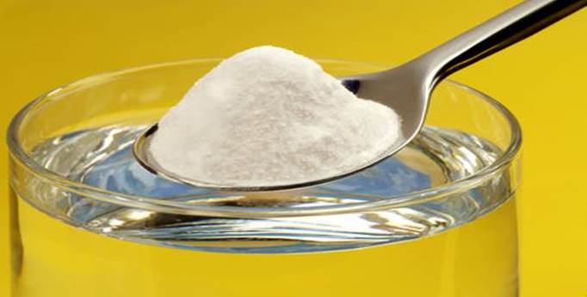
Controlling Variables
Salt Dissolving in Water

Slide 2
Solution Formation
How does temperature effect solubility?
Does particle size affect rate of dissolving?
Does dissolving occur at a constant rate?
Does stirring affect rate of dissolving?
Do sugar and salt dissolve at the same rate?

Slide 3
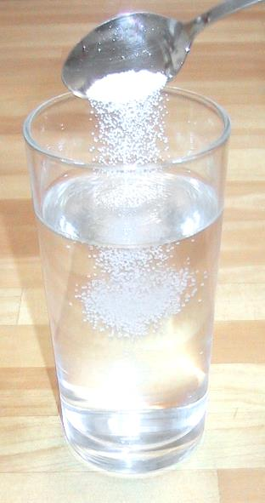
Add 1 teaspoon (5 mL) of table salt (NaCl) to the 250 mL container of water. Stir until the salt is completely dissolved.
Record the length of time required for the salt to dissolve in table 1.
Repeat this procedure using 2 teaspoons, 3 teaspoons, 4 teaspoons, and 5 teaspoons of salt. Important: Always start with fresh water before adding any salt.
What is the independent variable?
What is the dependent variable
List at least two controlled variables.
What did you find out about how the amount of salt affects the length of time it takes the salt to dissolve?
Explain why you think you got these results.
Amount of Salt | Length of Time for Salt to Dissolve
1 teaspoon
2 teaspoons
3 teaspoons
4 teaspoons
5 teaspoons

Slide 4
Add 1 teaspoon (5 mL) of table salt (NaCl) to the 250 mL container of water. Stir until the salt is completely dissolved.
Record the length of time required for the salt to dissolve in table 1.
Repeat this procedure using 2 teaspoons, 3 teaspoons, 4 teaspoons, and 5 teaspoons of salt. Important: Always start with fresh water before adding any salt.
What is the independent variable? The amount of salt used.
What is the dependent variable The length of time it takes all of the salt to dissolve.
List at least two controlled variables. Amount of water used; fresh water each time; Rate of stirring; temperature of water
What did you find out about how the amount of salt affects the length of time it takes the salt to dissolve? The more salt added, the longer time it took to dissolve.
Explain why you think you got these results.
Amount of Salt | Length of Time for Salt to Dissolve
1 teaspoon | 20 seconds
2 teaspoons | 25 seconds
3 teaspoons | 29 seconds
4 teaspoons | 32 seconds
5 teaspoons | 36 seconds

Slide 5
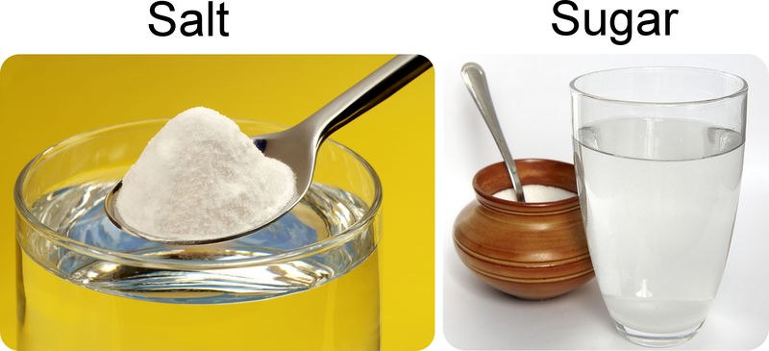
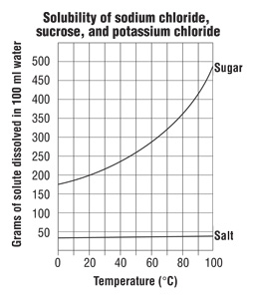
Notes:
http://www.middleschoolchemistry.com/lessonplans/chapter5/lesson6

