Slide 1
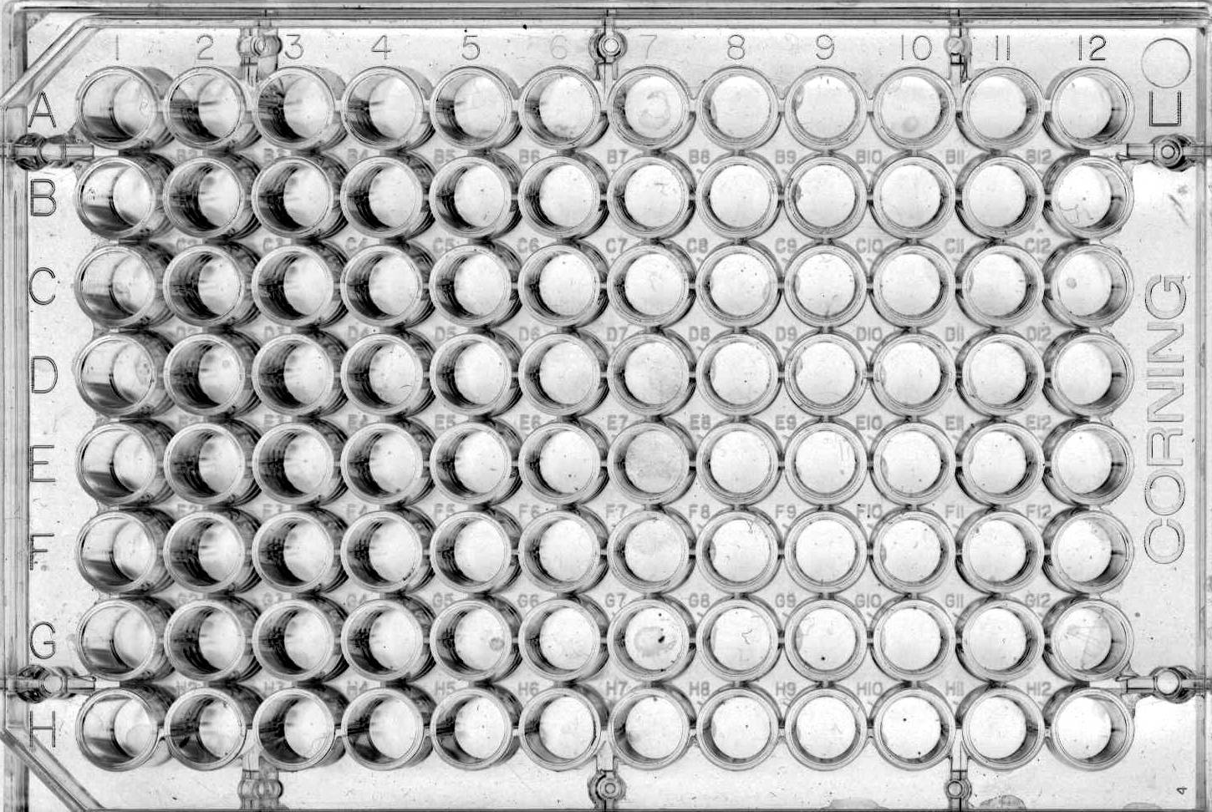
1
18
H
He
H
1
He
2
2
13
14
15
16
17
Li
Be
B
C
N
O
F
Ne
Li
3
Be
4
N
7
O
8
F
9
Ne
10
Na
Mg
Al
Si
P
S
Cl
Ar
Na
11
Mg
12
P
15
S
16
Cl
17
Ar
18
K
Ca
Ga
Ge
As
Se
Br
Kr
K
19
Ca
20
As
33
Se
34
Br
35
Kr
36
Rb
Sr
In
Sn
Sb
Te
I
Xe
Cs
Ba
Th
Pb
Bi
Po
At
Rn
Rb
37
Sr
38
Sb
51
Te
52
I
53
Xe
54
Fr
Ra
Cs
55
Ba
56
Bi
83
Po
84
At
85
Rn
86
Fr
87
Ra
88
1 2 7 8 9 10 11 12
Hydrogen Helium
Lithium Beryllium Boron Carbon Nitrogen Oxygen Fluorine Neon
Sodium Magnesium Aluminum Silicon Phosphorous Sulfur Chlorine Argon
Potassium Calcium Gallium Germanium Arsenic Selenium Bromine Krypton
Rubidium Strontium Indium Tin Antimony Tellurium Iodine Xenon
Cesium Barium Thallium Lead Bismuth Polonium Astatine Radon
Francium Radium
1 2 13 14 15 16 17 18
Instructions:
In this activity, you will need to create a 3-dimensional periodic table showing a trend of the periodic table.
Examples of trends: atomic radius, ionic radius, electronegativity, electron affinity,
density, melting point, boiling point, atomic mass, 1st ionization energy, etc…

Slide 2
Trend ____________________________
1 2 13 14 15 16 17 18
1 2 7 8 9 10 11 12
Hydrogen Helium
Lithium Beryllium Boron Carbon Nitrogen Oxygen Fluorine Neon
Sodium Magnesium Aluminum Silicon Phosphorous Sulfur Chlorine Argon
Potassium Calcium Gallium Germanium Arsenic Selenium Bromine Krypton
Rubidium Strontium Indium Tin Antimony Tellurium Iodine Xenon
Cesium Barium Thallium Lead Bismuth Polonium Astatine Radon
Francium Radium
Scale 1 cm = __________
Definition of trend:
__________________________________________________
__________________________________________________
__________________________________________________
__________________________________________________
Name(s)___________________________________________
__________________________________________________
__________________________________________________
H
He
Li
Be
B
C
N
O
F
Ne
Na
Mg
Al
Si
P
S
Cl
Ar
K
Ca
Ga
Ge
As
Se
Br
Kr
Rb
Sr
In
Sn
Sb
Te
I
Xe
Cs
Ba
Th
Pb
Bi
Po
At
Rn
Fr
Ra

Slide 3
H
He
H
He
Li
Be
B
C
N
O
F
Ne
Li
Be
B
C
N
O
F
Ne
Na
Mg
Al
Si
P
S
Cl
Ar
Na
Mg
Al
Si
P
S
Cl
Ar
K
Ca
Ga
Ge
As
Se
Br
Kr
K
Ca
Ga
Ge
As
Se
Br
Kr
Rb
Sr
In
Sn
Sb
Te
I
Xe
Rb
Sr
In
Sn
Sb
Te
I
Xe
Cs
Ba
Th
Pb
Bi
Po
At
Rn
Cs
Ba
Th
Pb
Bi
Po
At
Rn
Fr
Ra
Fr
Ra
Cut on lines to fit in Corning 96-well microplates.
Developed by Jeff Christopherson
H
He
H
He
Li
Be
B
C
N
O
F
Ne
Li
Be
B
C
N
O
F
Ne
Na
Mg
Al
Si
P
S
Cl
Ar
Na
Mg
Al
Si
P
S
Cl
Ar
K
Ca
Ga
Ge
As
Se
Br
Kr
K
Ca
Ga
Ge
As
Se
Br
Kr
Rb
Sr
In
Sn
Sb
Te
I
Xe
Rb
Sr
In
Sn
Sb
Te
I
Xe
Cs
Ba
Th
Pb
Bi
Po
At
Rn
Cs
Ba
Th
Pb
Bi
Po
At
Rn
Fr
Ra
Fr
Ra

Slide 4
Plotting Trends A Periodic Table Activity
Introduction
Does ionization energy increase going up or down a column in the periodic table? Do atoms get smaller
or larger from right to left across a row? Most students have a hard time answering these questions. In
this cooperative activity, students use microscale reaction plates and straws of different lengths to con-
struct three-dimensional bar-type charts of element properties. Lets students discover for themselves
the existence and direction of periodic trends.
Concepts
Periodic table
Periodic trends
Materials
Calculator, at least 1 per student group | Straws (300)
Index cards, 4 x 6 inches (7) | Scissors, at least 1 per student group
Reaction plates, 96-well (8 x 12 layout), 7 | Metric rulers, marked in millimeters (28)
Periodic table, (28)
Notes:
Flinn Scientific Inc.
PO Box 219
Batavia, IL 60510
1-800-452-1261
flinn@flinnsci.com
www.flinnscie.com
Publication No. 10480

Slide 5
Procedure
Form a working group with three other students.
2. Obtain a periodic table, a reaction plate, a metric ruler, scissors, and 40 plastic straws.
3. Each group chooses or is assigned one element property: atomic mass, atomic radius,
ionization energy, electronegativity, electron affinity, density, or melting point.
4. Find your assigned physical property on the periodic table.
5. Find the maximum value of the assigned physical property for the elements 1-20, 31-38, and 49-54
(these are the representative or main group elements in periods #1-5).
Example: The maximum value of the density for these elements is 7.31 g/cm³ (for tin).
6. Let the length of the staw minus one cm represent this maximum value. This length will be the scale
for all the other values of the density of the elements. Example: For a straw that is 19.5 cm long, a
straw length of 18.5 cm will represent a density of 7.31 g/cm³. This scale is thus 18.5 cm = 6.31 g/cm³.
Round off straw length to 0.1 cm (1 mm).
7. Use this "straw" scale as a ratio, calculate the straw length that is needed to represent the assigned
property for each element in the list. Example: The density of beryllium is 1.85 g/cm³. Solving
Equation 1 for the straw length (sl) shows that a straw length of 4.7 cm is needed to represent the
density of beryllium. Round off all straw lengths to 0.1 cm.
8. Add 1.0 cm to the calculated straw length for each element and cut a straw to that length.
Example: Cut a straw 5.7 cm (4.7 cm + 1.0 cm) long to represent beryllium.
18.5 cm sl
=
7.31 g/cm³ 1.85 g/cm³
sl = (18.5 x 1.85) / 7.31 = 4.7 cm

Slide 6
Procedure
9. Place the straw in the reaction plate according to the position of the element in the periodic table.
Remember, the transition elements are not included in the list of representative elements.
Example: Beryllium (period 2, Group 2 is placed in row 2, column 2).
10. Repeat steps 6-9 for each element in the list.
11. Determine the nature of any periodic trend that may exist for the assigned property of the elements
and propose an explanation for the observed trend.
12. Create a descriptive card to be displayed with the three-dimensional chart. Include the following
information on the card: (1) names of group members; (2) the assigned physical property of the
element; (3) description of the observed trend; (4) proposed explanation for the trend.
Tips
1. If the periodic tables you have available do not list all of the suggested physical properties, compile
a list of the elements and their properties. An appropriate reference source is the CRC Handbook of
of Chemistry and Physics. See also the Website www.webelements.com.
2. A large quantity of straws may be available from a local restaurant - ask them to support science activities.
3. This activity require 1 full class period.
Printable
copy of
LAB
Printable
copy of
DATA
Interactive
Periodic
Table
Flinn ChemTopic Labs, Volume 4, The Periodic Table; Cesa, I., Ed,; Flinn Scientific: Batavia, IL, 2002,

Slide 7
Melting Points
1
H
-259.2
Mg
650
He
-269.7
1
Symbol
Melting point ºC
2
Li
^{180.5}
Be
1283
B
2027
C
4100
N
-210.1
O
-218.8
F
-219.6
Ne
-248.6
2
Na
98
Mg
650
> 3000 ºC
2000 - 3000 ºC
Al
660
Si
1423
P
44.2
S
119
Cl
-101
Ar
-189.6
3
3
4
K
63.2
Ca
850
Sc
1423
Ti
1677
V
1917
Cr
1900
Mn
1244
Fe
1539
Co
1495
Ni
1455
Cu
1083
Zn
420
Ga
29.78
Ge
960
As
817
Se
217.4
Br
-7.2
Kr
-157.2
4
5
Rb
38.8
Sr
770
Y
1500
Zr
1852
Nb
2487
Mo
2610
Tc
2127
Ru
2427
Rh
1966
Pd
1550
Ag
961
Cd
321
In
156.2
Sn
231.9
Sb
630.5
Te
450
I
113.6
Xe
-111.9
5
6
Cs
28.6
Ba
710
La
920
Hf
2222
Ta
2997
W
3380
Re
3180
Os
2727
Ir
2454
Pt
1769
Au
1063
Hg
-38.9
Tl
303.6
Pb
327.4
Bi
271.3
Po
254
At
Rn
-71
6
Ralph A. Burns, Fundamentals of Chemistry , 1999, page 1999

Slide 8
Densities of Elements
1
H
0.071
He
0.126
1
2
Li
0.53
Be
1.8
B
2.5
C
2.26
N
0.81
O
1.14
F
1.11
Ne
1.204
2
3
Na
0.97
Mg
1.74
Al
2.70
Si
2.4
P
1.82w
S
2.07
Cl
1.557
Ar
1.402
3
4
K
0.86
Ca
1.55
Sc
(2.5)
Ti
4.5
V
5.96
Cr
7.1
Mn
7.4
Fe
7.86
Co
8.9
Ni
8.90
Cu
8.92
Zn
7.14
Ga
5.91
Ge
5.36
As
5,7
Se
4.7
Br
3.119
Kr
2.6
4
5
Rb
1.53
Sr
2.6
Y
5.51
Zr
6.4
Nb
8.4
Mo
10.2
Tc
11.5
Ru
12.5
Rh
12.5
Pd
12.0
Ag
10.5
Cd
8.6
In
7.3
Sn
7.3
Sb
6.7
Te
6.1
I
4.93
Xe
3.06
5
6
Cs
1.90
Ba
3.5
La
6.7
Hf
13.1
Ta
16.6
W
19.3
Re
21.4
Os
22.48
Ir
22.4
Pt
21.45
Au
19.3
Hg
13.55
Tl
11.85
Pb
11.34
Bi
9.8
Po
9.4
At
---
Rn
4.4
6
8.0 – 11.9 g/cm³
12.0 – 17.9 g/cm³
> 18.0 g/cm³
Mg
1.74
Symbol
Density in g/cm³C, for gases, in g/L
Ω
Notes:
Element Year Discovered Density (g/cm³)
Osmium 1804 22.59
Iridium 1804 22.56
Platinum 1784 21.45
Rhenium 1925 21.01
Neptunium 1940 20.47
Plutonium 1940 20.26
Gold prehistoric 19.32
Tungsten 1783 19.26
Uranium 1789 19.05
Tantalum 1802 16.67

Slide 9
Electronegativities
1A
8A
1
H
2.1
1
2A
3A
4A
5A
6A
7A
2
Li
1.0
Be
1.5
B
2.0
C
2.5
N
3.0
O
3.5
F
4.0
2
3
Na
0.9
Mg
1.2
Al
1.5
Si
1.8
P
2.1
S
2.5
Cl
3.0
3
3B
4B
5B
6B
7B
8B
1B
2B
Period
4
K
0.8
Ca
1.0
Sc
1.3
Ti
1.5
V
1.6
Cr
1.6
Mn
1.5
Fe
1.8
Co
1.8
Ni
1.8
Cu
1.9
Zn
1.7
Ga
1.6
Ge
1.8
As
2.0
Se
2.4
Br
2.8
4
5
Rb
0.8
Sr
1.0
Y
1.2
Zr
1.4
Nb
1.6
Mo
1.8
Tc
1.9
Ru
2.2
Rh
2.2
Pd
2.2
Ag
1.9
Cd
1.7
In
1.7
Sn
1.8
Sb
1.9
Te
2.1
I
2.5
5
Cs
0.7
Ba
0.9
∗
6
La
1.1
Hf
1.3
Ta
1.5
W
1.7
Re
1.9
Os
2.2
Ir
2.2
Pt
2.2
Au
2.4
Hg
1.9
Tl
1.8
Pb
1.8
Bi
1.9
Po
2.0
At
2.2
6
Fr
0.7
Ra
0.9
ψ
Ac
1.1
∗
7
Lanthanides: 1.1 - 1.3
ψ
Actinides: 1.3 - 1.5
Below 1.0
2.0 - 2.4
1.0 - 1.4
2.5 - 2.9
1.5 - 1.9
3.0 - 4.0
Hill, Petrucci, General Chemistry An Integrated Approach 2nd Edition, page 373
Notes:
Linus Pauling (1901 - 1994) awarded Nobel Prize in chemistry in 1954 for his 1939 text, The Nature of the Chemical Bond,
and also won the Nobel Peace Prize in 1962 for his fight to control nuclear weapons.
The greater the electronegativity of an atom in a molecule, the more strongly it attracts the electrons in a covalent bond.

Slide 10
Atomic Radii
Ionic Radii
IA IIA IIIA IVA VA VIA VIIA
IA IIA IIIA IVA VA VIA VIIA
Li¹⁺
Be²⁺
N³⁻
Li
Be
O²⁻
F¹⁻
B
C
N
O
F
1.52 1.11
0.88 0.77 0.70 0.66 0.64
0.60 0.31
1.71 1.40 1.36
Na
Na¹⁺
Mg²⁺
Al³⁺
S²⁻
Cl¹⁻
Mg
Al
Si
P
S
Cl
1.86 1.60
1.43 1.17 1.10 1.04 0.99
0.95 0.65
0.50 1.84 1.81
K
Ca
Ge
As
Se²⁻
Br¹⁻
Ga
Se
Br
K¹⁺
Ca²⁺
Ga³⁺
2.31 1.97
1.22 1.22 1.21 1.17 1.14
1.33 0.99
0.62 1.98 1.85
Rb
Sr
Te²⁻
I¹⁻
In
In³⁺
Sn
Sb
Te
I
Rb¹⁺
Sr²⁺
2.44 2.15
1.62 1.40 1.41 1.37 1.33
1.48 1.13
0.81 2.21 2.16
Cs
Ba
Tl
Pb
Cs¹⁺
Ba²⁺
Tl³⁺
Bi
2.62 2.17
1.71 1.75 1.46
= 1 Angstrom
1.69 1.35
0.95
= 1 Angstrom

Slide 11
Atomic Radii
IA IIA IIIA IVA VA VIA VIIA
Li
Be
B
C
N
O
F
1.52 1.11
0.88 0.77 0.70 0.66 0.64
Na
Mg
Al
Si
P
S
Cl
1.86 1.60
1.43 1.17 1.10 1.04 0.99
K
Ca
Ga
Ge
As
Se
Br
2.31 1.97
1.22 1.22 1.21 1.17 1.14
Rb
Sr
In
Sn
Sb
Te
I
2.44 2.15
1.62 1.40 1.41 1.37 1.33
Cs
Ba
Tl
Pb
Bi
2.62 2.17
1.71 1.75 1.46
= 1 Angstrom

Slide 12
Ionization Energies
Group 1
18
1
H
1312
Mg
738
Symbol
First Ionization Energy
(kJ/mol)
He
2372
1
2
13
14
15
16
17
2
Li
520
Be
900
B
801
C
1086
N
1402
O
1314
F
1681
Ne
2081
2
3
Na
496
Mg
738
Al
578
Si
787
P
1012
S
1000
Cl
1251
Ar
1521
3
3
4
5
6
7
8
9
10
11
12
Period
4
K
419
Ca
590
Sc
633
Ti
659
V
651
Cr
653
Mn
717
Fe
762
Co
760
Ni
737
Cu
746
Zn
906
Ga
579
Ge
762
As
947
Se
941
Br
1140
Kr
1351
4
5
Rb
403
Sr
550
Y
600
Zr
640
Nb
652
Mo
684
Tc
702
Ru
710
Rh
720
Pd
804
Ag
731
Cd
868
In
558
Sn
709
Sb
834
Te
869
I
1008
Xe
1170
5
Cs
376
Ba
503
∗
6
La
538
Hf
659
Ta
761
W
770
Re
760
Os
839
Ir
878
Pt
868
Au
890
Hg
1007
Tl
589
Pb
716
Bi
703
Po
812
At
--
Rn
1038
6
Fr
--
Ra
509
ψ
Uuu
--
Uub
--
Uut
--
Uuq
--
Uup
--
Uuo
--
7
Ac
490
Rf
--
Db
--
Sg
--
Bh
--
Hs
--
Mt
--
Ds
--
∗
Ce
534
Pr
527
Nd
533
Pm
536
Sm
545
Eu
547
Gd
592
Tb
566
Dy
573
Ho
581
Er
589
Tm
597
Yb
603
Lu
523
Lanthanide series
ψ
Th
587
Pa
570
U
598
Np
600
Pu
585
Am
578
Cm
581
Bk
601
Cf
608
Es
619
Fm
627
Md
635
No
642
Lr
--
Actinide series
Notes:
Linus Pauling (1901 - 1994) awarded Nobel Prize in chemistry in 1954 for his 1939 text, The Nature of the Chemical Bond,
and also won the Nobel Peace Prize in 1962 for his fight to control nuclear weapons.
The greater the electronegativity of an atom in a molecule, the more strongly it attracts the electrons in a covalent bond.

Slide 13
Summary of Periodic Trends
Shielding is constant
Atomic radius decreases
Ionization energy increases
Electronegativity increases
Nuclear charge increases
Nuclear charge increases
Shielding increases
Atomic radius increases
Ionic size increases
Ionization energy decreases
Electronegativity decreases
1A
0
2A
3A
4A
5A
6A
7A
Ionic size (cations) Ionic size (anions)
decreases decreases

Slide 14
Hydrogen
Halogens
Alkali metals
Noble Gases
Alkaline Earth Metals
Other Nonmetals
Coinage Metals
Lanthanides
1
H
1
Other Transition Elements
Actinides
He
2
Metalloids
(B, Si, Ge, As, Sb, Te, At)
Other metals
2
Li
3
Be
4
B
5
C
6
N
7
O
8
F
9
Ne
10
3
Na
11
Mg
12
Al
13
Si
14
P
15
S
16
Cl
17
Ar
18
4
K
19
Ca
20
Sc
21
Ti
22
V
23
Cr
24
Mn
25
Fe
26
Co
27
Ni
28
Cu
29
Zn
30
Ga
31
Ge
32
As
33
Se
34
Br
35
Kr
36
5
Rb
37
Sr
38
Y
39
Zr
40
Nb
41
Mo
42
Tc
43
Ru
44
Rh
45
Pd
46
Ag
47
Cd
48
In
49
Sn
50
Sb
51
Te
52
I
53
Xe
54
6
Cs
55
Ba
56
∗
Hf
72
Ta
73
W
74
Re
75
Os
76
Ir
77
Pt
78
Au
79
Hg
80
Tl
81
Pb
82
Bi
83
Po
84
At
85
Rn
86
7
Fr
87
Ra
88
Ω
Rf
104
Db
105
Sg
106
Bh
107
Hs
108
Mt
109
La
57
Ce
58
Pr
59
Nd
60
Pm
61
Sm
62
Eu
63
Gd
64
Tb
65
Dy
66
Ho
67
Er
68
Tm
69
Yb
70
Lu
71
∗
Ac
89
Th
90
Pa
91
U
92
Np
93
Pu
94
Am
95
Cm
96
Bk
97
Cf
98
Es
99
Fm
100
Md
101
No
102
Lr
103
Ω

Slide 15
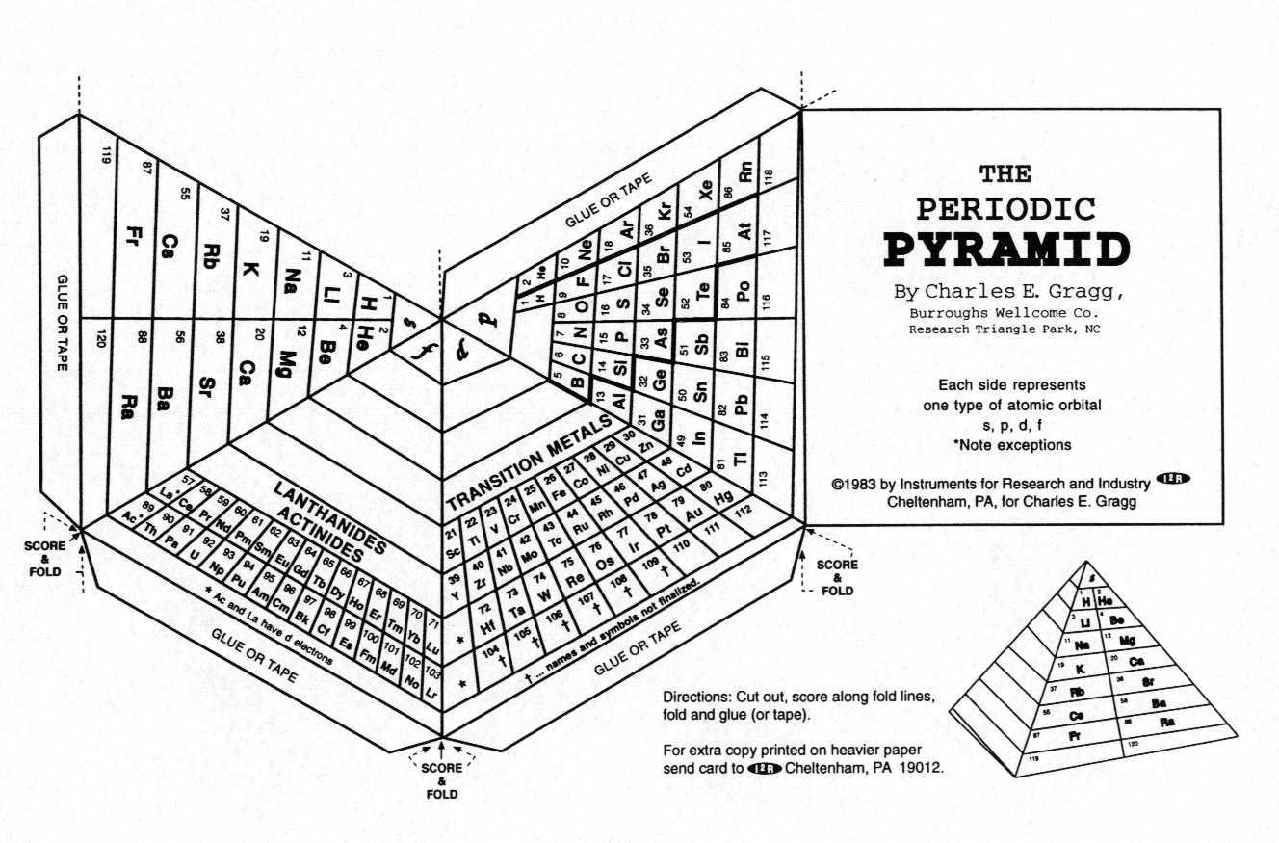

Slide 16
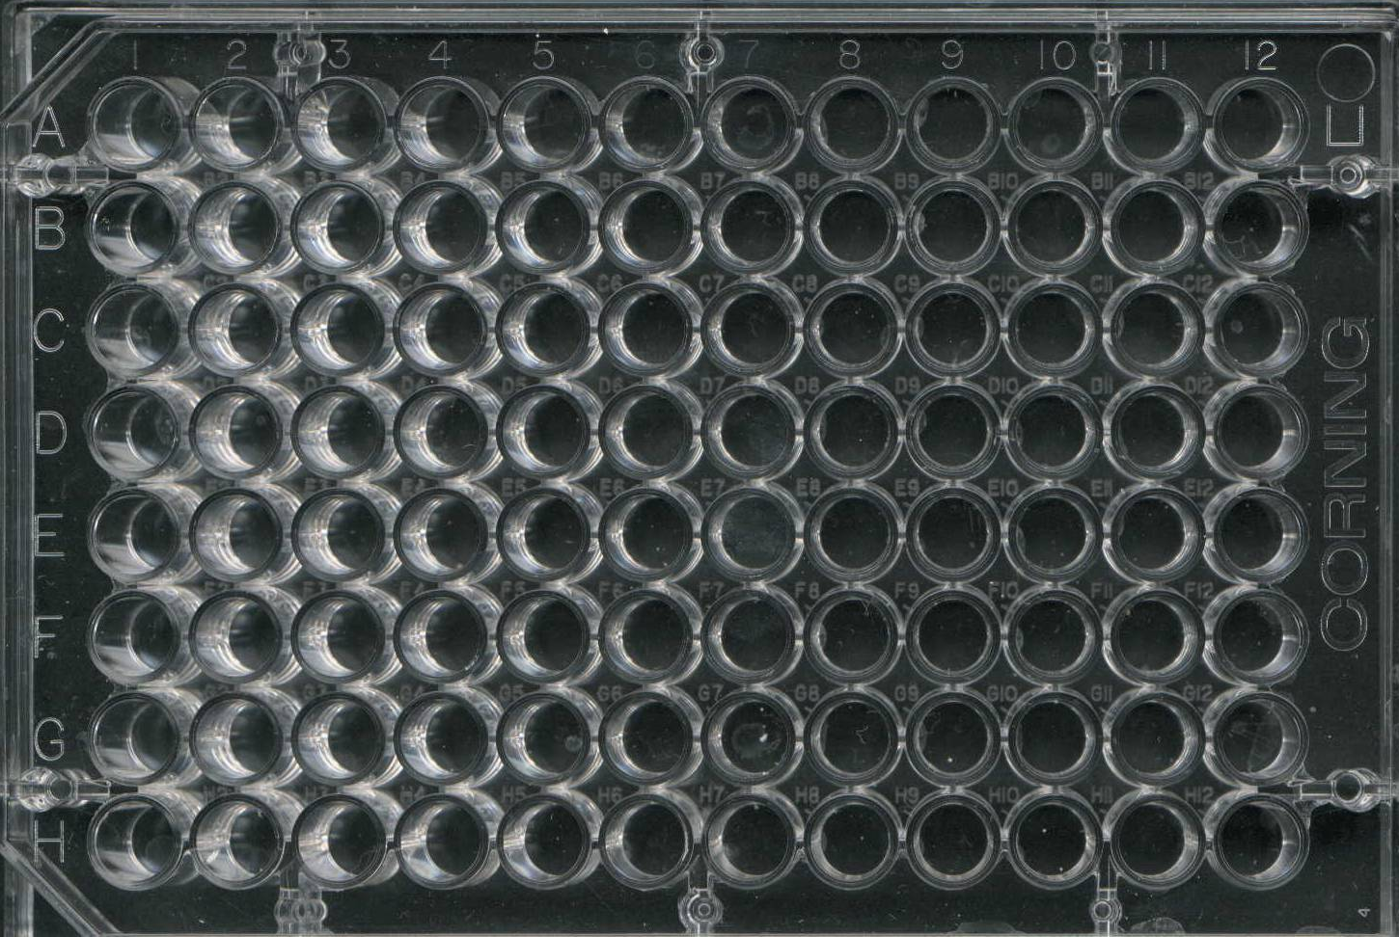
H
He
Li
Be
B
C
N
O
F
Ne
Na
Mg
Al
Si
P
S
Cl
Ar
K
Ca
Ga
Ge
As
Se
Br
Kr
Rb
Sr
In
Sn
Sb
Te
I
Xe
Cs
Ba
Th
Pb
Bi
Po
At
Rn
Fr
Ra
1 2 7 8 9 10 11 12
Hydrogen Helium
Lithium Beryllium Boron Carbon Nitrogen Oxygen Fluorine Neon
Sodium Magnesium Aluminum Silicon Phosphorous Sulfur Chlorine Argon
Potassium Calcium Gallium Germanium Arsenic Selenium Bromine Krypton
Rubidium Strontium Indium Tin Antimony Tellurium Iodine Xenon
Cesium Barium Thallium Lead Bismuth Polonium Astatine Radon
Francium Radium

