Slide 1
Reactions of Copper
Percent Yield
Answer Key

Slide 2
Reactions of Copper
Copy of Lab
Cu(s) + 4 HNO₃(aq) Cu(NO₃)₂(aq) + 2 NO₂(g) + 2 H₂O(l)
Redox [1]
Cu(NO₃)₂(aq) + 2 NaOH(aq) Cu(OH)₂(s) + 2 NaNO₃(aq)
Metathesis [2]
(double replacement)
Cu(OH)₂(s) CuO(s) + H₂O(g)
Dehydration [3]
CuO(s) + H₂SO₄(aq) CuSO₄(aq) + H₂O(l)
Metathesis [4]
CuSO₄(aq) + Zn(s) ZnSO₄(aq) + Cu(s)
Redox [5]
The objective in this experiment is to recover all of the copper you begin with
in analytically pure form. This is the test of your laboratory skills.

Slide 3
The objective in this experiment is to recover all of the copper you begin with
in analytically pure form. This is the test of your laboratory skills.
The percent yield of the copper can be expressed as the ratio of the recovered
weight to initial weight, multiplied by 100:
% yield = x 100
recovered weight of Cu
initial weight of Cu

Slide 4
Procedure
Weight approximately 0.500 g of no. 16 or no. 18 copper wire (1) to the nearest
0.0001 g and place it in a 250 mL beaker. Add 4-5 mL of concentrated HNO₃
to the beaker, IN THE HOOD. After the reaction is complete, add 100 mL
distilled H₂O. Describe the reaction (6) as to color change, evolution of gas,
and change in temperature (exothermic or endothermic) in the report sheet.
Add 30 mL of 3.0 M NaOH to the solution in your beaker and describe the
reaction (7). Add two or three boiling chips and carefully heat the solution
-- while stirring with a glass stirring rod -- just to the boiling point. Describe
the reaction on your report sheet (8). Remove the boiling chips.
Allow the black CuO to settle; then decant the supernantant liquid. Add about
200 mL of very hot distilled water and allow the CuO to settle. Decant once
more. What are you removing by washing and decanting (9)?
Add 15 mL of 6.0 M H₂SO₄.
What copper compound is present in the beaker now (10)?

Slide 5
Pre-lab (Review Questions)
1. Give an example, other than the ones listed in this experiment, of redox and metathesis reactions.
Redox: Zn + MgCl₂ ZnCl₂ + Mg
Zinc is oxidized: Zn⁰ Zn²⁺ + 2e⁻
Magnesium is reduced: Mg²⁺ + 2e‑ Mg⁰
Metathesis: Pb(NO₃)₂ + H₂S PbS + HNO3 (metathesis is also known as a double-replacement reaction)
2. When will reactions proceed to completion?
3. Define percent yield in general terms.
4. Name six methods of separating materials.
5. Give criteria in terms of temperature changes for exothermic and endothermic reactions.
Driving forces for double replacement reaction is formation of water, gas or a solid. Single replacement reactions we use an activity series to predict if they will occur. For a reaction to proceed to completion all of the reactants must mix: they may need to be stirred, or heated to assist in the process of them reacting.
Percent yield is a measure of how well the reaction proceeded to completion. The formula for
percent yield is the experimental yield divided by the calculated (theoretical yield).
a) filtration b) magnetism c) centrifugation d) decantation e) color f) distillation
Exothermic reactions - release heat and feel “hot” to the touch
Endothermic reaction - gain heat and feel “cold” to the touch

Slide 6
Pre-lab (Review Questions)
6. If 1.65 g of Cu(NO₃)₂ are obtained from allowing 0.93 g of Cu to react with excess HNO₃,
what is the percent yield of the reaction?
1.65 g
Cu + 2 HNO₃ Cu(NO₃)₂ + H₂
0.93 g excess x g
x g Cu(NO₃)₂ = 0.93 g Cu
1 mol Cu(NO₃)₂
187.5 g Cu(NO₃)₂
1 mol Cu
= 2.75 g Cu(NO₃)₂
63.5 g Cu
1 mol Cu
1 mol Cu(NO₃)₂
1.65 g
2.75 g
% = 60% yield
% =
7. What is the maximum percent yield in any reaction?
100%; any value higher would be impurities in product (e.g. water, by-product)

Slide 7
Pre-lab (Review Questions)
8. What is meant by the terms decantation and filtration?
9. When Cu(OH)₂(s) is heated, Copper (II) oxide and water are formed.
Write a balanced equation for the reaction.
Decantation - pour off solvent leaving behind precipitate
Filtration - pass through filter that separates our components of a mixture
by differences in particle size
Cu(OH)₂(s) CuO(s) + H₂O(g)
10. When sulfuric acid and copper (II) oxide are allowed to react, copper (II) sulfate and water are formed. Write a balanced equation for this reaction.
H₂SO₄(aq) + CuO(s) CuSO₄(aq) + H₂O(l)
11. When copper (II) sulfate and aluminum are allowed to react, aluminum sulfate and copper
are formed. What kind of reaction is this? Write a balanced equation for this reaction.
3 CuSO₄(aq) + 2 Al(s) Al₂(SO₄)₃(aq) + 3 Cu(s)
This reaction is an example of a redox reaction: where aluminum is oxidized and copper
is reduced. The copper is the oxidizing agent and the aluminum is the reducing agent.
Aluminum is oxidized: Al⁰ Al³⁺ + 3e⁻ Copper is reduced: Cu²⁺ + 2e‑ Cu⁰
It could also be called a single replacement reaction – where aluminum is chemically more active than copper.

Slide 8
REPORT SHEET
Chemical Reactions of Copper and Percent Yield
0.485 g
1. Weight copper initial _______________
*2. Weight of copper and evaporating dish _______________
3. Weight of evaporating dish (initial) _______________
*4. Weight of copper final _______________
*5. % Yield (show calculations) _______________
136.427 g
135.973 g
0.454 g
93.6 %
% yield = x 100
0.454 g
recovered weight of Cu
x 100
initial weight of Cu
0.485 g
93.6 % yield
*These values will not be obtained until the last day of the lab when the copper
has been dried in the evaporating dish.

Slide 9
How to get your Cu sample back…
CuSO₄(aq) + Al(s) Al₂(SO₄)₃(aq) + Cu(s)
blue color
excess
colorless
red-brown
You only want to add a slight excess of aluminum foil.
Too much foil…
… will need to be removed by adding additional hydrochloric acid:
Al(s) + HCl(aq) H₂(g) + AlCl₃(aq)
Failure to rinse out aluminum sulfate or aluminum chloride ions will yield
a product contaminated with these salts and give product a gray color.

Slide 10
REPORT SHEET
Chemical Reactions of Copper and Percent Yield
6. Describe the reaction Cu(s) + HNO₃(aq) Cu(NO₃)₂(aq) + 2 NO₂(g) + 2 H₂O(l)
The addition of nitric acid caused the copper metal to slowly dissolve. A red-brown gas (NO₂) was
produced. The odor was similar to the smell of chlorine. The nitric acid liquid changed color from
colorless to a blue-green color.
Cu(s) + 4 HNO₃(aq) Cu(NO₃)₂(aq) + 2 NO₂(g) + 2 H₂O(l)
7. Describe the reaction Cu(NO₃)₂(aq) + NaOH(aq) Cu(OH)₂(s) + 2 NaNO₃(aq)
The addition of sodium hydroxide solution with the copper nitrate solution produced a bright blue
colored solid (gel-like) material [Cu(OH)₂].
Cu(NO₃)₂(aq) + 2 NaOH(aq) Cu(OH)₂(s) + 2 NaNO₃(aq)
8. Describe the reaction Cu(OH)₂(s) CuO(s) + H₂O(g)
Δ
When the beaker containing the copper (II) hydroxide and water was heated the blue solid changed
color into a black fine powder. Upon cooling the black powder (CuO) could be separated from the
water by decantation.
Cu(OH)₂(s) CuO(s) + H₂O(g)
Δ

Slide 11
REPORT SHEET
Chemical Reactions of Copper and Percent Yield
9. What are you removing by this washing?
10. What copper compound is present in the beaker?
11. Describe the reaction CuSO₄(aq) + Zn(s), or CuSO₄(aq) + Al(s)
12. What is present in solution?
13. What is the gas?
Unreacted (impurities) and excess NaNO₃ that wasn’t removed in the previous step.
CuSO₄ copper (II) sulfate
When aluminum foil is added to the solution of copper (II) sulfate, the foil dissolves
and has copper spots.
The solution changes color from pale blue to colorless.
A gas is released (hydrogen).
Al³⁺ ions and SO₄²⁻ ions.
They are removed in the final washing to leave you with pure Copper!
Hydrogen gas. (Also yields pale yellow-green chlorine gas)

Slide 12
REPORT SHEET
Chemical Reactions of Copper and Percent Yield
14. How do you know?
15. What are you removing by washing?
16. What color is your copper sample?
17. Is it uniform in appearance?
18. Suggest possible sources of error in this experiment.
Any time an acid is added to a metal hydrogen gas is released.
We also checked with a glowing wooden splint that burst into flames when placed in the beaker.
Al³⁺ ions and SO₄²⁻ ions.
Initial color is red-brown (copper colored) when wet. After drying, many samples will have a
clear crystal of aluminum sulfate crystals that weren’t removed during washing. Small bits
of excess aluminum may be present giving the silver color of aluminum mixed in with copper
sample. Finally, upon standing, the copper may oxidize and change to a slightly green color.
*
Yes, with exceptions listed in question #16 (above).
When decanting, lost some sample by pouring it out. It is difficult to have all CuO settle to
bottom and remove all liquid.
Approximate volumes of acids and bases were added. We assumed we had excess in all
cases and removed the excess by washing.
Extremely hard to remove excess Al foil – addition of [hydrochloric acid] to dissolve foil may
have caused the copper product to react and form copper (II) chloride.

Slide 13
Answer Key
POST LAB QUESTIONS
1. If your percent yield of copper was greater than 100%, what are two plausible errors
you may have made?
2. Consider the combustion of methane, CH₄:
CH₄(g) + 2 O₂(g) -----> CO₂(g) + 2 H₂O(g)
Suppose 2 mole of methane is allowed to react with 3 mol of oxygen.
a) What is the limiting reagent? (show work)
b) How many moles of CO₂ can be made from this mixture? How many grams of CO₂?
Sample was not fully dried and still contained water.
Impurities were mixed in with copper causing it to weigh more than it should.
OXYGEN is the limiting reactant. According to the balanced chemical equation, you need 2x the amount of oxygen as methane.
You would need 4 mole of oxygen to react with 2 mol of methane
(you have only 3 mol of oxygen).
x mol CO₂ = 3 mol O₂
1 mol CO₂
= 1.5 mol CO₂
2 mol O₂
x g CO₂ = 3 mol O₂
1 mol CO₂
44 g CO₂
= 66 g CO₂
2 mol O₂
1 mol CO₂

Slide 14
3. Suppose 8.00 g of CH₄ is allowed to burn in the presence of 6.00 g of oxygen.
How much (in grams) CH₄, O₂, CO₂, and H₂O remain after the reaction is complete?
CH₄(g) + 2 O₂(g) CO₂(g) + 2 H₂O(g)
8 g 6 g
limiting
/ 16 g
/ 32 g
[Have 0 g O₂ remaining]
0.5 mol CH₄
0.1875 mol O₂
1
2
0.5
0.093
x g CH₄ = 0.1875 mol O₂
1 mol CH₄
16 g CH₄
2 mol O₂
1 mol CH₄
= 1.5 g CH₄
[Have 6.5 g CH₄ remaining]
x g CO₂ = 0.1875 mol O₂
1 mol CO₂
44 g CO₂
2 mol O₂
1 mol CO₂
= 4.125 g CO₂
[Have 4.125 g CO₂ produced]
x g H₂O = 0.1875 mol O₂
2 mol H₂O
18 g H₂O
2 mol O₂
1 mol H₂O
= 3.375 g H₂O
[Have 3.375 g H₂O produced]
Note that we begin with 14 g of reactant and end with 14 g on product side.

Slide 15
4. How many milliliters of 6.0 M H₂SO₄ are required to react with 0.80 g of CuO
according to Equation [4]?
CuO(s) + H₂SO₄(aq) CuSO₄(aq) + H₂O(l)
0.80 g x mol
x mol H₂SO₄ = 0.80 g CuO
1 mol CuO
1 mol H₂SO₄
79.5 g CuO
= 0.0100628 mol H₂SO₄
1 mol CuO
convert to millimoles (mmol)
by dividing by 1000.
mol solute
10.0628 mmol
Molarity (M) =
6.0 M H₂SO₄ =
L of solution
X mL of solution
= 1.677 mL 6.0 M H₂SO₄

Slide 16
5. If 2.00 g of Zn is allowed to react with 1.75 g of CuSO₄ according to Equation [5],
how many grams of Zn will remain after the reaction is complete?
(from the question we can assume that Zn in excess reactant)
excess
CuSO₄(aq) + Zn(s) ZnSO₄(aq) + Cu(s)
1.75 g 2.00 g
x g
/ 159.5 g
x = 0.72 g
x 65.4 g/mol Zn
0.01097 mol
0.01097 mol
The reaction will consume 0.72 g of Zn.
Therefore you will have 2.00 g – 0.72 g or 1.28 g of Zn remaining.
6. What is meant by the term limiting reagent?
The limiting reactant is the starting material used in a chemical reaction that is
used up first (or that you run out of). When no more of it remains, no additional
product can be made and the reaction stops. The quantity of limiting reactant
determines (LIMITS) the amount of product that is made.

Slide 17
TEACHER NOTES:
W a r n i n g : This lab experiment requires a large quantity or reagents.
The acids and base are very concentrated and should only
be used in a fume hood with proper teacher supervision.
For a class of 100 students you will need:
750 mL concentrated nitric acid [HNO₃]
650 mL concentrated sulfuric acid [H₂SO₄]
480 g sodium hydroxide (NaOH)
The concentrated nitric acid is not diluted.
The concentrated sulfuric acid is diluted to 6 M H₂SO₄.
Concentrated sulfuric acid is 18.1 M. Therefore, take 1 part [H₂SO₄] to 2 part H₂O.
The resulting solution will be approximately 6 M H₂SO₄.
To make 3 M NaOH, begin with 2000 mL of cold distilled water and add 240 g NaOH.
You will need to mix two batches of NaOH to yield 4 L of 3 M NaOH.
Be sure students have read the lab and completed the pre-lab before going into the lab.
The lab requires two full days (in the lab) to complete.
Day 1) Students should be able to get through equation (3).
They must have added the NaOH to yield Cu(OH)₂
Heating the solution with a boiling chip is ideally where they should get to –
boiling chips must be removed and not left in beaker over night.
If students are rushed for time and can’t heat – don’t worry, the reaction will
proceed to completion on its own over night.
Day 2) Complete lab
Students tend to have very high yields (~150% - 300%) due to impurities in product.
Notes:
I no longer use evaporating dishes. I purchase disposable 6 ounce plastic dishes from Sam’s Club. I have the student record the mass of the initial mass of copper + disposable dish with a permanent marker on the side. When students are done, they hand me the dish with the recovered copper. I then weigh the product and can see truly how accurate the students were. The cups can be disposed of – making clean-up very easy.
Using this method, numerous students came up with almost exactly 100% yield. I had students wash final product 3x with distilled water in disposable dish and allowed samples to dry over a weekend.

Slide 18
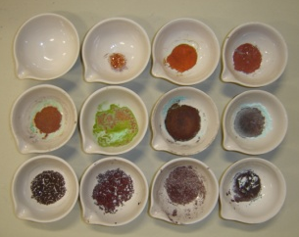
What you may see…
During the LAB:
The solution will change color many times during the reactions:
A) red brown gas given off when nitric acid is added to copper
B) water is added to copper nitrate solution (green to blue liquid)
C) NaOH is added to copper nitrate yielding copper (II) hydroxide
D) Cu(OH)₂ decomposes into CuO
E) sulfuric acid added to CuO yields CuSO₄
(this reaction may take ~2 minutes to occur … black to green)
F) Al foil added to CuSO₄ yields back original copper
FINAL Product:
Failure to rinse properly will yield numerous contaminants:
excess Al³⁺ and SO₄²⁻ … gives clear, solid Al₂(SO₄)₃ crystals
excess foil … gives silver color
excess foil digested with too much HCl … yields AlCl₃ (gray powder)
not enough foil … and solution remains faint blue and CuSO₄ crystals
appear (blue-green color)

Slide 19
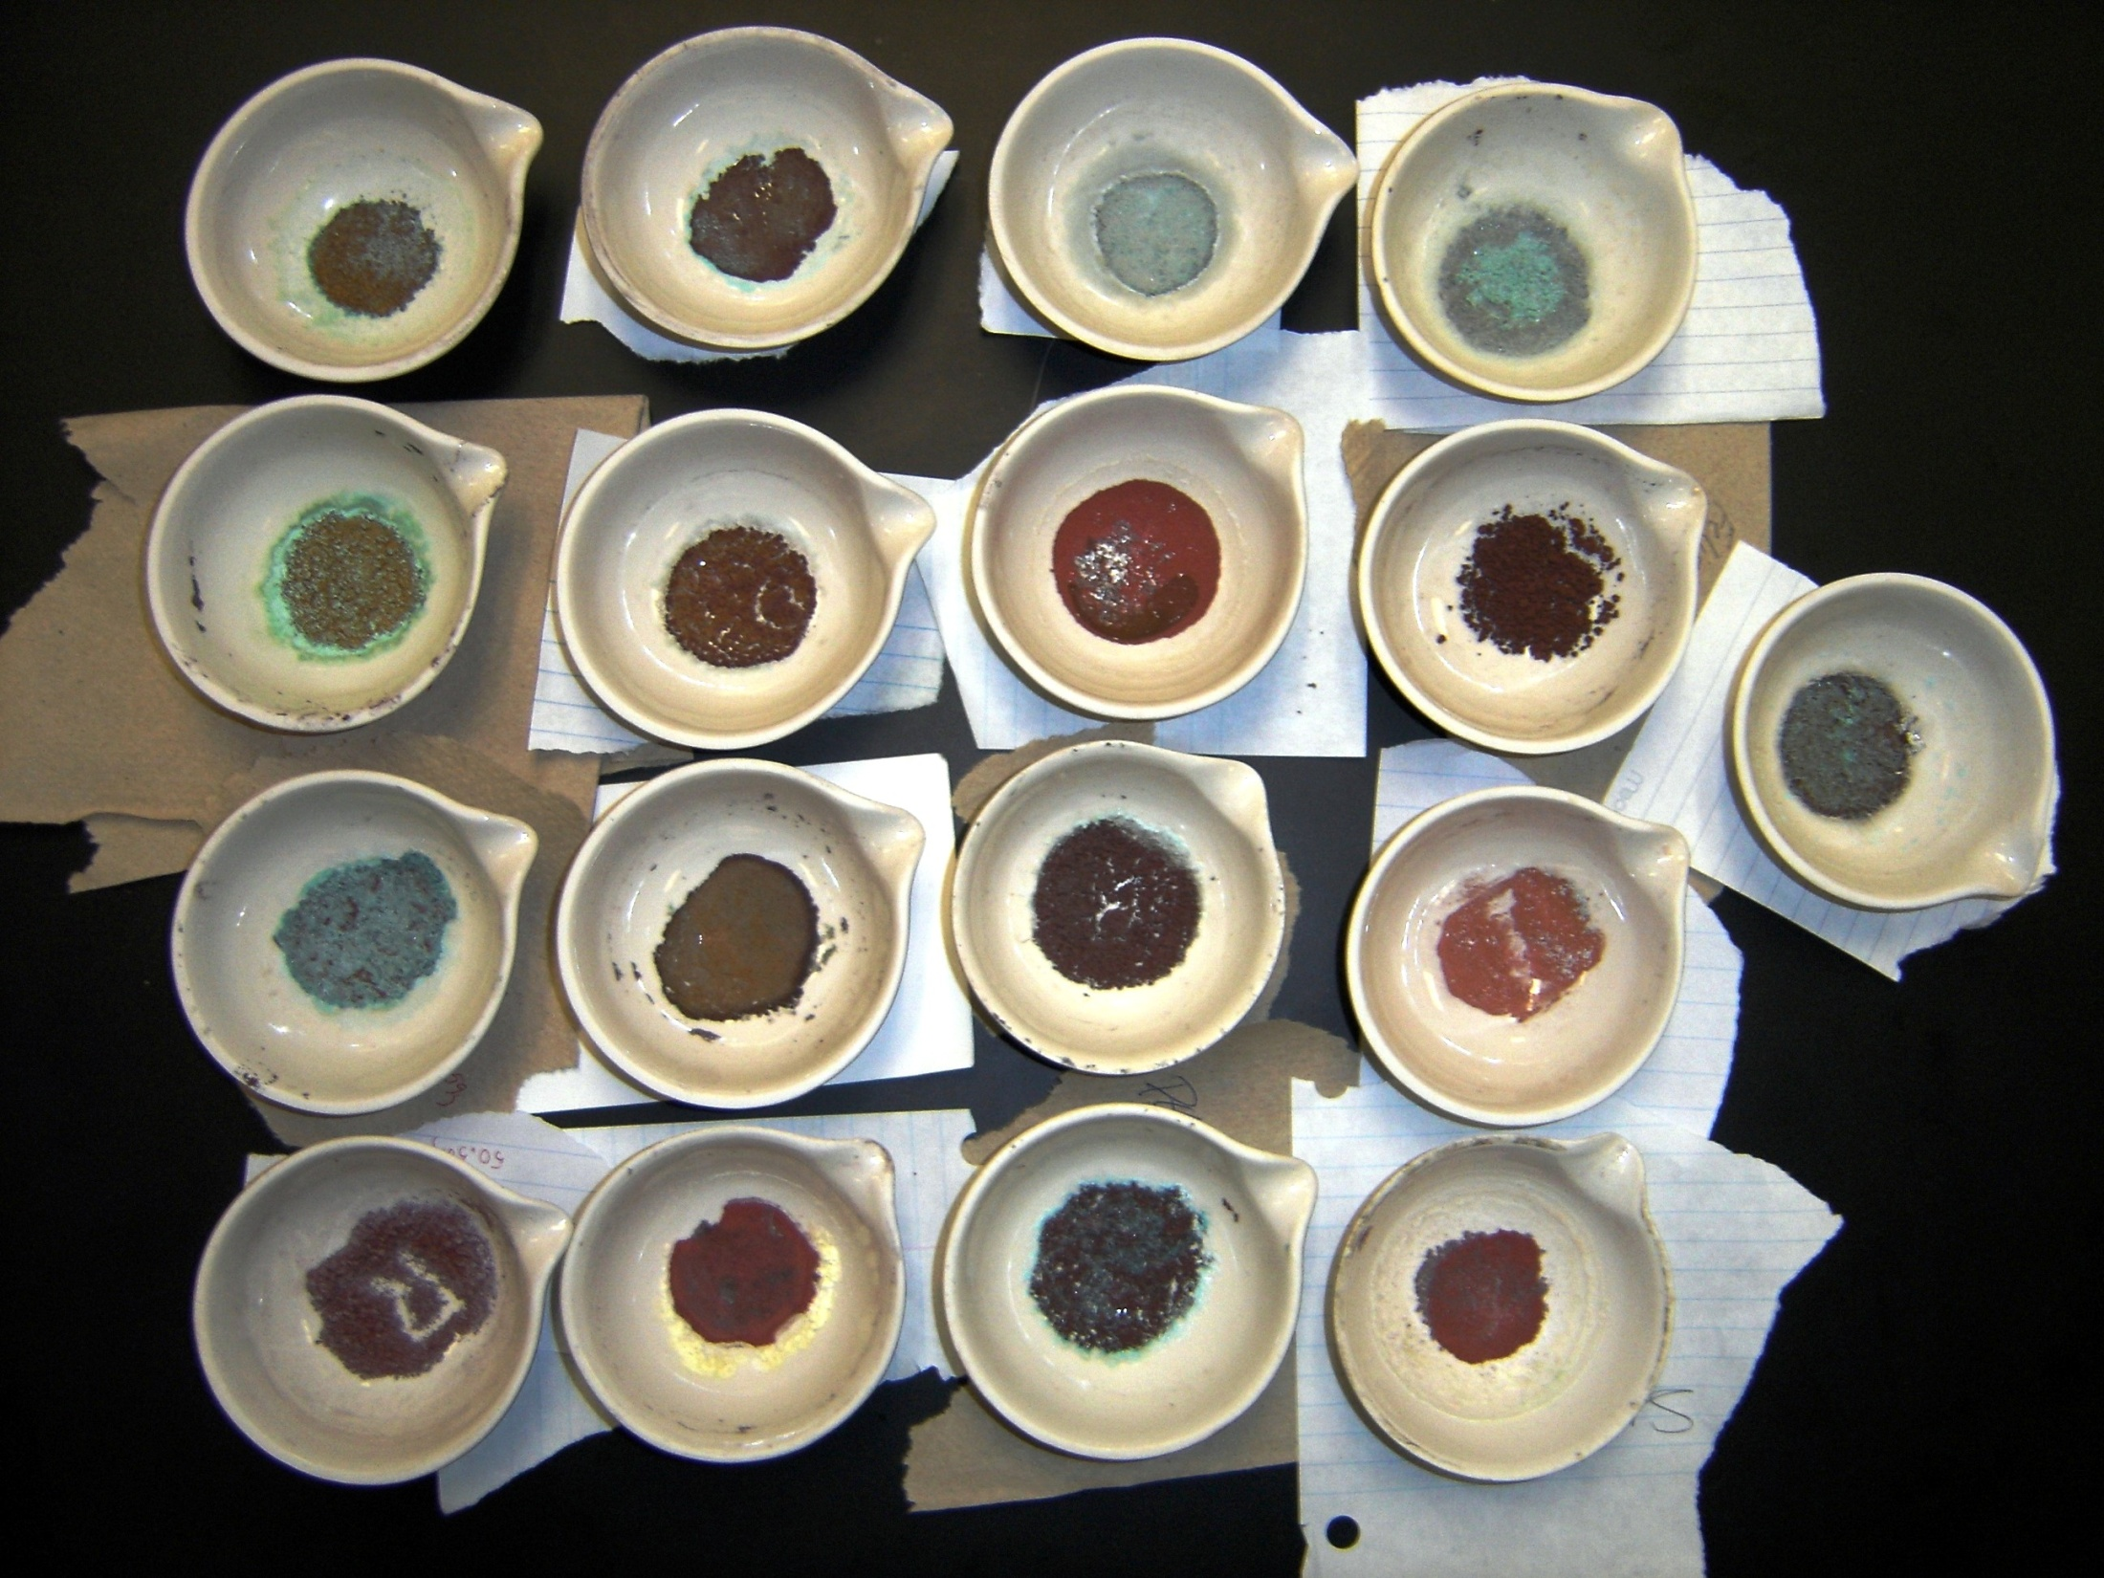

Slide 20
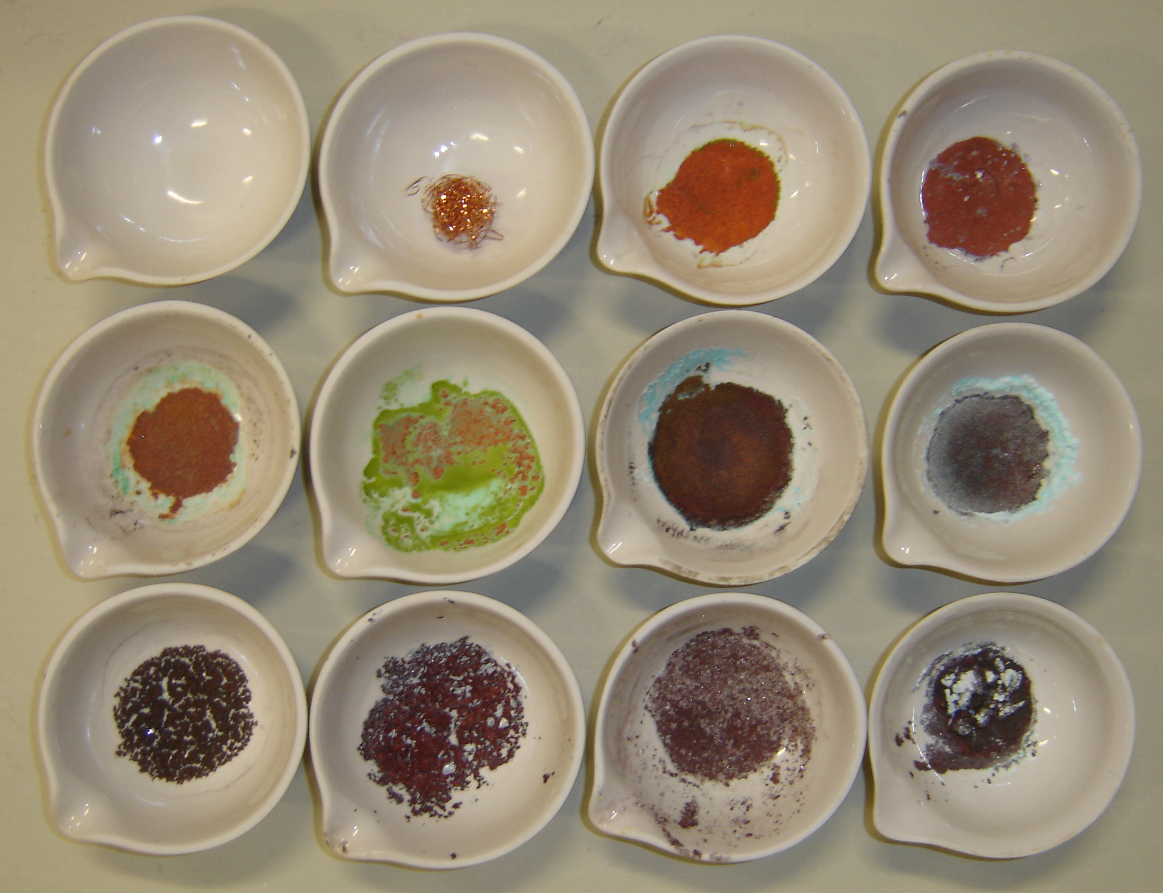
Cu sample at
beginning of lab
Few impurities…
should look like this!
Reactions
of Copper
CuCl₂
CuSO₄
Al foil
Al(SO₄)₃
AlCl₃
Photographs of copper samples at end of lab – note many have impurities.

