Slide 1
HCl = 0.10 M
NaOH = ? M
Initial HCl | Final HCl | HCl added | Initial NaOH | Final NaOH | NaOH added | Molarity of NaOH
0.00 mL | 1.10 mL | 1.10 mL | 3.00 mL | 5.35 mL | 0.85 mL
1.10 mL | 2.10 mL | 1.00 mL |  |  | 0.77 mL
2.10 mL | 5.10 mL | 3.00 mL |  |  | 2.30 mL
5.10 mL | 10.10 mL | 5.00 mL |  |  | 3.85 mL
10.10 mL | 20.10 mL | 10.00 mL |  |  | 7.70 mL
20.10 mL | 35.10 mL | 15.00 mL |  |  | 11.5 mL
M₁.V₁ = M₂.V₂
(0.10 M)(1.10 mL) = (M₂)(2.35 mL)
Notes:
Base is 0.13 M NaOH

Slide 2
Titration Lab
Teacher Notes:
Step 1) Mix 5 liters of 0.100 M HCl
M₁V₁ = M₂ V₂
(0.100 M) (5000 mL) = (12.1 M) (x mL)
requires 41.3 mL of 12.1 M HCl for 5 L of 0.100 M HCl
Step 2) Mix 5 liters of 0.13 M NaOH
M = mol
L requires 0.65 moles NaOH in 5 L or 26 g NaOH in 5000 mL water
Step 3) Prepare indicators (500 mL of each indicator)
Phenolphthalein should be mixed fresh each year (for ammonia titration with HCl)
Use methyl orange for titration of vinegar (with NaOH)
Use bromthymol blue for titration of NaOH with HCl

Slide 3
Day 1) Get used to indicators and using a buret
use litmus paper to identify the acid and the base
Then check pH of each using pH paper
Add ~1 mL of universal indicator into a 150 mL Erlenmeyer flask,
Add acid and note color change, then add base and note color change
Rinse out Erlenmeyer flask and add 1 mL of phenolphthalein.
Add base and record the color of phenolphthalein, finally, add acid
Until a faint pink color persists.
Repeat several times to reach the endpoint.
I use household ammonia (as base) and vinegar (as acid).
Day 2) Set up calibration curve with 0.1 M HCl and unknown [NaOH]
calculate concentration of ammonia and vinegar.

Slide 4
What is the pH of a solution made from mixing 50 mL of 3.0 M HCl
with 75 mL of 2.0 M NaOH?
HCl H¹⁺ + Cl¹⁻
NaOH Na¹⁺ + OH¹⁻
mol
L
mol
L
M =
M =
x mol
0.050 L
x mol
0.075 L
3.0 M =
2.0 M =
x = 0.15 mol HCl
x = 0.15 mol NaOH
pH = 7

Slide 5
What is the pH of a solution made from mixing 50 mL of 3.0 M HCl
with 80 mL of 2.0 M NaOH?
HCl H¹⁺ + Cl¹⁻
NaOH Na¹⁺ + OH¹⁻
mol
L
mol
L
M =
M =
x mol
0.050 L
x mol
0.080 L
3.0 M =
2.0 M =
x = 0.15 mol HCl
x = 0.16 mol NaOH
0.16 mol OH¹⁻
0.15 mol H¹⁺
mol
L
-
M =
0.01 mol OH¹⁻
K_{w} = [H⁺][OH⁻]
0.01 mol
0.130 L
1x10⁻¹⁴ = [H⁺][0.0769 M]
x M =
[H⁺] = 1.3 x10⁻¹³
X = 0.0769 M OH¹⁻
pH = 12.89

Slide 6
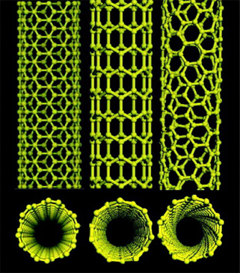
Credit: Baughman et al., Science 297, 787 (2002)

